Slide 1
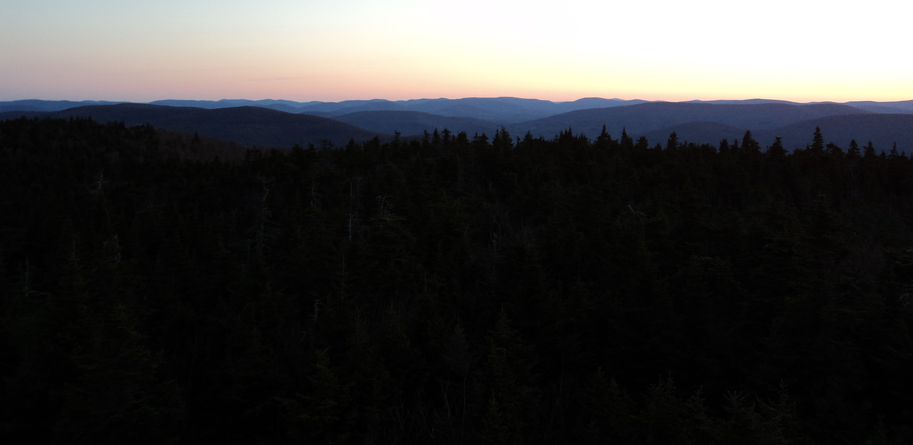
Characteristics, Impacts, and Historical Perspectives of ARs along the U.S. East Coast during Winter 2023–2024
Jason M. Cordeira¹, Nicholas D. Metz², Xun Zou¹, Emily A. Slinskey¹, and F. Martin Ralph¹
¹Center for Western Weather & Water Extremes (CW3E), Scripps Institution of Oceanography at UC San Diego
2Hobart and William Smith Colleges, Geneva, NY
Special Thanks also to Alicia Bentley (NOAA/NWS/NCEP/EMC)
Funding provided by NOAA, awarded to the
Cooperative Institute for Research to Operations in Hydrology (CIROH)
through the NOAA Cooperative Agreement with The University of Alabama (NA22NWS4320003)
Tri-State Weather Conference
21 September 2024 | Danbury, CT

Slide 2
What is an Atmospheric River?
18 December 2023
ARs represent water vapor transport in the atmosphere
“cfs in the sky”
Channel tropical and/or subtropical water vapor in association with midlatitude storms
Extensive research and applications focus on the West Coast of the U.S.
L
Atmospheric River
Shade fill: water vapor in the atmosphere (yellows = more)

Slide 3
What is an Atmospheric River?
18 December 2023
L
Atmospheric River
L
They are not exclusively West Coast phenomena
Atmospheric River
Shade fill: water vapor in the atmosphere (yellows = more)

Slide 4
Some of the statistics on U.S. East Coast ARs
#
ARs are as frequent or more frequent across Eastern US than Western US
Slinskey et al. 2020; Kaminski et al. 2023
>25–50% of non-summer precipitation is associated with ARs across Northeast and Southeast US
Slinskey et al. 2020; Kaminski et al. 2023
>90% of non-summer extreme precipitation is associated with ARs across Northeast and Southeast US
Slinskey et al. 2020; Lamjiri et al. 2020
>85% of flood/flash flood watches, warnings, and advisories occur on day of or day after an AR over Northeast US
Glade et al. 2023
95% of ice jam events in Northeast US influenced by ARs
Sanders et al. 2020

Slide 5
Three strong ARs during Winter 2023 – 2024
(a) 0600 UTC 11 December 2023
(b) 1200 UTC 18 December 2023
(c) 0000 UTC 10 January 2024
11 Dec
18 Dec
10 Jan
Select GFS Model Analyses of 700-hPa Geo. Height, IVT magnitude, and IVT Direction (adapted adapted from imagery provided by Dr. Alicia Bentley).

Slide 6
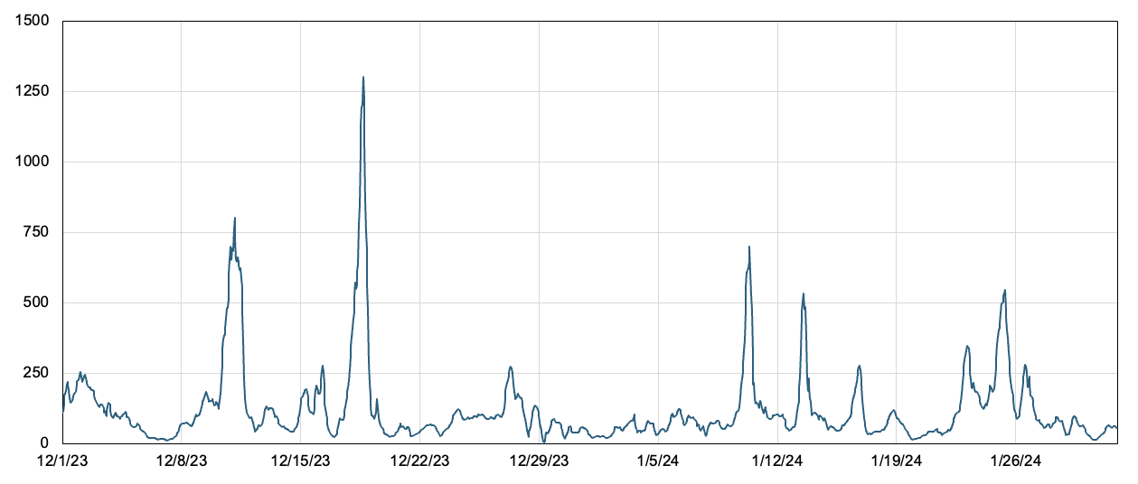
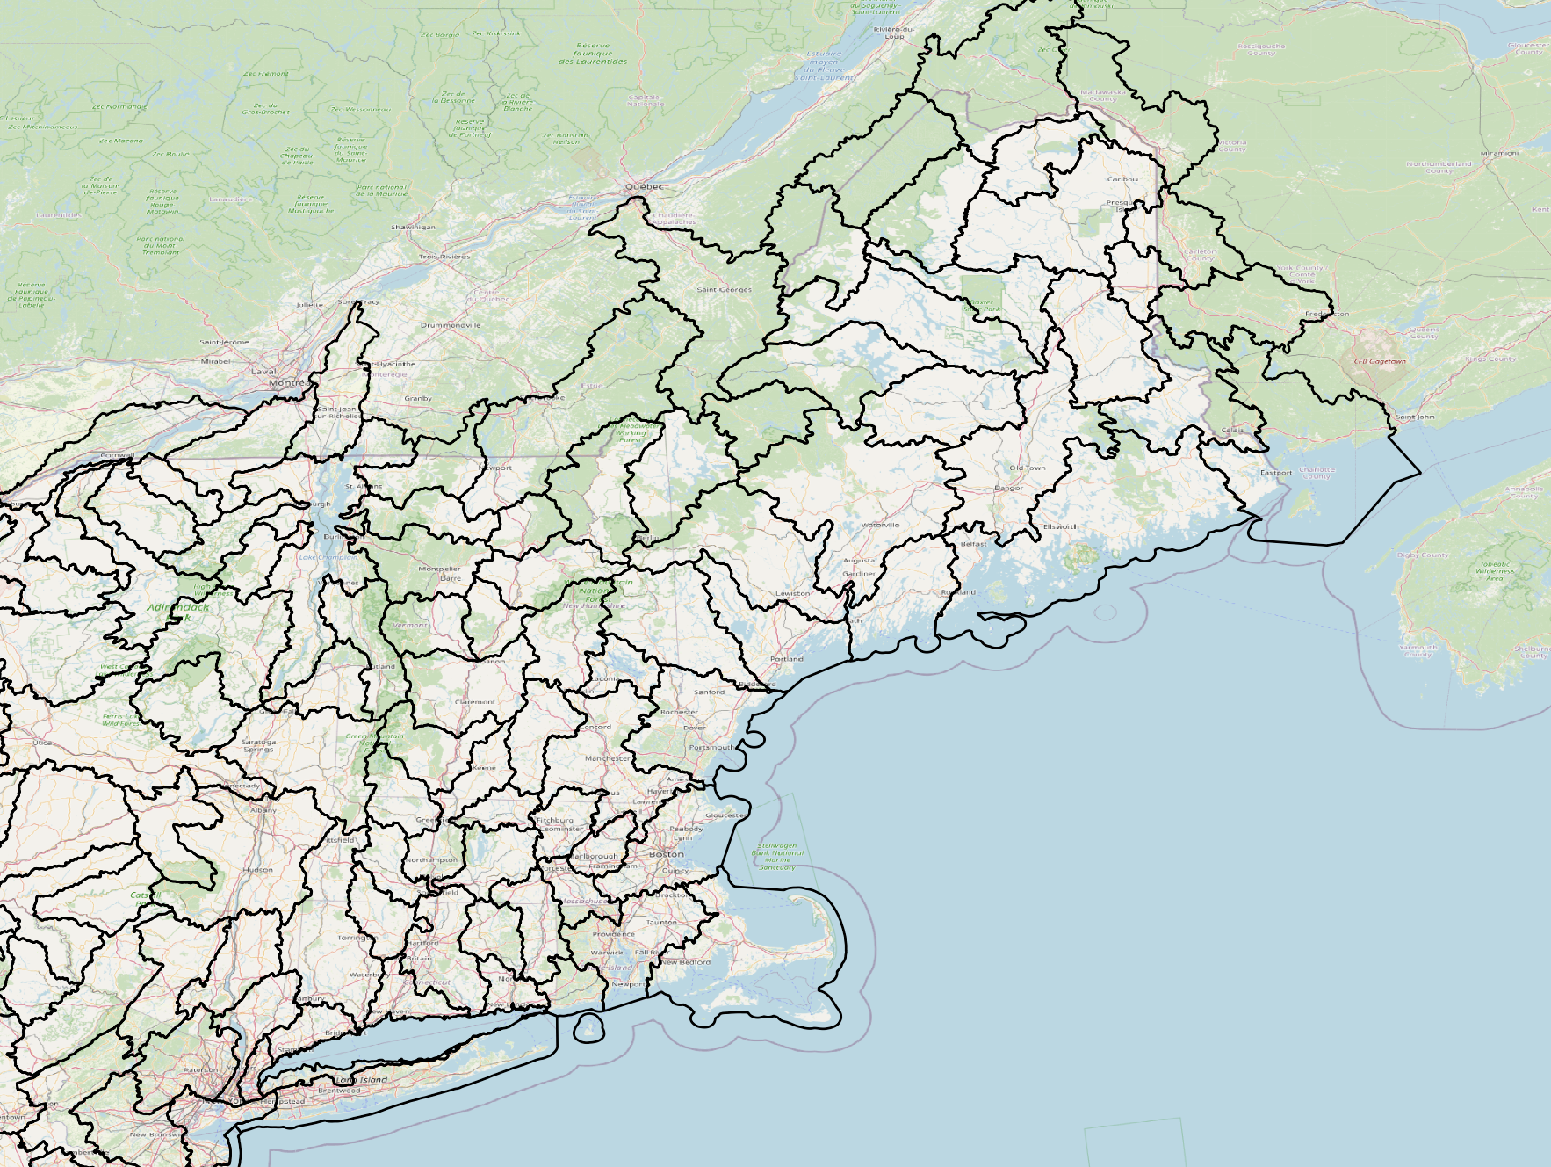
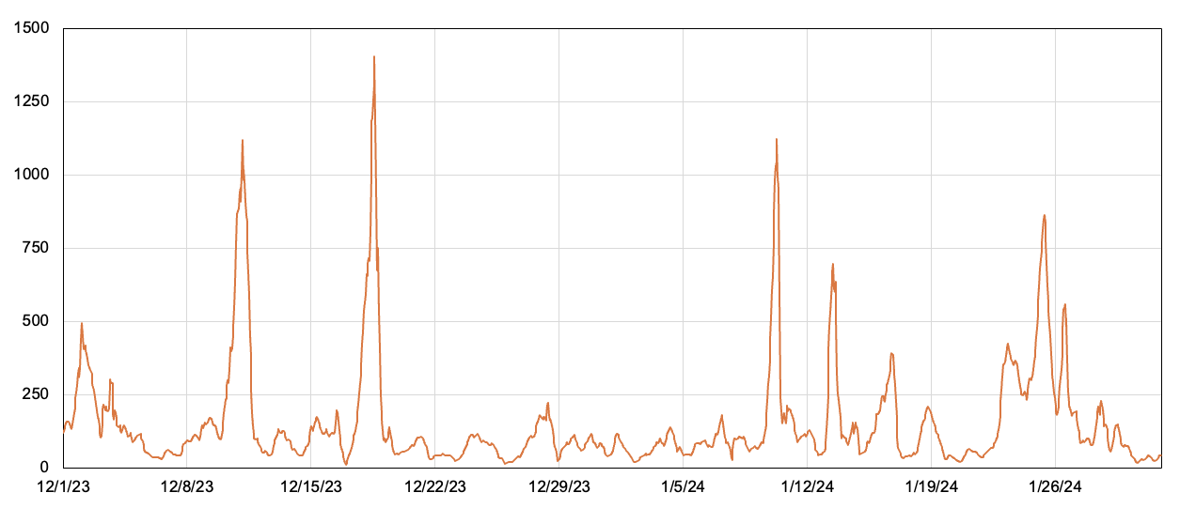
IVT Magnitude Time Series and AR Scale (Dec 2023 – Jan 2024)
a. IVT at ERA5 grid point within Saco River basin (New Hampshire/Maine)
c. HUC8 watersheds with locations of Saco River and Shetucket River basins
IVT magnitude (kg/ms)
ME
VT
b. IVT at ERA5 grid point within Shetucket River basin (Connecticut)
NH
NY
MA
IVT magnitude (kg/ms)
CT
RI

Slide 7
IVT Magnitude Time Series and AR Scale (Dec 2023 – Jan 2024)
a. IVT at ERA5 grid point within Saco River basin (New Hampshire/Maine)
c. HUC8 watersheds with locations of Saco River and Shetucket River basins
IVT magnitude (kg/ms)
ME
VT
b. IVT at ERA5 grid point within Shetucket River basin (Connecticut)
NH
NY
MA
ARs can be ranked based on their intensity and duration according to the Ralph et al. (2019) AR Scale from 1 to 5
IVT magnitude (kg/ms)
CT
RI

Slide 8
IVT Magnitude Time Series and AR Scale (Dec 2023 – Jan 2024)
a. IVT at ERA5 grid point within Saco River basin (New Hampshire/Maine)
c. HUC8 watersheds with locations of Saco River and Shetucket River basins
AR5
AR3
AR1
IVT magnitude (kg/ms)
AR1
AR1
ME
VT
b. IVT at ERA5 grid point within Shetucket River basin (Connecticut)
AR5
NH
AR4
AR3
NY
MA
AR3
ARs can be ranked based on their intensity and duration according to the Ralph et al. (2019) AR Scale from 1 to 5
IVT magnitude (kg/ms)
AR1
CT
AR1
AR1
RI
AR1

Slide 9
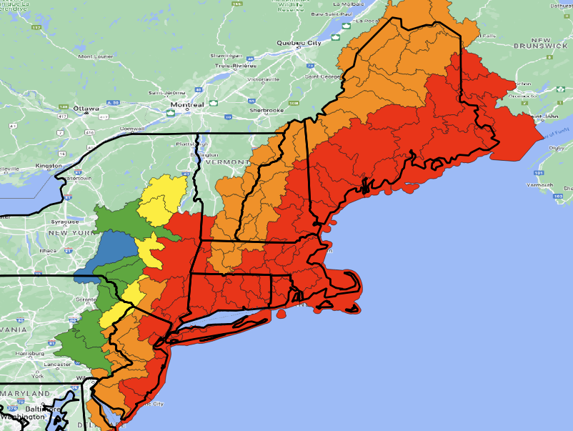
IVT Magnitude Time Series and AR Scale (Dec 2023 – Jan 2024)
a. IVT at ERA5 grid point within Saco River basin (New Hampshire/Maine)
c. AR Scale for events containing the date/time of 1200 UTC 18 Dec 2023
AR5
AR3
AR1
IVT magnitude (kg/ms)
AR1
AR1
ME
NY
VT
NH
b. IVT at ERA5 grid point within Shetucket River basin (Connecticut)
AR5
MA
AR1
AR4
AR3
CT
AR2
AR3
RI
AR1
AR3
IVT magnitude (kg/ms)
AR1
AR1
AR1
AR4
AR5

Slide 10
18 December 2023 Event Rank
All Season
Dec, Jan, Feb
21+
11–20
1
1
1
1
21+
1–2
1–2
11–20
3–5
3–5
21+
6–10
6–10
Event rank defined as maximum IVT during event compared to event-based climatology in ERA5 (1959–2024)
11–20
11–20
21+
21+

Slide 11
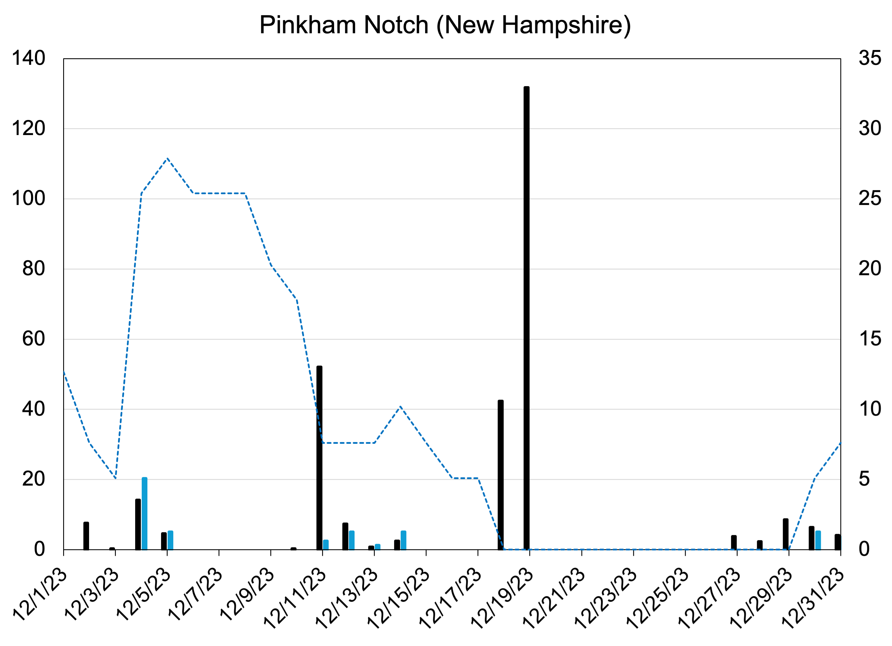
11 and 18 December 2023 were “Compound” Events
(a) 0600 UTC 11 Dec 2023
(b) 1200 UTC 18 Dec 2023
(c) Daily precipitation and snow summary at Pinkham Notch, NH (~619 m ASL)
Second AR
Precip
Snow depth
Precip [mm; black] and Snowfall [cm; blue]
Snow Depth [cm; dashed blue]
First AR
Snow
Select GFS Model Analyses of 700-hPa Geo. Height, IVT magnitude, and IVT Direction (adapted adapted from imagery provided by Dr. Alicia Bentley).
Time series of daily precipitation (black bars, mm), daily snowfall (blue bars, cm), and daily snow depth (blue dashed line) at Pinkham Notch, New Hampshire for 1–31 December 2023. Data source: NOAA/NCEI coop.

Slide 12
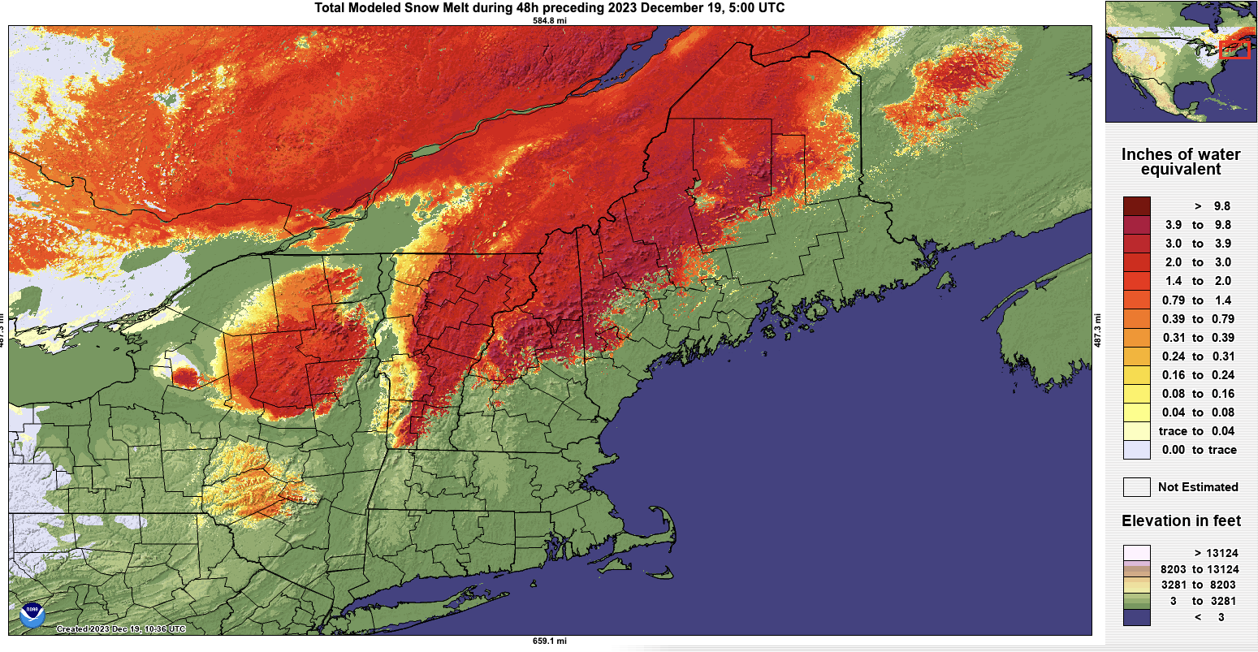
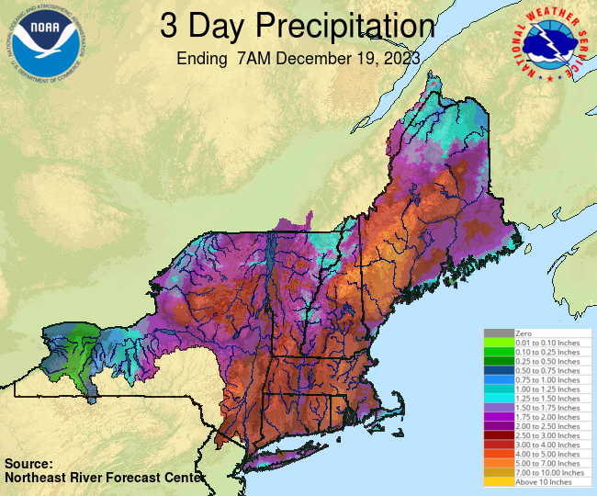
11 and 18 December 2023 were “Compound” Events
(a) 48-hour Snow Melt prior to 0500 UTC 19 December 2023
(b) 72-hour Precipitation ending at 1200 UTC 19 December 2023
Green and White Mountains
~4000–6000 feet ASL
~1200–1800 m ASL
~6–8”
(150–200 mm)
White Mountains
Adirondacks
Green Mtns
~1–3”
(~25–75 mm)
of snow water loss
Catskills
~4–6”
(100–150 mm)
Notes:
Heavy rainfall, combined with favorable antecedent ground conditions (frozen/snow-covered, or saturated) and a ripe snowpack, resulted in significant riverine flooding across New England.
In some locations, e.g., the NH White Mountains extending into Western ME, received ~7–8” of rain that combined with ~2–3” of melted snow-water equivalent, to yield >10” of “forcing” for streamflow flooding.

Slide 13
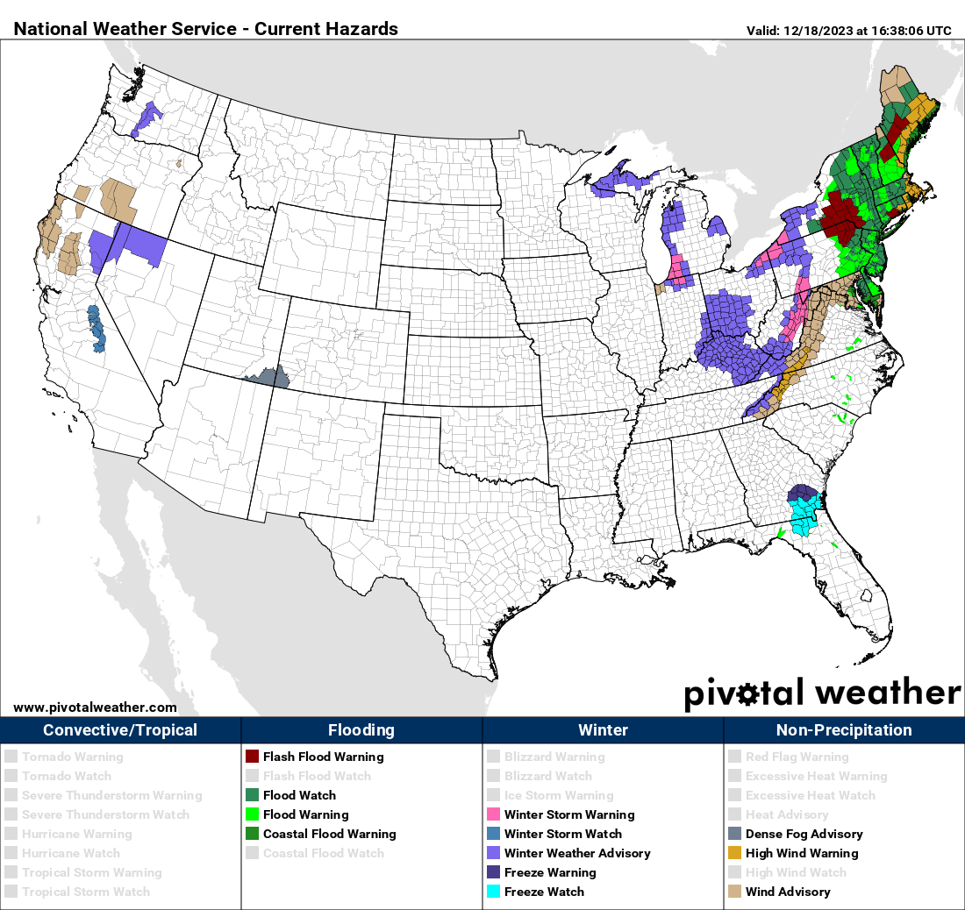
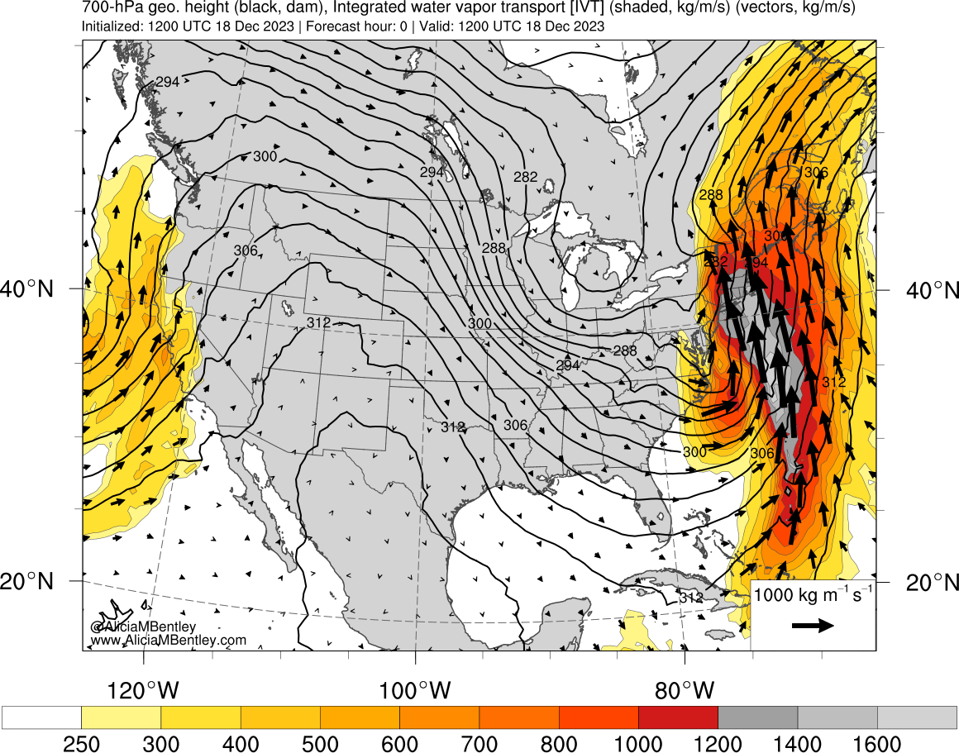
Outcome – 11 and 18 December 2023
Widespread Moderate to Major Flooding
Heavy rainfall, combined with favorable antecedent ground conditions (frozen/snow-covered, or saturated) and a ripe snowpack, resulted in significant riverine flooding across New England.
In some locations, e.g., the NH White Mountains extending into Western ME, received ~7–8” of rain that combined with ~2–3” of melted snow-water equivalent, to yield >10” of “forcing” for streamflow flooding.
Flood Watch
Flash Flood Warning
Flood Warning
11 Dec 2023
18 Dec 2023
Select GFS Model Analyses of 700-hPa Geopotential Height, IVT magnitude, and IVT Direction (adapted adapted from imagery provided by Dr. Alicia Bentley).
National Weather Service watches, warnings, and advisories that were active at 1638 UTC (11:38AM EST) on 18 December 2023 courtesy Pivotal Weather.

Slide 14
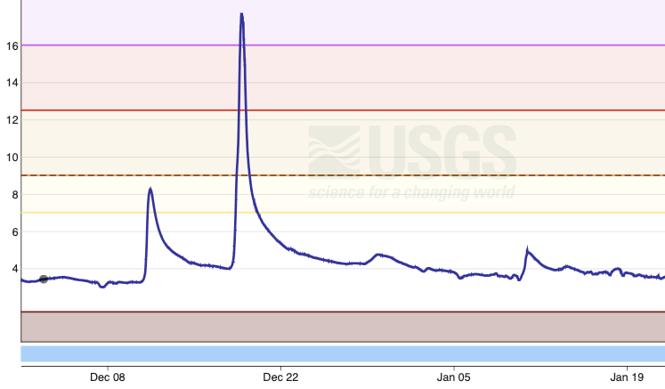
Outcome – 11 and 18 December 2023
a. Gauge height (Feet) on the Saco River in New Hampshire
Second AR
Major flood stage
Moderate flood stage
Feet
Minor flood stage
First AR
Action stage
Enhanced streamflow due to prior storm on 11 December; produced “action stage” flows.
Saco River crested at 17.71 feet (2nd all time // ~100 years).
Higher crest than Hurricane Irene (2011, 17.23 feet) and second only to March 1979.
Images NWS/Data USGS

Slide 15
Final note on the 18 Dec event: The Hurricane Hunters flew this storm!
0000 UTC 17 Dec 2023
0000 UTC 18 Dec 2023
1200 UTC 18 Dec 2023
Flight Track: A66
Flight Track: A65
Flight Track: A61
As part of the NOAA National Winter Season Operations Plan and Winter Storm Reconnaissance, the Air Force 53rd Weather Reconnaissance Squadron was tasked by the NOAA SDM, in collaboration with the NWS Weather Prediction Center, to provide enhanced observations for model data assimilation at 0000 UTC 17 December 2023, 0000 UTC 18 December 2023, and 1200 UTC 18 December 2023. The approximate tracks and drop locations of these data are shown above overlaid atop GFS analyses of IVT magnitude, direction, and 700-hPa geo. heights.

Slide 16
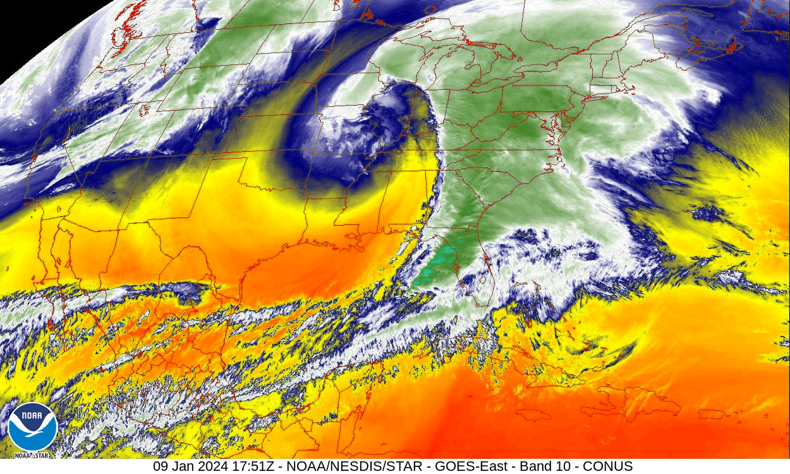
Let’s jump forward now to 10 January 2024
1700–1900 UTC 9 January 2024
0000 UTC 10 January 2024
L
AR3 in Connecticut
GOES-East, Band 10, 9 January 2024: East Coast AR was embedded within warm sector of a broad and strong cyclone moving over Ohio River Valley and into Great Lakes region. Image: NOAA
Select GFS Model Analyses of 700-hPa Geopotential Height, IVT magnitude, and IVT Direction (adapted adapted from imagery provided by Dr. Alicia Bentley).

Slide 17
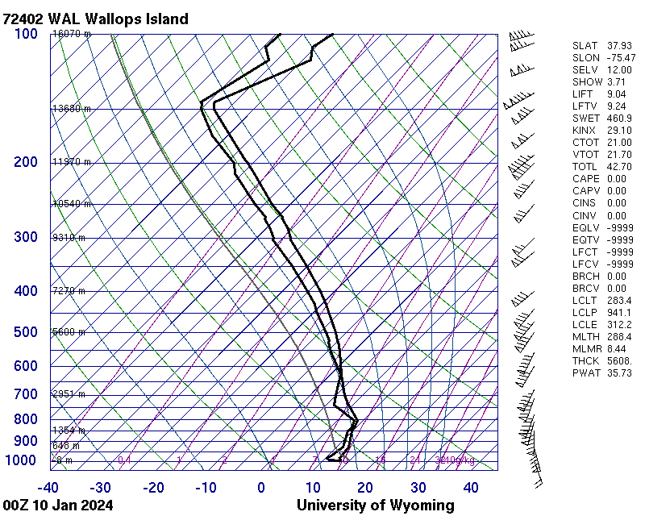
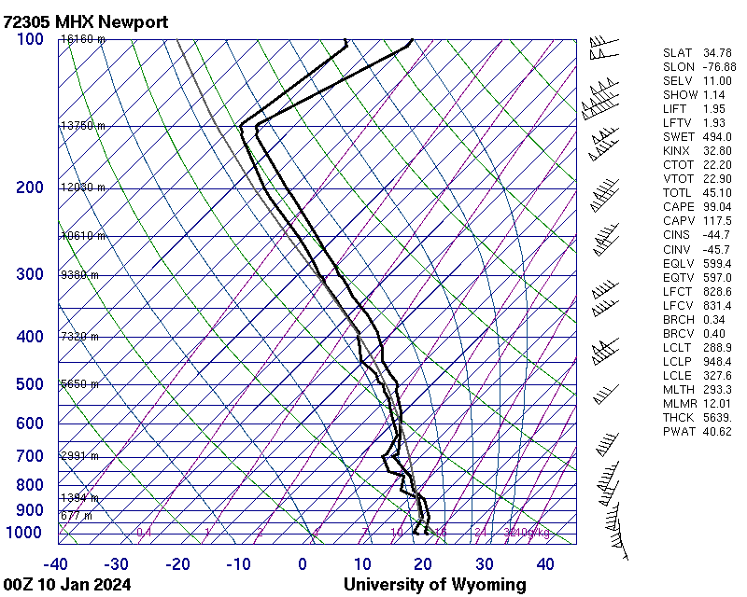
Observations of the event on 10 January 2024
0000 UTC 10 January 2024
Observed IVT magnitudes
>1500 kg/ms in coastal North Carolina
~1400 kg/ms in the Mid-Atlantic
These numbers are impressive!
WAL/Wallops Island
Observed IWV: 35.7 mm
Observed IVT: 1388 kg/ms
MHX/Newport
Observed IWV: 40.6 mm
Observed IVT: 1528 kg/ms
Select GFS Model Analyses of 700-hPa Geopotential Height, IVT magnitude, and IVT Direction (adapted adapted from imagery provided by Dr. Alicia Bentley).

Slide 18
10 January 2024 was also a compound event
a. 24-h snowfall reports 4:30AM–9:30AM EST 10 Jan 2024
c. 24-h precipitation reports 4:30AM–9:30AM EST 10 Jan 2024
1–25” (~2.5–64 cm) snowfall via CoCoRaHS
High Wind Warning
b. 24-h snow melt 1100 UTC 10 Jan 2024
~1–2” (~25–50 mm) of snow-water equivalent melt in 24 hours via NOHRSC
Snow from prior event on 7–8 Jan
1–5” (25–125 mm) rainfall reports across Mid-Atlantic and southern New England
via CoCoRaHS

Slide 19
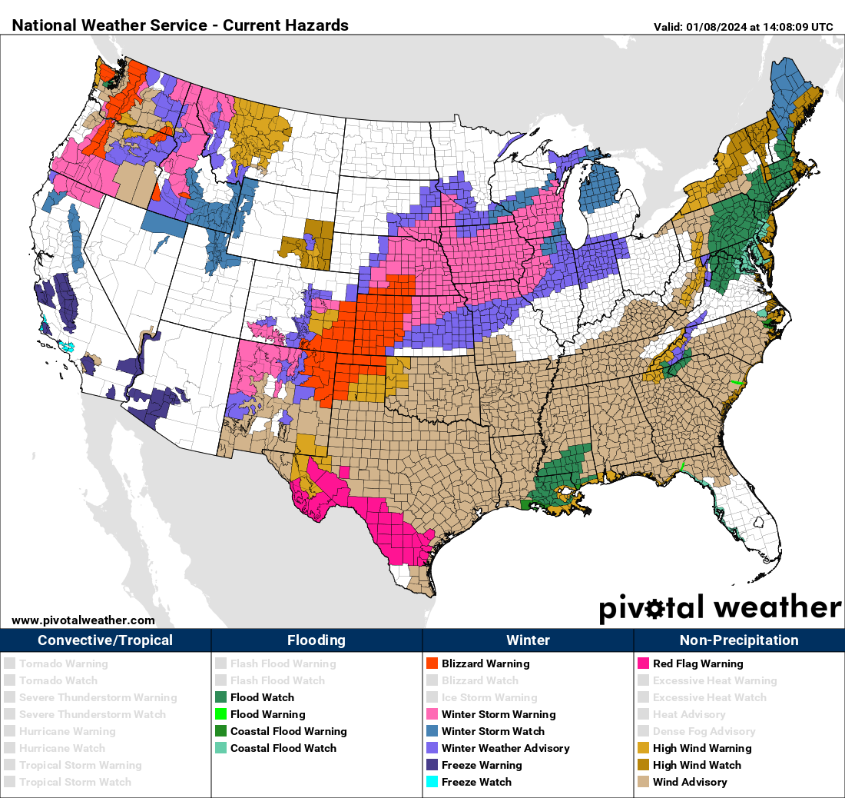
Outcome – 10 January 2024
0000 UTC 10 January 2024
Winter Storm Watch
High Wind Watch
Flood Watch
High Wind Warning
Coastal Flood Watch
Wind Advisory
Select GFS Model Analyses of 700-hPa Geopotential Height, IVT magnitude, and IVT Direction (adapted adapted from imagery provided by Dr. Alicia Bentley).
Hazards valid 1400 UTC 8 January 2024: Multi-hazard event with widespread winter weather across Plains into Northern New England, hydrology concerns in Mid-Atlantic, high winds across Southeast, coastal storm surge, and severe weather (not shown).

Slide 20
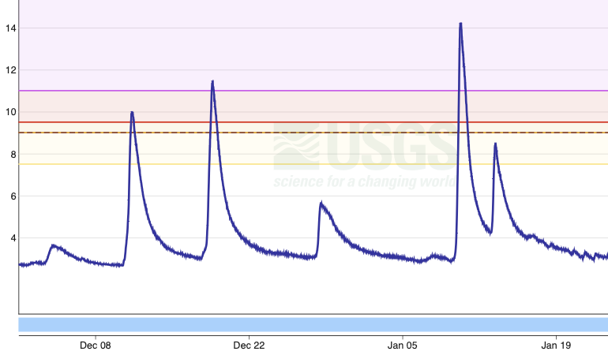
Outcome – 10 January 2024
a. Gauge height (Feet) on the Yantic River in Connecticut
Third AR
Jan 10
Second AR
18 Dec
Major flood stage
Mod. flood stage
First AR
11 Dec
Feet
Minor flood stage
Action stage
10 Jan crest at 14.23 feet
3rd mod. flood in 31 days
2nd major flood in 23 days
Highest crest since 1982
3rd highest crest on record (~100 years) behind Jun 1982, Sep 1938
Highest Jan crest on record by +1.5 feet
b. Gauge height (Feet) on the Yantic River in Connecticut
Feet

Slide 21
Jay Cordeira
jcordeira@ucsd.edu
Summary
ARs occur along the U.S. East Coast, often embedded in Nor’easters.
December 2023 and January 2024 featured several strong ARs, including seasonally record-breaking IVT magnitudes (18 Dec).
Impacts (e.g., flooding) were the result of compound events, either back-to-back ARs, snowmelt, or both.
Many additional facets not shown, including record tides/storm surge, numerous power outages due to wind, impact to ski resorts, mud slides, and predictability.
For more, see CW3E Event Summaries on our webpage: https://cw3e.ucsd.edu

