Slide 1
Science

Slide 3
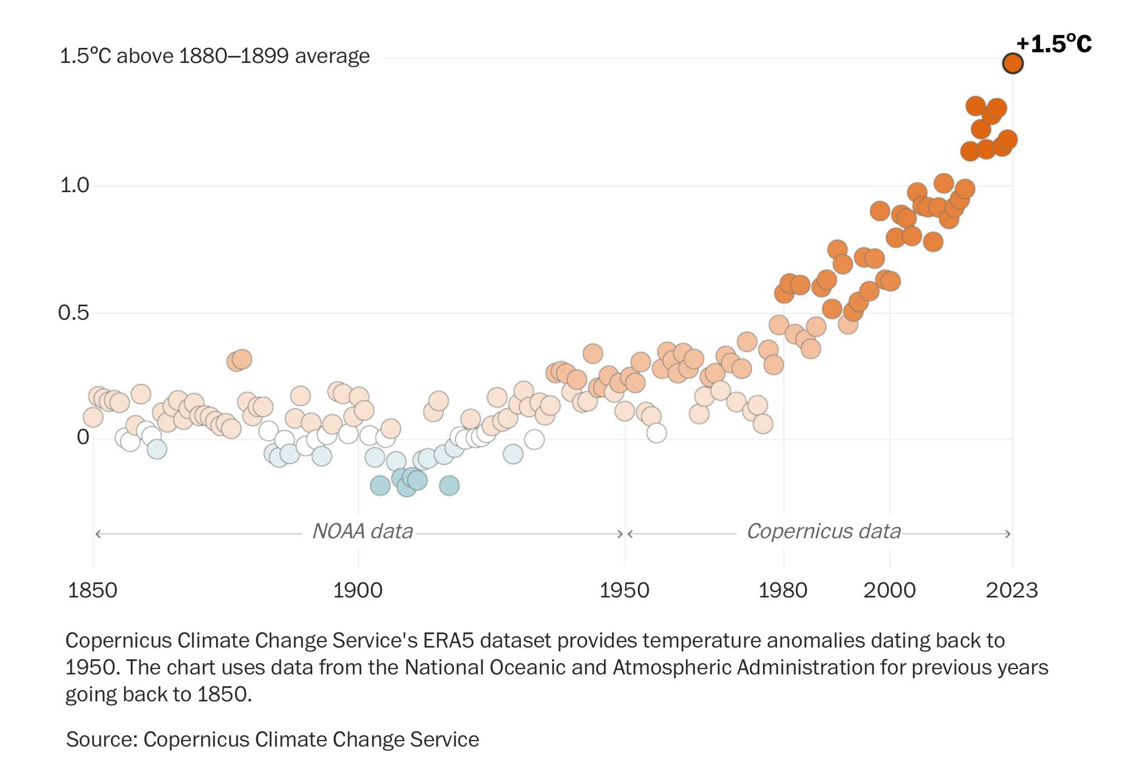

Slide 4
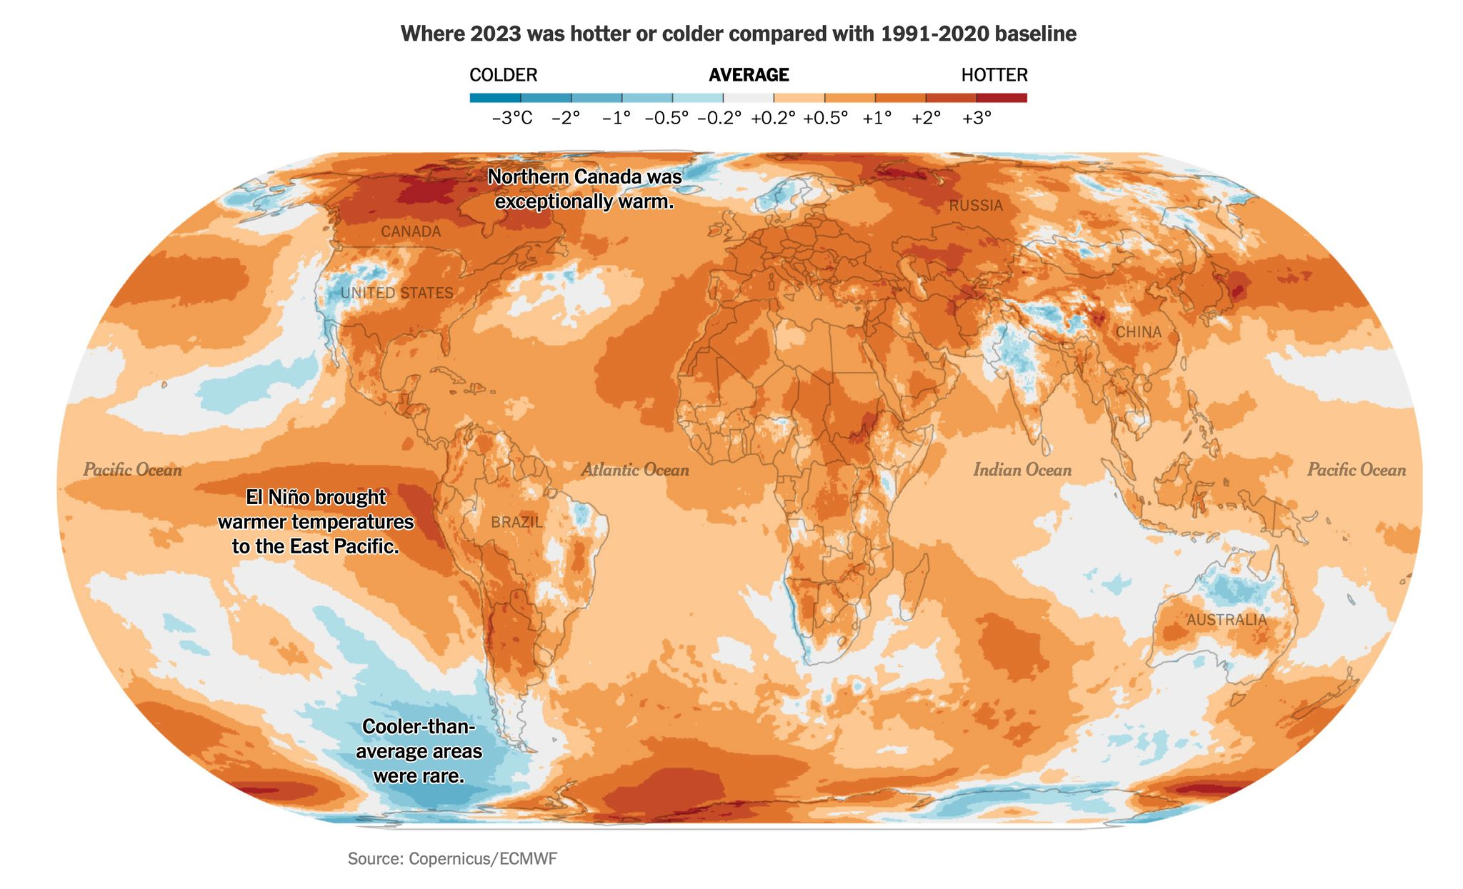
2023
Baseline: 1991–2020

Slide 5
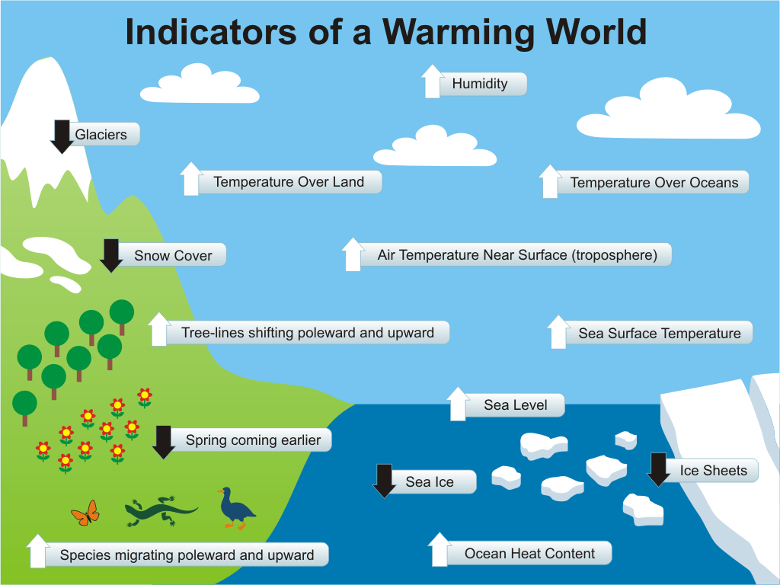

Slide 6
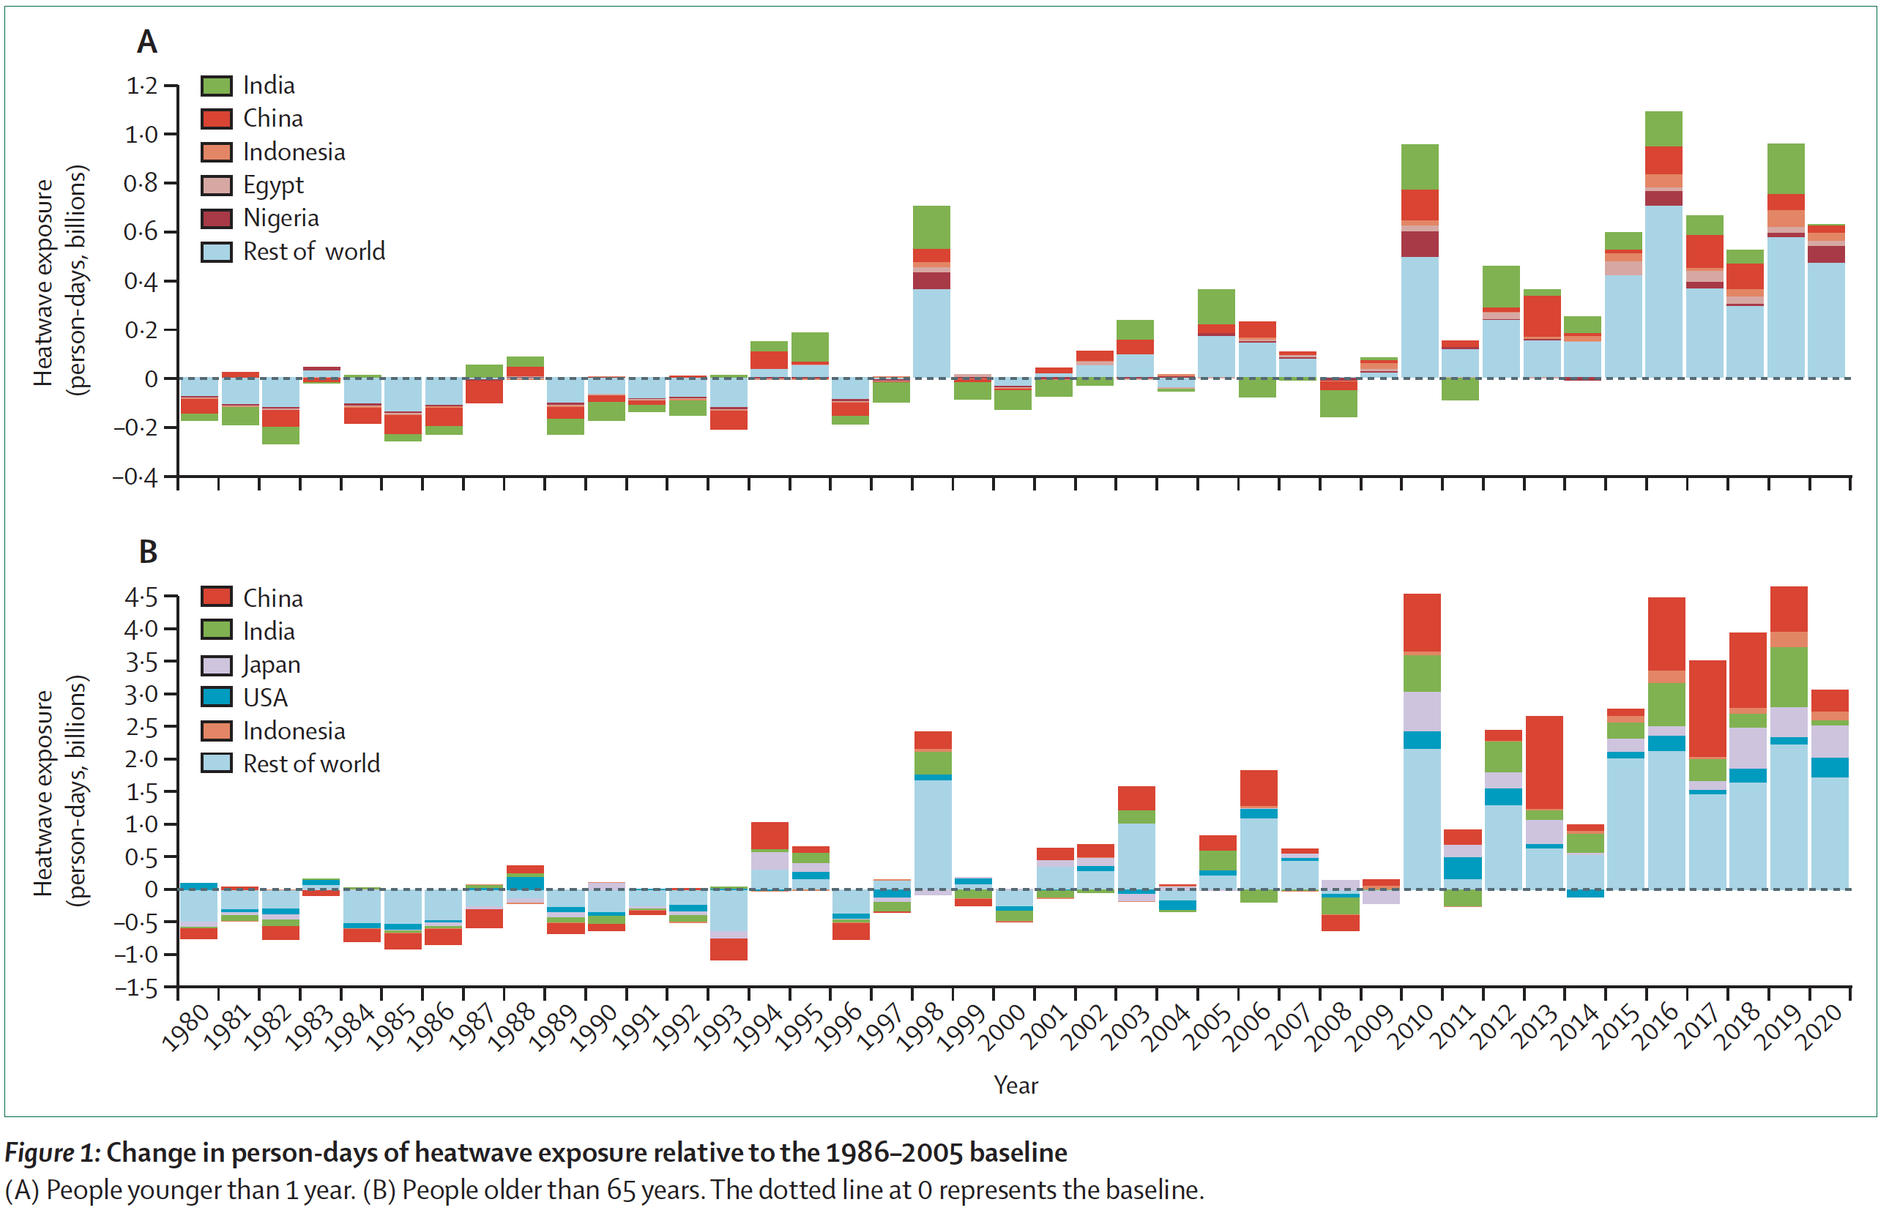
Exposure to heat waves of infants and people over 65

Slide 7
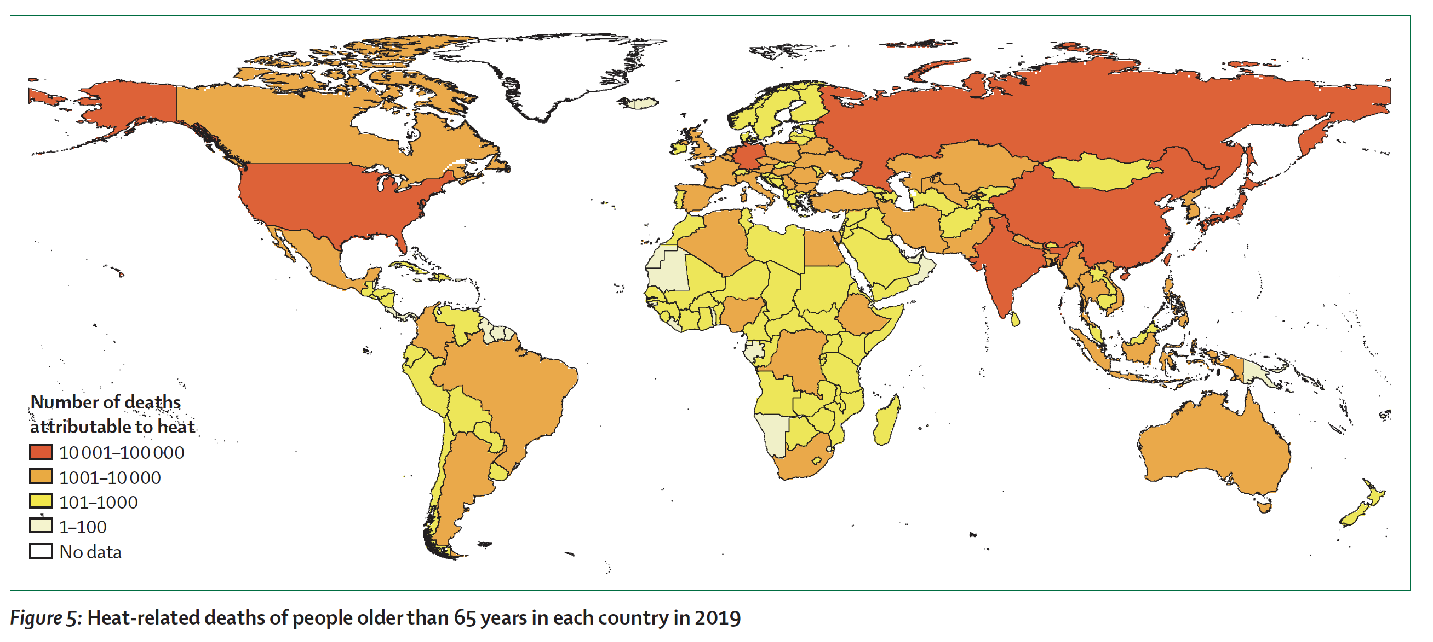
Heat-related deaths of those 65 and older

Slide 8
Wet-bulb Temperature
33°C : Onset of heat stress for healthy, acclimatized humans at rest
35°C : Risk of death

Slide 9
Warming is favorable to vectors
Mosquitos
Yellow fever
Eastern Equine Encephalitis, West Nile
Ticks
Lyme
Babesiosis
Powassan, Anaplasmosis, Ehrlichiosis, Rocky Mountain spotted fever…

Slide 10
Insect-vectored diseases
Malaria
Dengue
Zika
Yellow fever

Slide 11
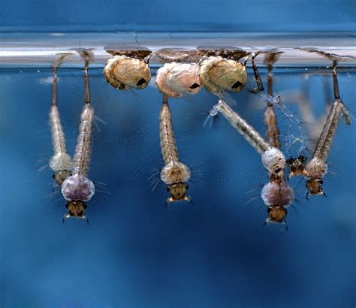

Slide 12
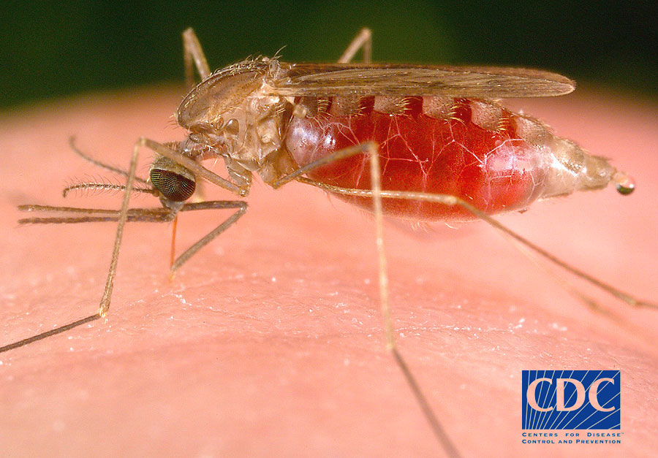

Slide 13
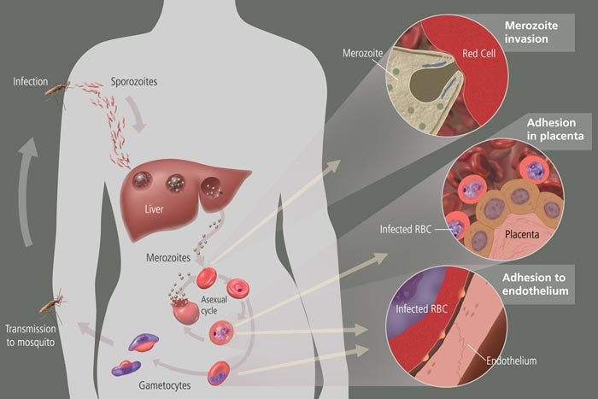

Slide 14
Malaria is transmitted where:
Anopheles can survive and reproduce
Plasmodium can complete its growth cycle in mosquitoes

Slide 15
Aedes species may carry:
dengue fever
yellow fever
Zika virus
chikungunya

Slide 16
Dengue Fever
Carried by Aedes aegypti and A. albopictus.
Incidence affected by
Temperature
Moisture
presence of water containers

Slide 17
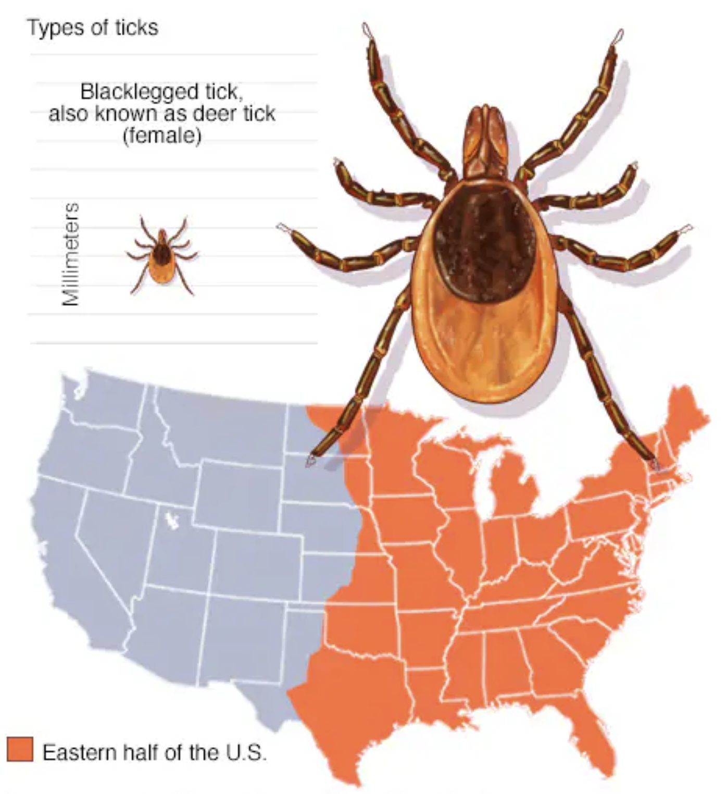
The black-legged tick,
also known as a deer tick,
is responsible for
spreading anaplasmosis,
babesiosis, ehrlichiosis,
Lyme disease, Borrelia
miyamotoi disease and
Powassan virus disease.

Slide 18
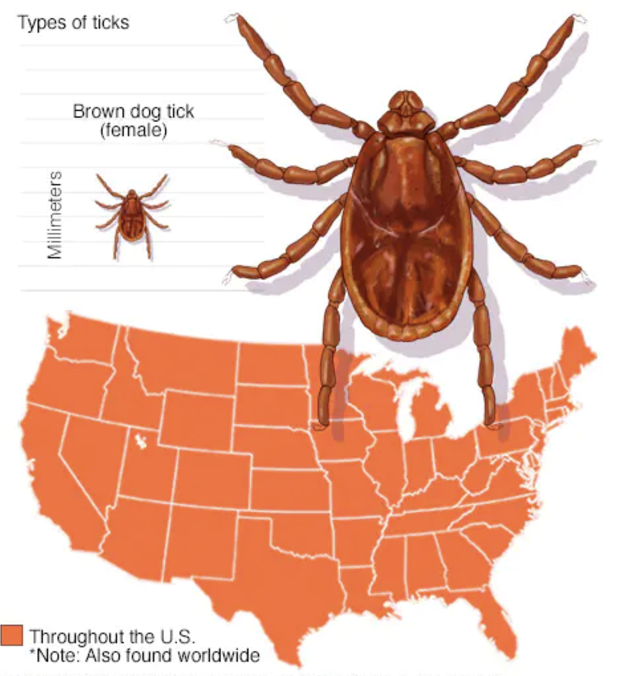
The American dog tick,
also known as a wood
tick, is responsible for
spreading Rocky
Mountain spotted fever
and tularemia.

Slide 19
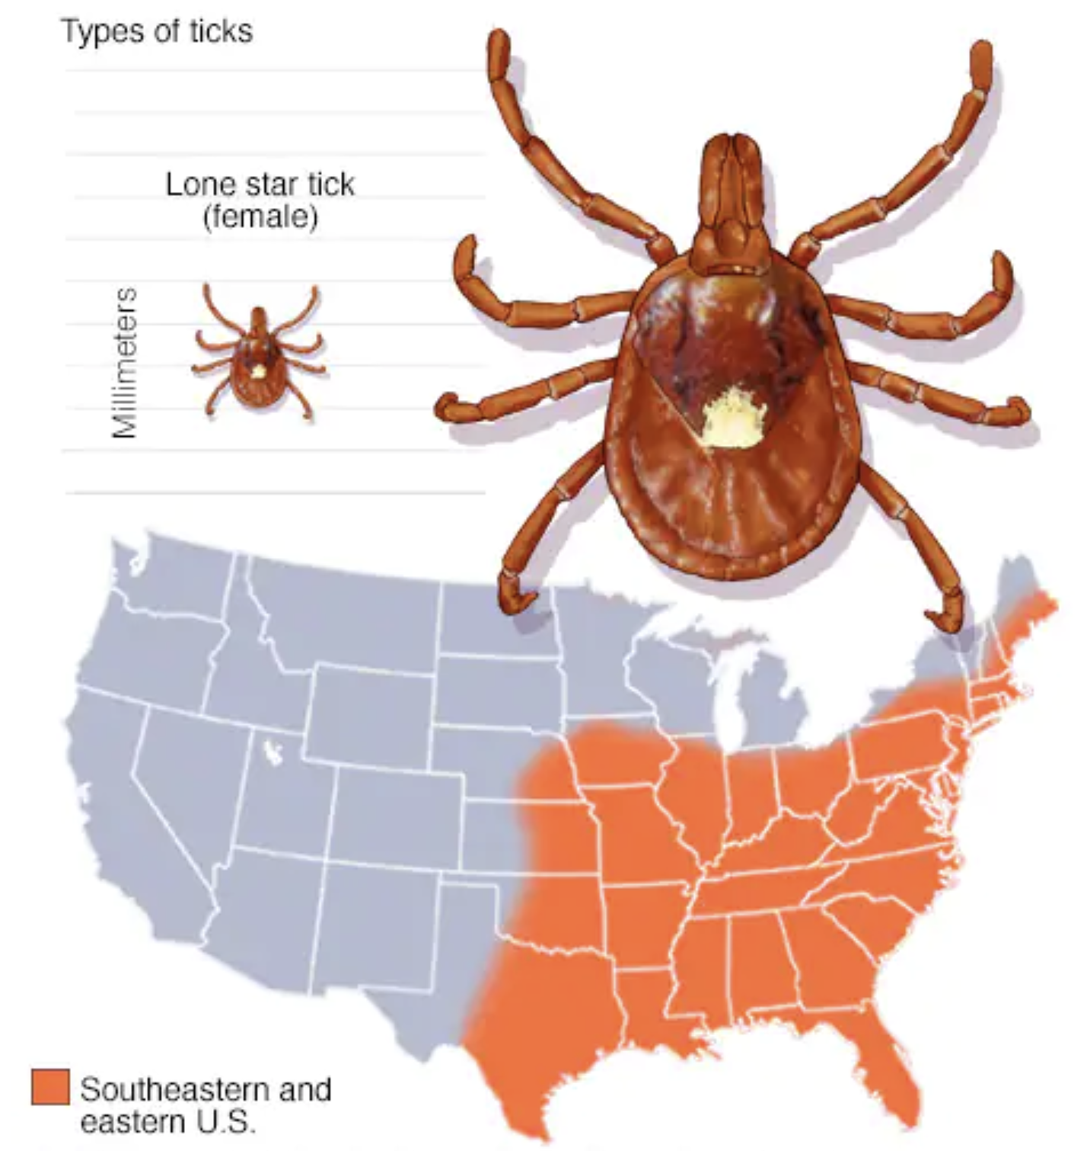
The Lone Star tick is
responsible for
spreading ehrlichiosis,
Heartland virus disease,
southern tick-associated
rash illness (STARI),
Bourbon virus disease
and tularemia. Bites
from the Lone Star tick
can sometimes lead to
alpha-gal syndrome.

Slide 20
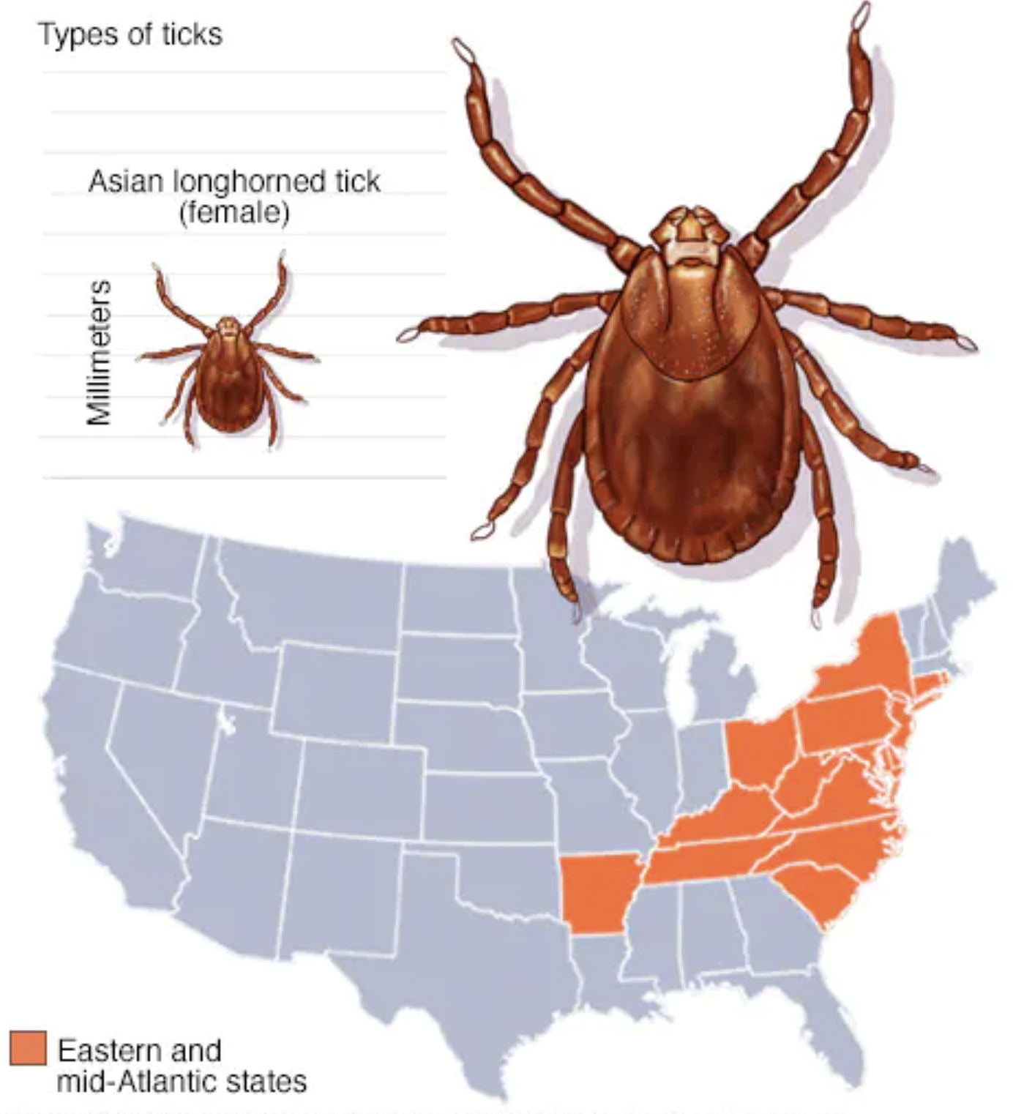
The Asian longhorned tick
is usually located in
countries in eastern
Asia. Since 2017, the tick
has been found in several
eastern states in the
United States. The tick can
potentially cause serious
human diseases, such as
anaplasmosis, babesiosis,
ehrlichiosis and
rickettsiosis, but the risk to
humans in the United
States from this tick is still
unknown.

Slide 21
Anthrax Outbreak in 2016

Slide 23
Repeated outbreaks of anthrax in Siberia in the early 20th century
More than a million reindeer killed
7000 burial grounds with infected carcasses

Slide 24
Carcasses of reindeer killed by anthrax bacteria frozen in permafrost for 75 years
Thawed in 2016 during a heat wave
Anthrax reactivated
2000 reindeer infected
Dozens of people hospitalized, 1 child died.

