Slide 1
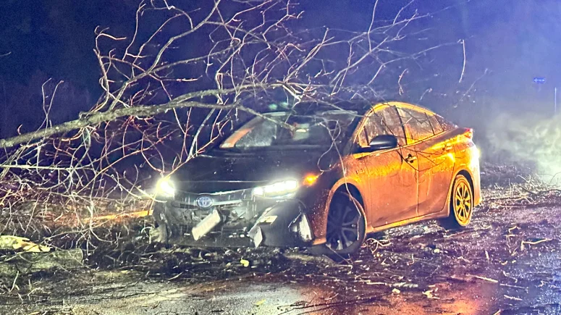
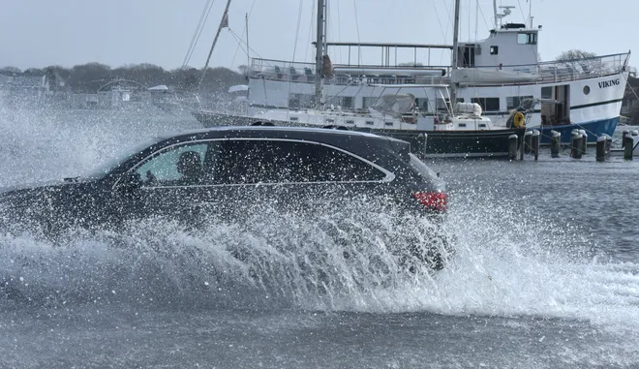
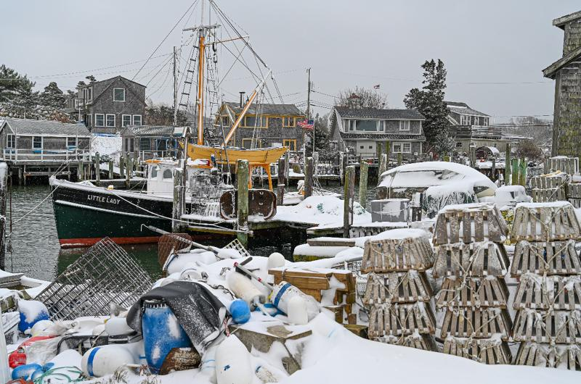
National Weather Service Boston/Norton
Event Review:
February 13th, 2024
Winter Storm
Notes:
Dark blue: 1e4e79
Light blue: 8ba6ca

Slide 2
Event Review: Winter Storm (North of I-90 Bust)
Increasing model agreement and high ensemble probabilities for significant snow led to Watches being issued on Saturday, February 10 and Warnings on Sunday.
Models began to shift the storm track southward with 00z Monday runs then the higher-resolution models jumped on board with 18z Monday runs
UKMET was the first with its 12z Thu solution and ECMWF followed Sat
After forecasting 8-12 inches across all of southern New England on Sunday, nearly everywhere north of I-90 was a shutout
Warnings verified in CT, RI, and Cape/Islands, with over a foot in parts of CT!
Downgrade to Advisory in Hartford County was never changed back to a Warning

Slide 3
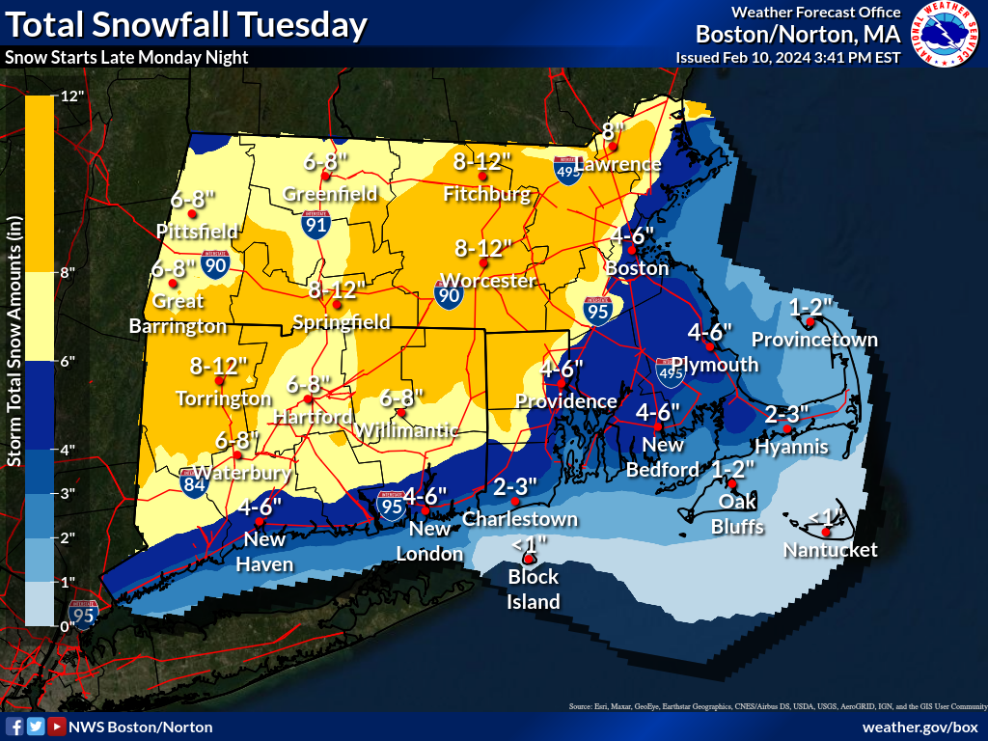
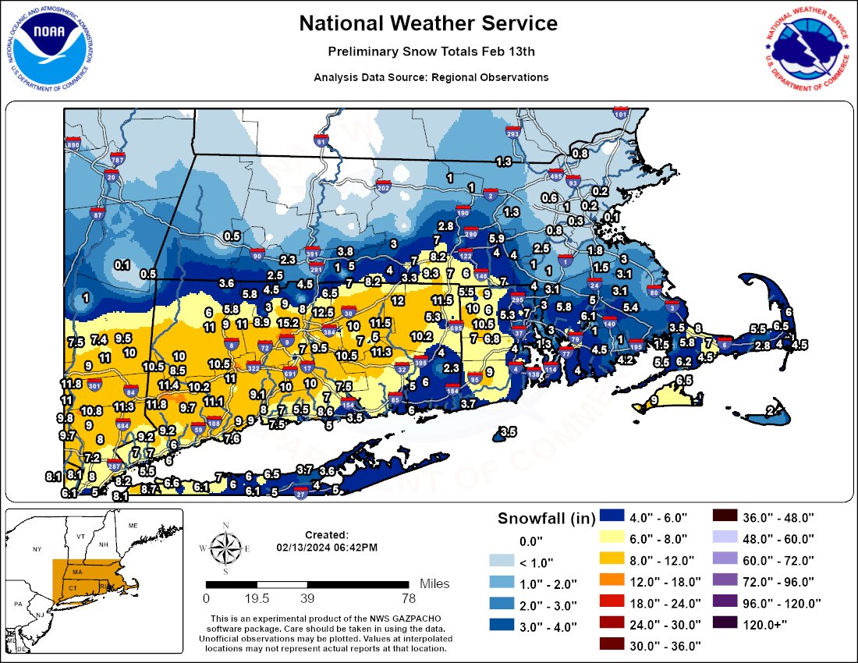
Day 3 Snowfall Forecast VS Observed Snowfall Amounts

Slide 4
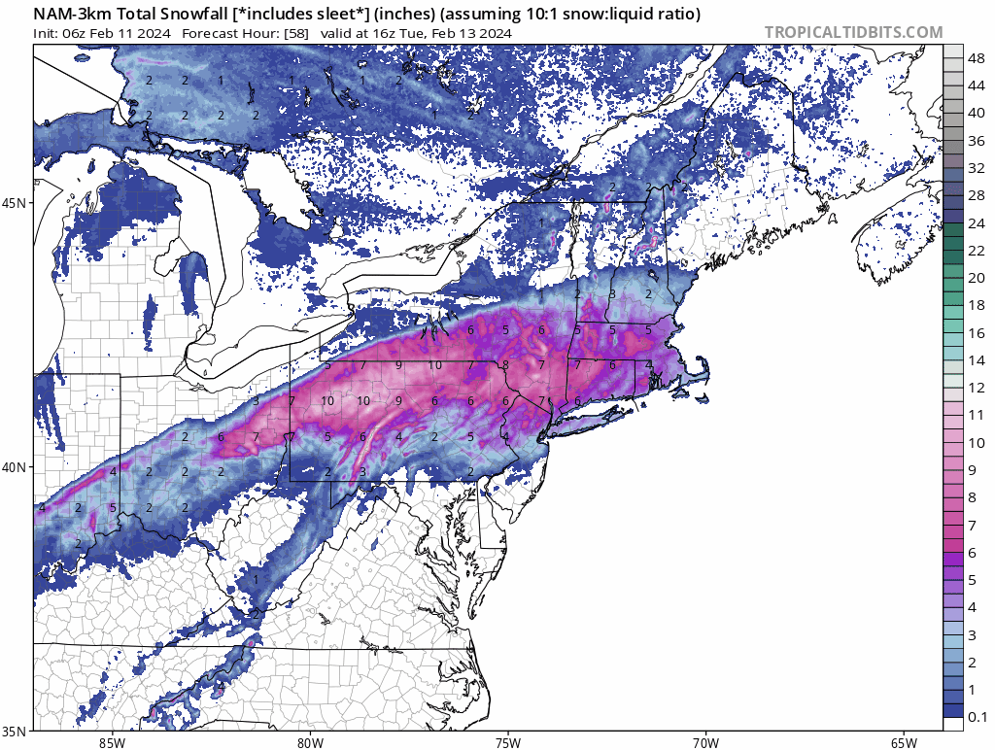
Event Review: Winter Storm (North of I-90 Bust)
This 3-km NAM d(prog)/dt loop shows the migration of the axis of heaviest snow southeast between forecasts initialized 06z Sunday, Feb 11 and 00z Tuesday, Feb 13.
Although only the 3-km NAM is shown, this trend was seen in most/all of the numerical guidance.
Not shown is the trend northward with heavy snow prior to the 06z Feb 11 guidance.
d(prog)/dt: F058–F016
Slide courtesy of NWS State College
Valid: 1600 UTC 13 Feb 2024

Slide 5
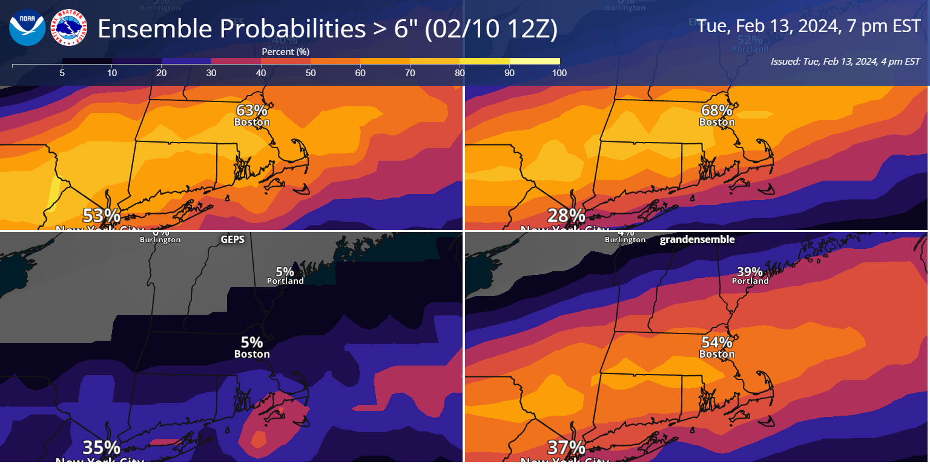
Day 3 Forecast: Canadian Ensemble - Had the Correct Axis (Sat Feb 10)
GEFS
EPS
GEPS
Grand Ensemble

Slide 6
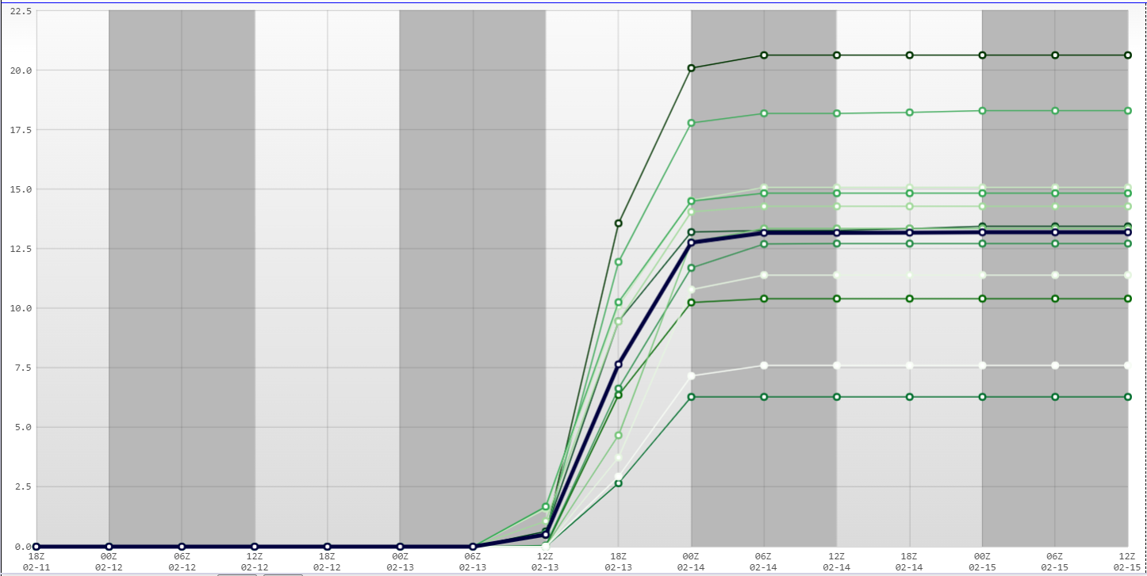
Boston GFS Members Snowfall Forecast: 12z Feb 11 2024…Day 3 Forecast
Boston:
GFS Members
Mean: 13.0”
Observed: 0.1”

Slide 7
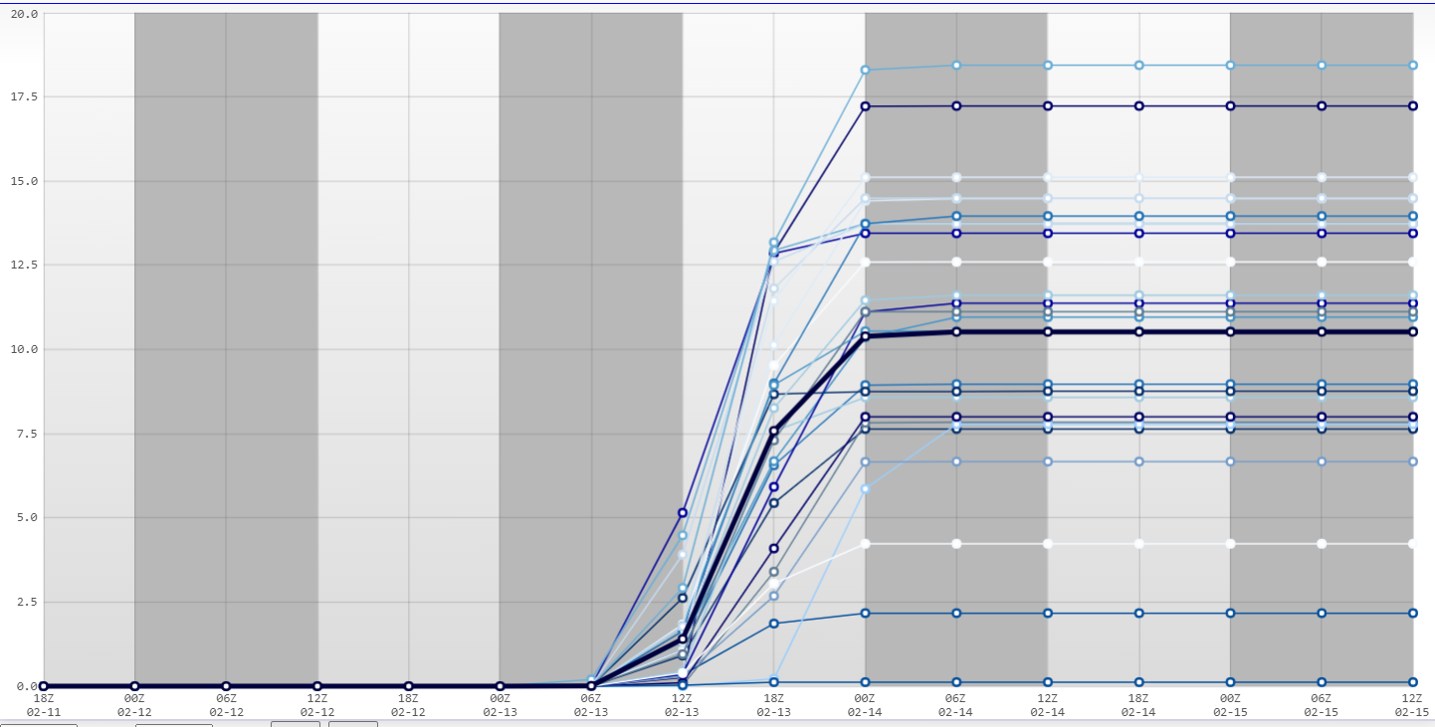
Boston EMCWF Members Snowfall Forecast: 12z Feb 11 2024
Assumes 10:1 Ratio
Boston:
ECMWF Members
Mean: 10.1
Observed: 0.1”
Large Spread =
High Uncertainty

Slide 8
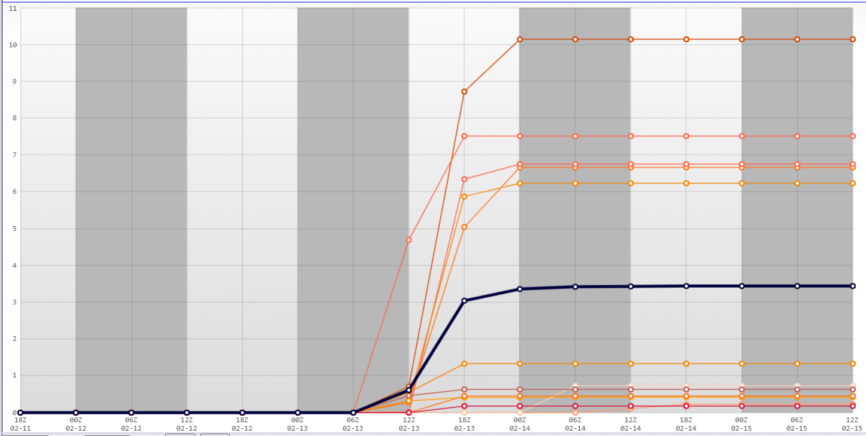
Boston CMC Members Snowfall Forecast: 12z Feb 11 2024…Day 3 Forecast
Boston:
CMC Members
Mean: 3.4”
Observed: 0.1”

Slide 9
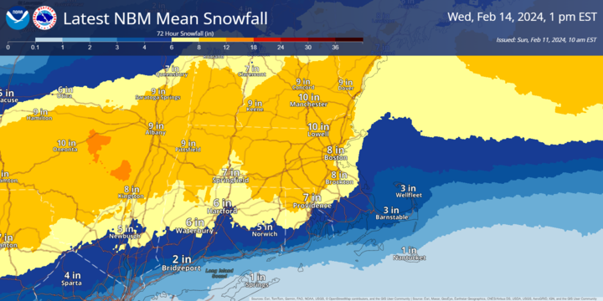
NBM Mean Snowfall: Sun Feb 11 2024…Day 3 Forecast
Remember: NBM is based upon the earlier model cycle and will be slow to react to significant changes

Slide 10
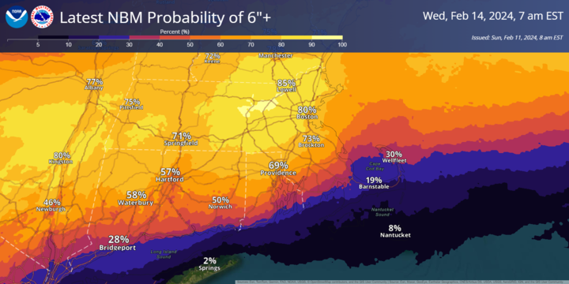
NBM Probability of 6+”: Sun Feb 11

Slide 11
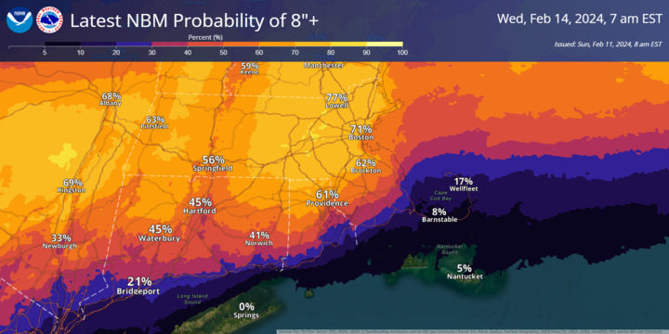
NBM Probability of 8+”: Sun Feb 11

Slide 12
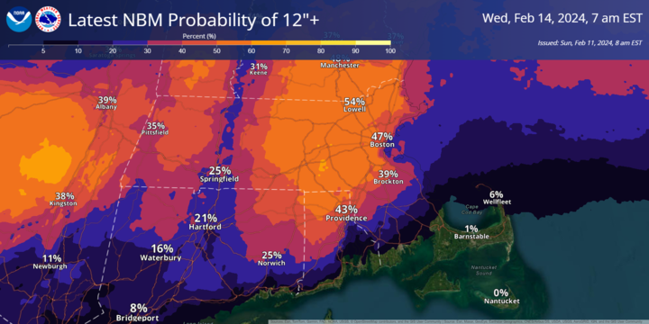
NBM Probability of 12+”: Sun Feb 11

Slide 13
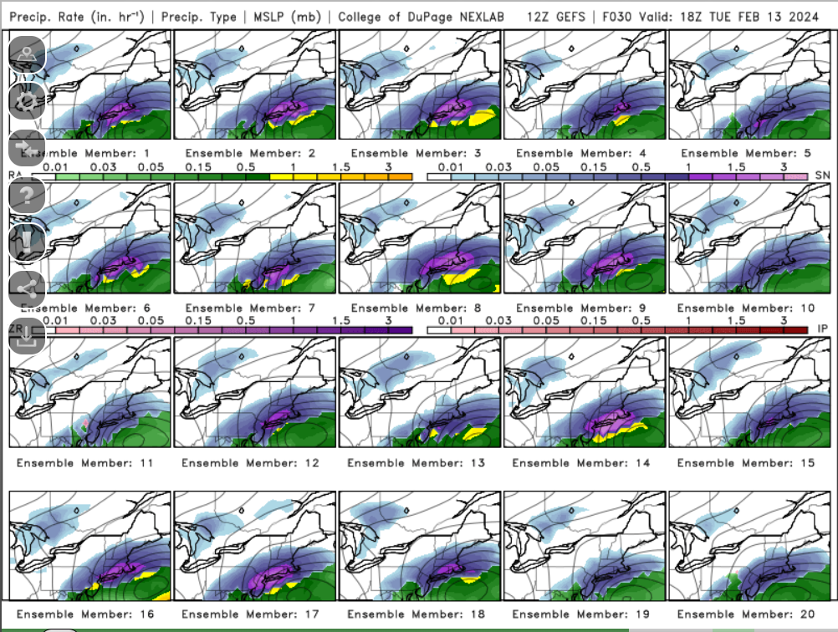
GEFS: 12z Mon February 12th 2024…Day 2 Forecast!
Just about all of the GEFS members showed a big hit for southern New England.
Are we still seeing an issue of underdispersement among ensemble members?

Slide 14
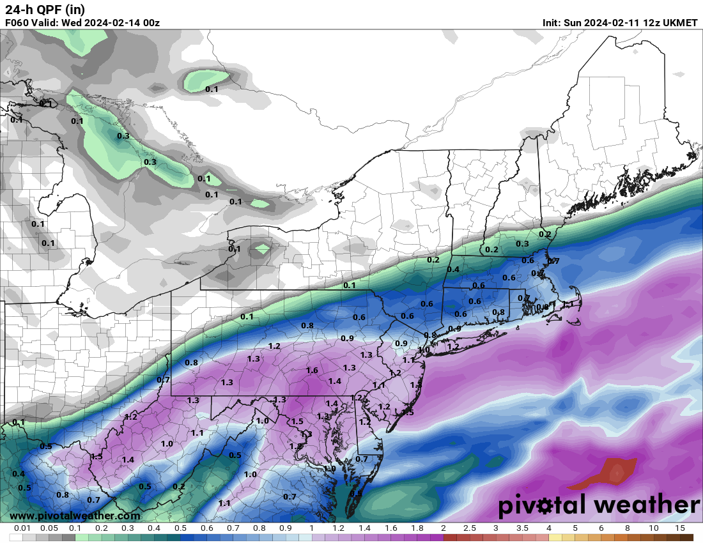
UKMET Forecast: Day 3 Forecast
12z Sunday UKMET further south than the GFS/ECMWF guidance…but still decent snow in the Worcester to Boston corridor.
Winter Storm Warnings were issued for much of the area.

Slide 15
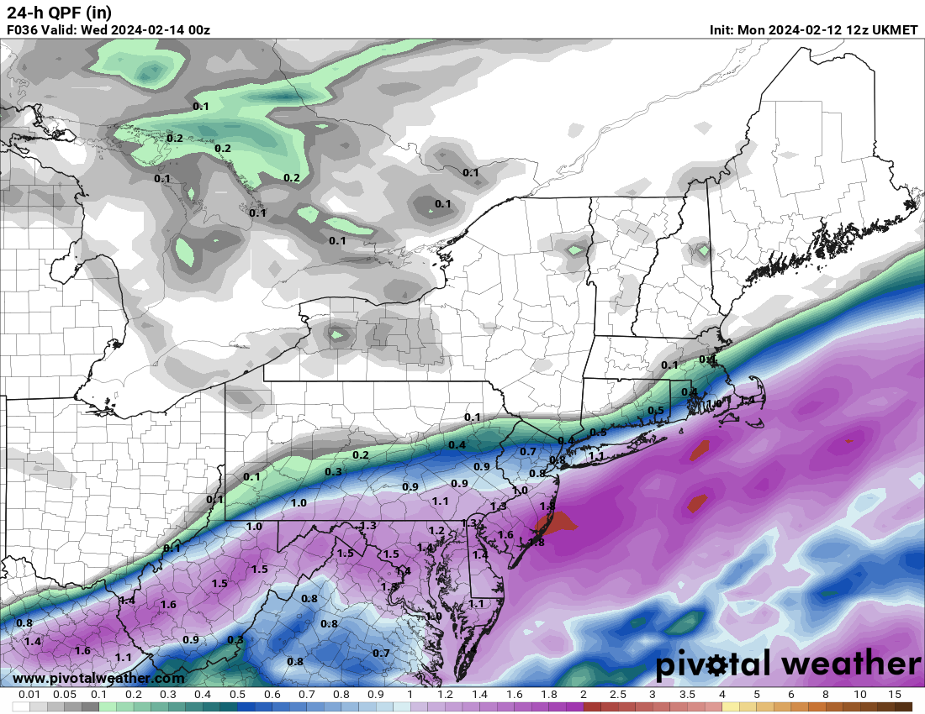
UKMET Forecast Trends: Day 2 Forecast
12z Monday UKMET too suppressed with its QPF especially across CT with 12+ inches of snow observed, but continues with a southern solution.
Hindsight is 20/20, but given the UKMET and to a lesser extent the NAM and CMC offered suppressed solutions, We probably could have done a better job messaging this in probabilistic terms and indicting a wider goal posts.

Slide 16
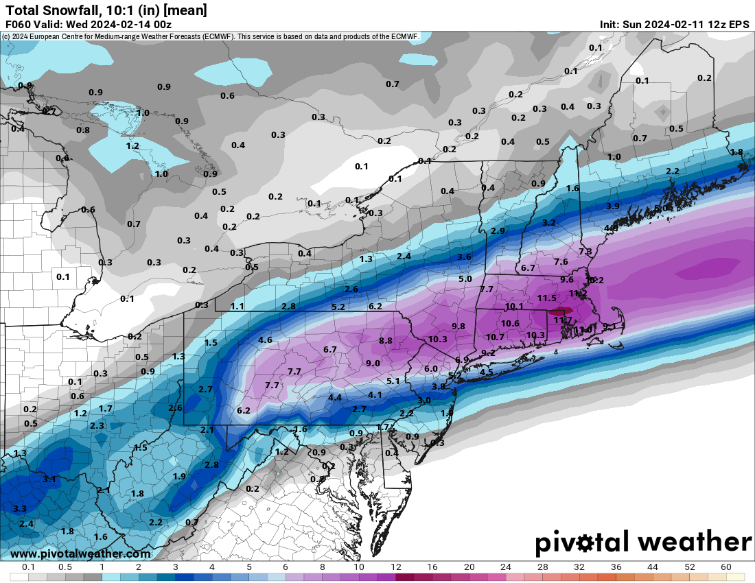
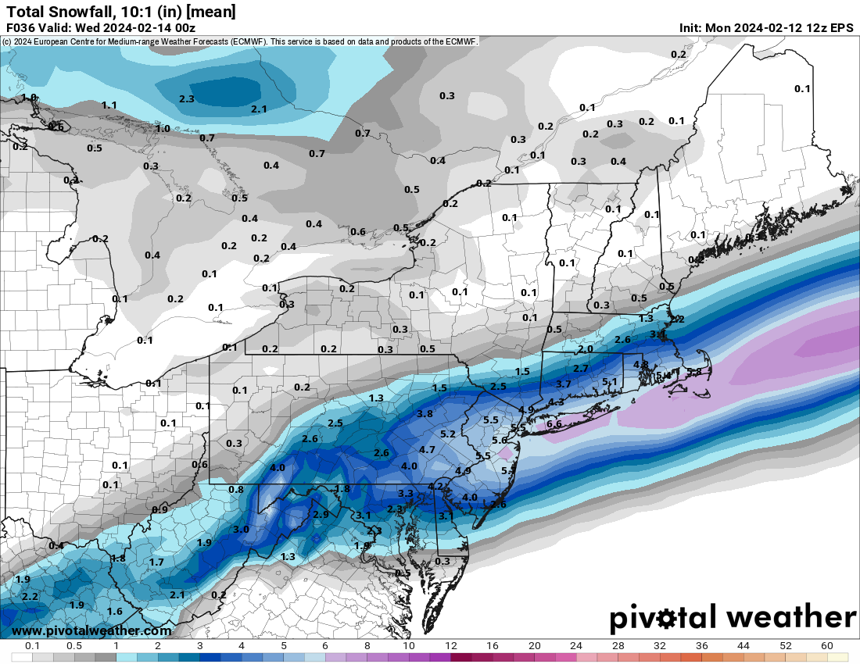
EPS Mean Snowfall Forecast Trend: Feb 11 vs Feb 12 (12Z)
Similar to the UKMET, the ECMWF also trended south with its QPF axis.

Slide 17
Rule of Thumb: UKMET and ECMWF
If the UKMET and ECMWF are not on board for a big storm, be careful!

Slide 18
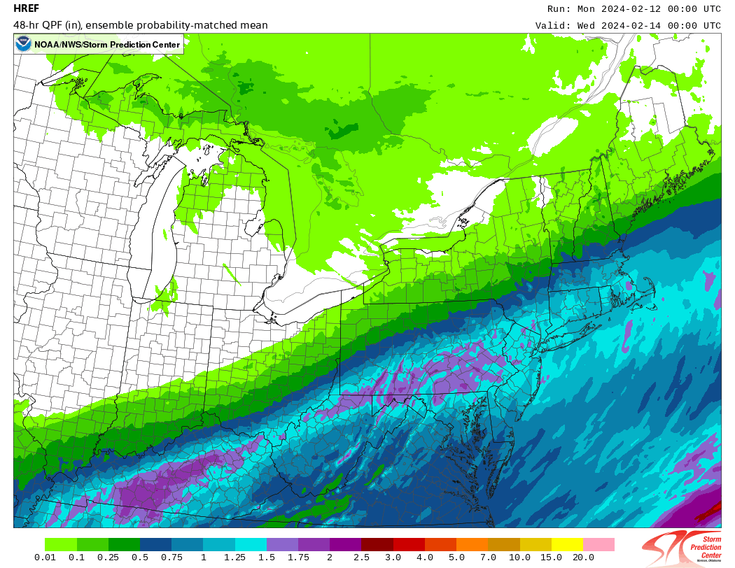
SPC HREF Trends: 48-Hour QPF
Similarly, note the southward trend in QPF, eventually focusing the axis of heaviest precipitation closer to the South Coast.
Since this is blended guidance which includes 5 of the 10 members from the previous run, it will be slower to show significant run to run changes.

Slide 19
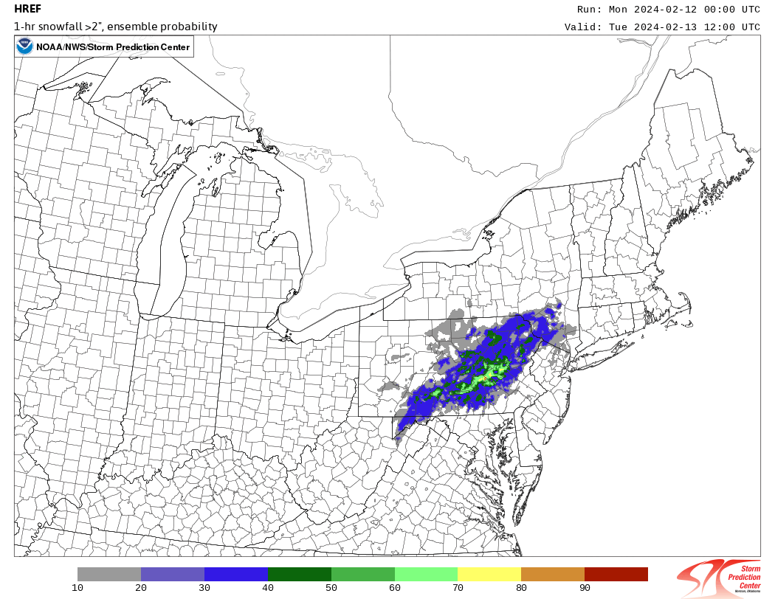
SPC HREF: Probability of 2”+/Hour Snowfall
From the 00z Mon run, note the very high probabilities over southern New England.

Slide 20
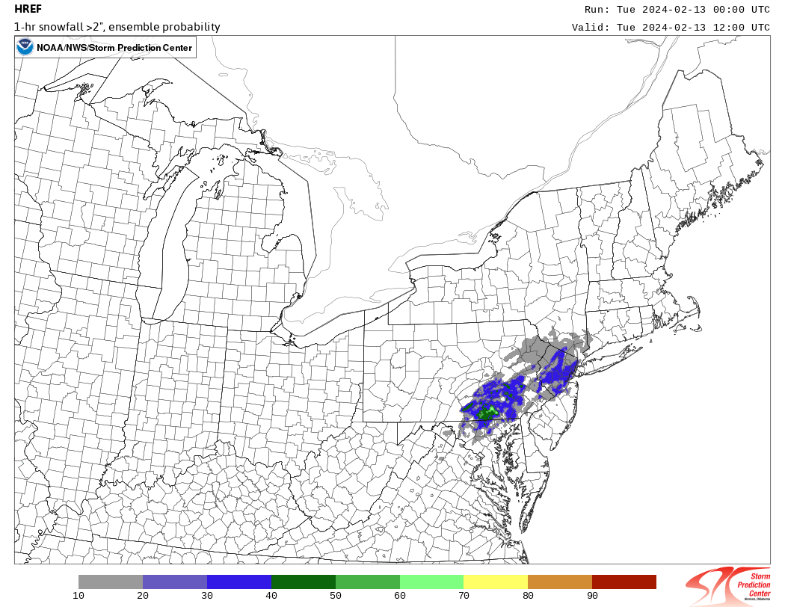
SPC HREF: Probability of 2”+/Hour Snowfall
From the 00z Tue run, the probabilities have decreased and the axis was south of the Mass Pike.

Slide 21
Monday Day Shift
After seeing a more definitive southward shift on the 12z ECMWF and 18z NAM/HRRR, a quick collaboration call was held with WPC and neighboring offices.
The consensus was to lower totals in the north and focus the higher snowfall totals across CT, RI, and southeast MA.
We were able to communicate these changes on our 2 PM EM Conference Call and with our TV met partners on Slack, as well as on social media.
Despite making these changes the day before, this still seemed late for some of our partners - especially schools which ended up closing the next day.
Is this due to higher expectations of accurate forecasts and the fact that schools need to make these decisions the day before?
We did emphasize that totals would probably be lowered further in later forecasts

Slide 22
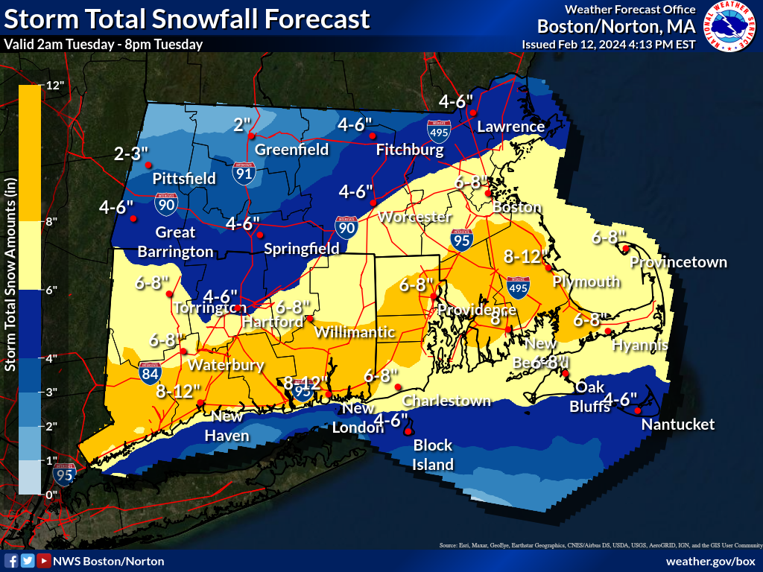
Observed Snowfall vs Final Call
Observed Snowfall
Final Call (Monday Day Shift)

Slide 23
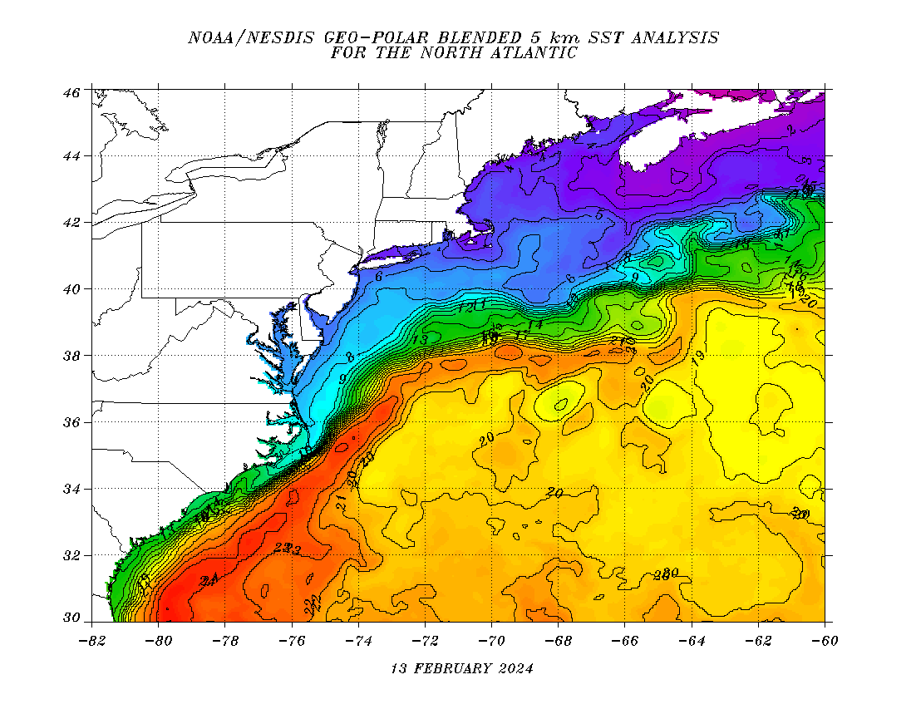
Sea Surface Temperatures
Sea surface temperatures were around 40 F, which is about 3-5 degrees above normal (inset)
NE winds during a large part of the storm led to low level warming around Boston
The Cape/Islands saw significant snow because they had enough intensity/duration to fully wet bulb.

Slide 24
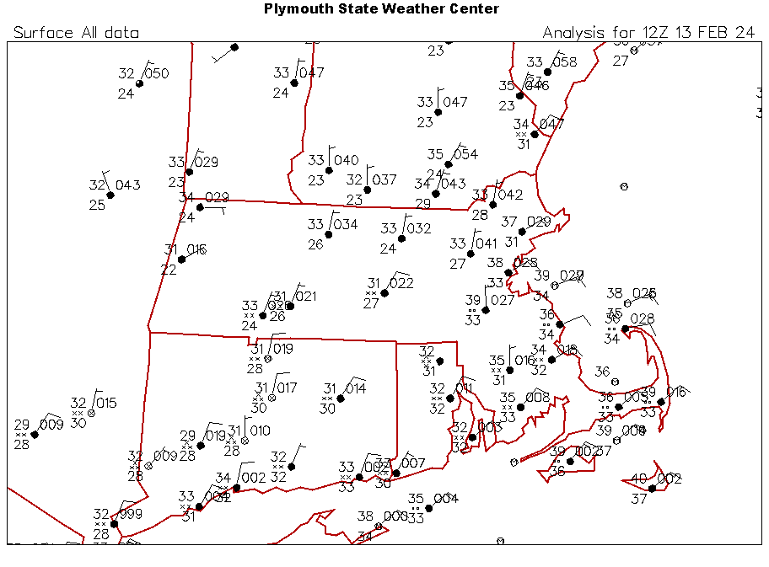
12z Tuesday Station Plot
Note the onshore flow in eastern MA.
Buoys reported sea surface temperatures near 40 degrees which maintained low level warming.
Also note temperatures inland were still above freezing - lack of antecedent cold air was eventually overcome by dynamic cooling.

Slide 25
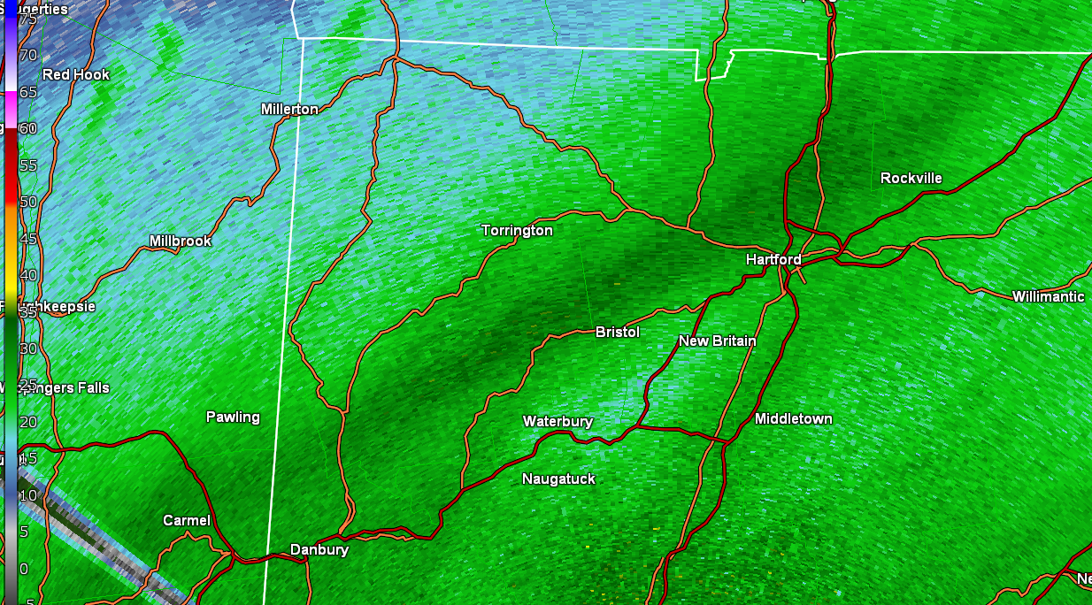
Mesoscale Snow Band in Hartford: 15.7” of Snow
This band of snow dumped 15.7” of snow in West Hartford, CT.
8” of snow fell between 7:15 am and 11:15 am!

Slide 26
Mesoscale Snow Band in Hartford: 15.7” of Snow
In hindsight, we should have re-issued the Winter Storm Warning once we had the initial 7” report came in.
At the time, we did not expect the band to remain quasi-stationary over the Hartford area and were not expecting to see amounts over 12”.
This made messaging for our TV met partners difficult - something we need to remember if this occurs again!
From Joe: We really couldn’t tell how long that band would stay in Hartford. Our thinking was another 2-3” but that turned out to be way off! My fault on that one.

Slide 27
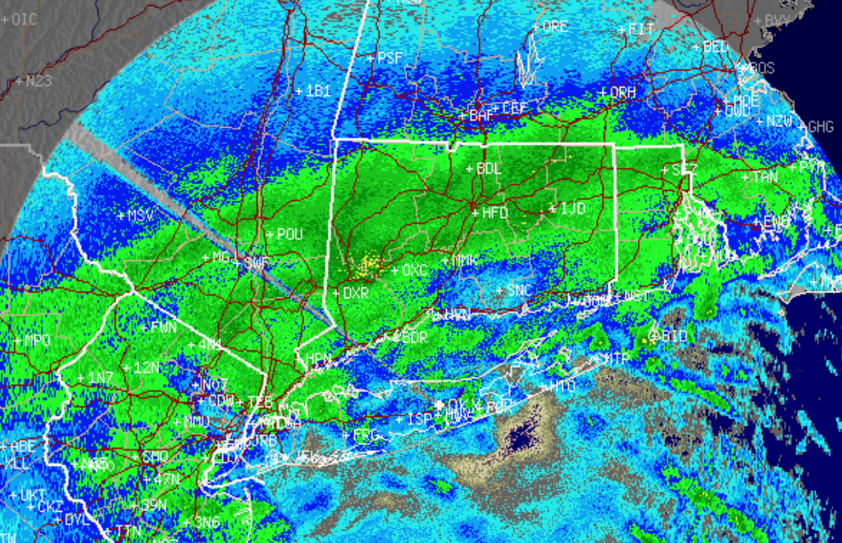
700 mb Frontogenesis
Frontogenesis trend picks up on the development of heavy snow band that we see on radar at 10z. Focused on 700mb vs 850mb given model guidance soundings suggesting the greater lift further aloft (700-300mb layer).

Slide 28
700 mb and 850 mb Thermal Advection
Focused on where heavy snow band is located, with sharp cutoff noted on these images over southeast NY into western/central MA where we have suggestion of weak downglide at 700mb.
850mb thermal advection/isentropic flow suggests low-level downglide, with source of lift further aloft, perhaps associated with broad upper divergence in exit RRQ of upper jet streak.

Slide 29
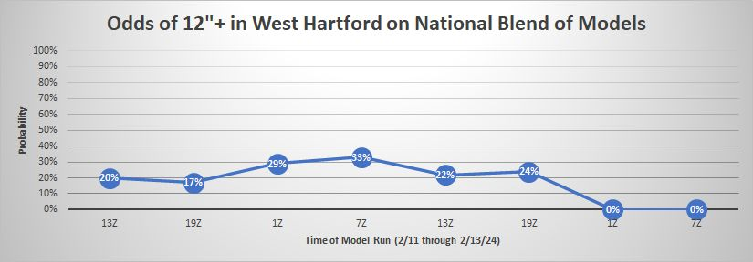
Mesoscale Snow Band in Hartford
NBM probabilities for 12”+ of snow in West Hartford decreased with time!
Courtesy of Ryan Hanrahan, NBC CT

Slide 30
Station Plot: 18z Tue
Snow finally made it to Boston as winds backed enough to allow temperatures to fall to 33 degrees (along with dynamic cooling).
But the snow wasn’t sticking except on the grass, and the heaviest precipitation would end in 1-2 hours.
Snow did actually stick on the Cape/Islands because they had a longer duration/intensity.

Slide 31
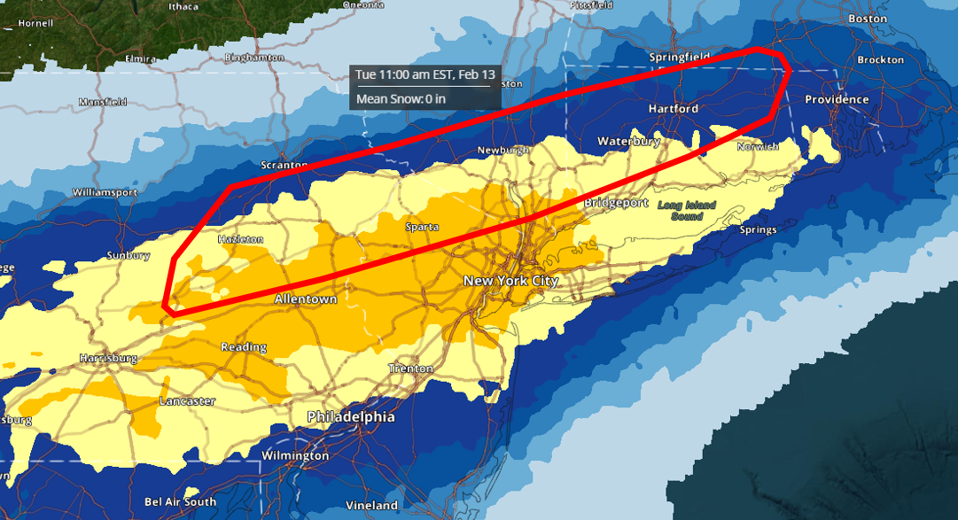
NBM Forecast Snowfall: Through 16z Tue
Red Outline =
observed 8-12” of snow
NBM (07z Tue) was too far south with its axis of heavier snow through 16z.
Note 2-4” in Boston but it was still raining!
4-6”
6-8”
8-12”
6-8”

Slide 32
Summary
Models hinted at a coastal storm almost a week in advance
Increasing model agreement and high ensemble probabilities for significant snow led to Watches and Warnings over the weekend
The southward trend was initially shown by the UKMET and then by the ECMWF but other guidance still showed a big snowstorm for most of southern New England.
If the UKMET and ECMWF are not on board for a big storm, be wary about forecasting high amounts. Our big storms tend to occur when both of these models are in agreement.
Focus more on the heavy snow ingredients first (banding, larger scale lift) instead of starting with post-processed output (QPF, snow).
This can bias us toward higher snow totals
Stay away from blended guidance in these situations since it will be slow to react!

Slide 33
Some Final Thoughts

