Slide 1
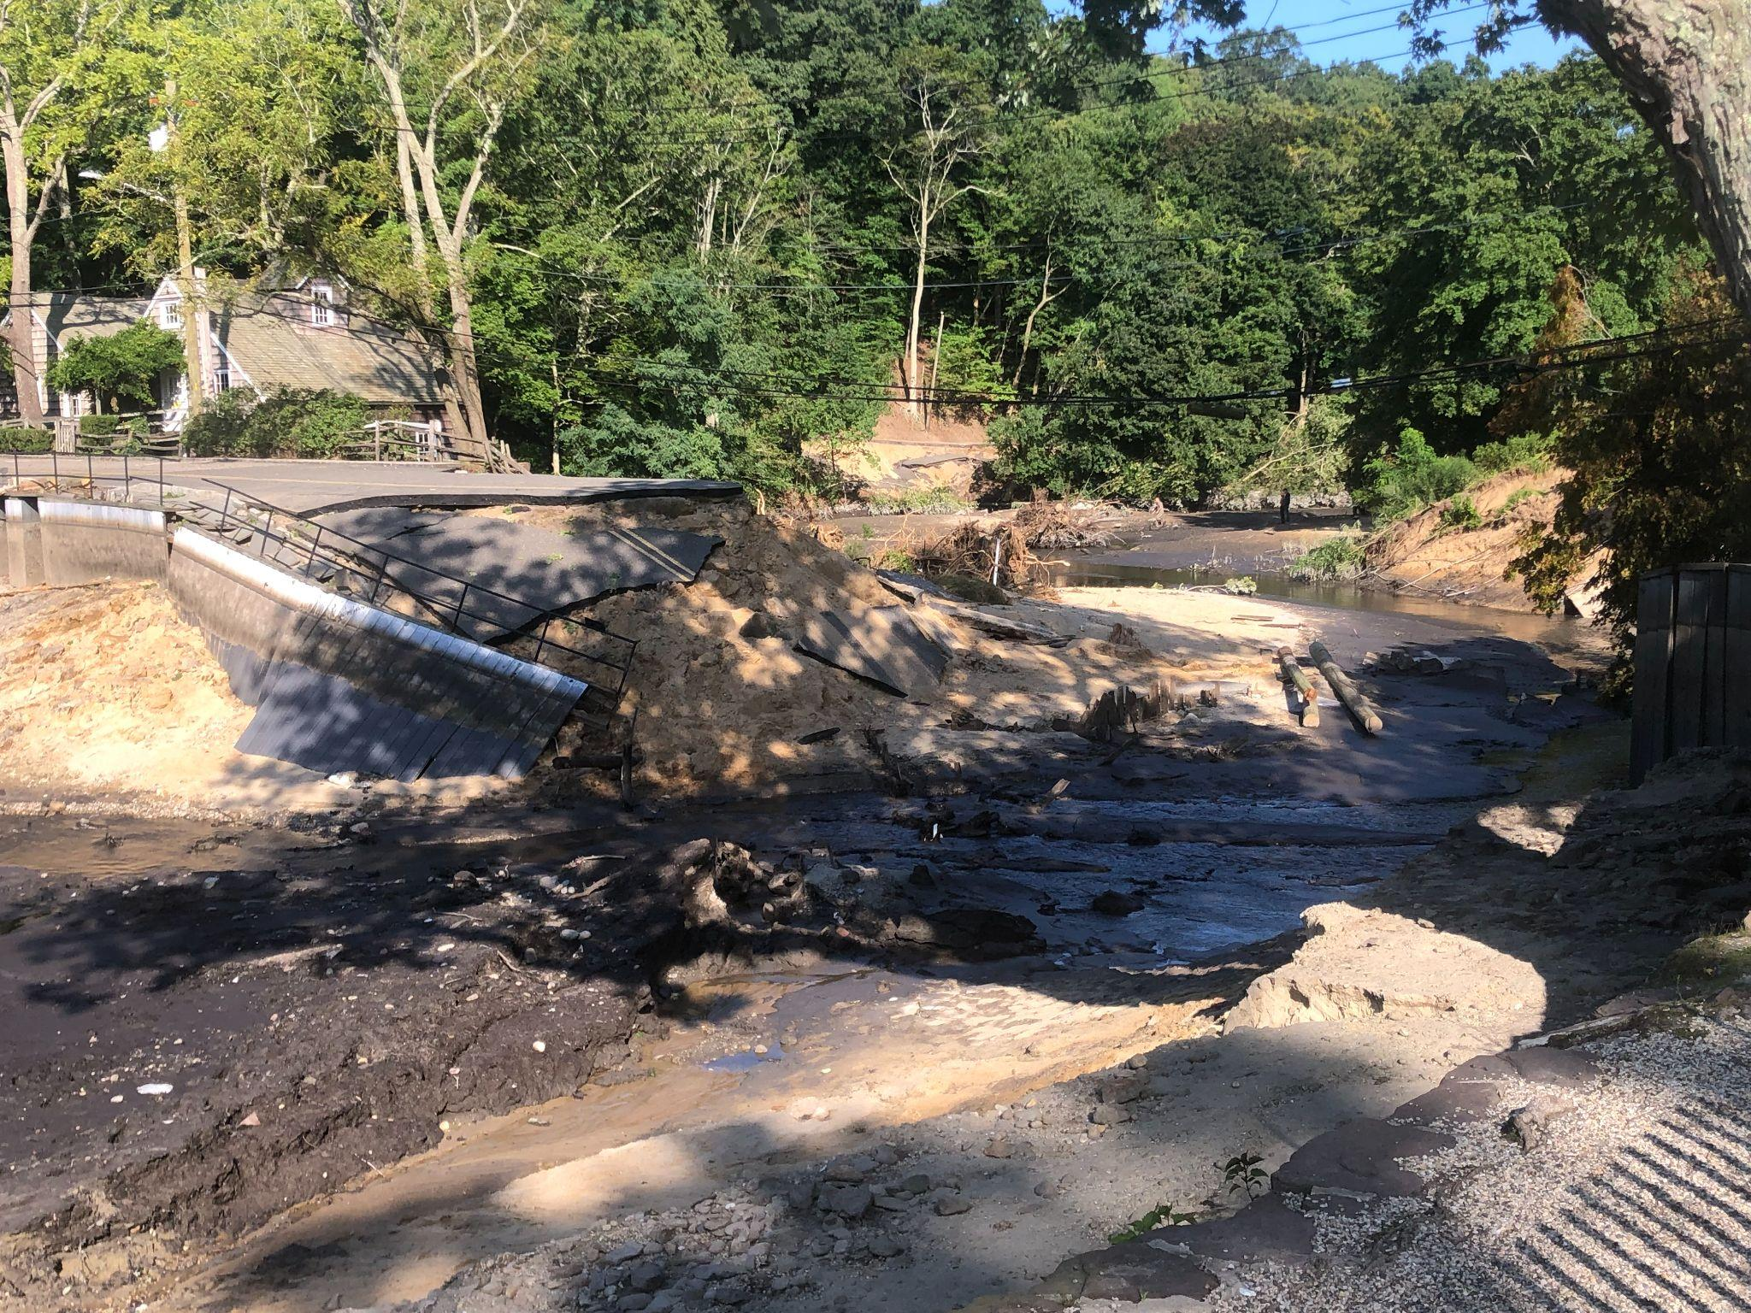
Destructive CT and Long Island Flash Floods
August 18-19, 2024
Presented by
Dominic Ramunni
Meteorologist
Dave Radell
Science and Operations Officer
Matt Wunsch
Meteorologist | Severe Team Lead
With contributions from: Dave Stark and John Murray
National Weather Service
WFO New York, NY

Slide 2
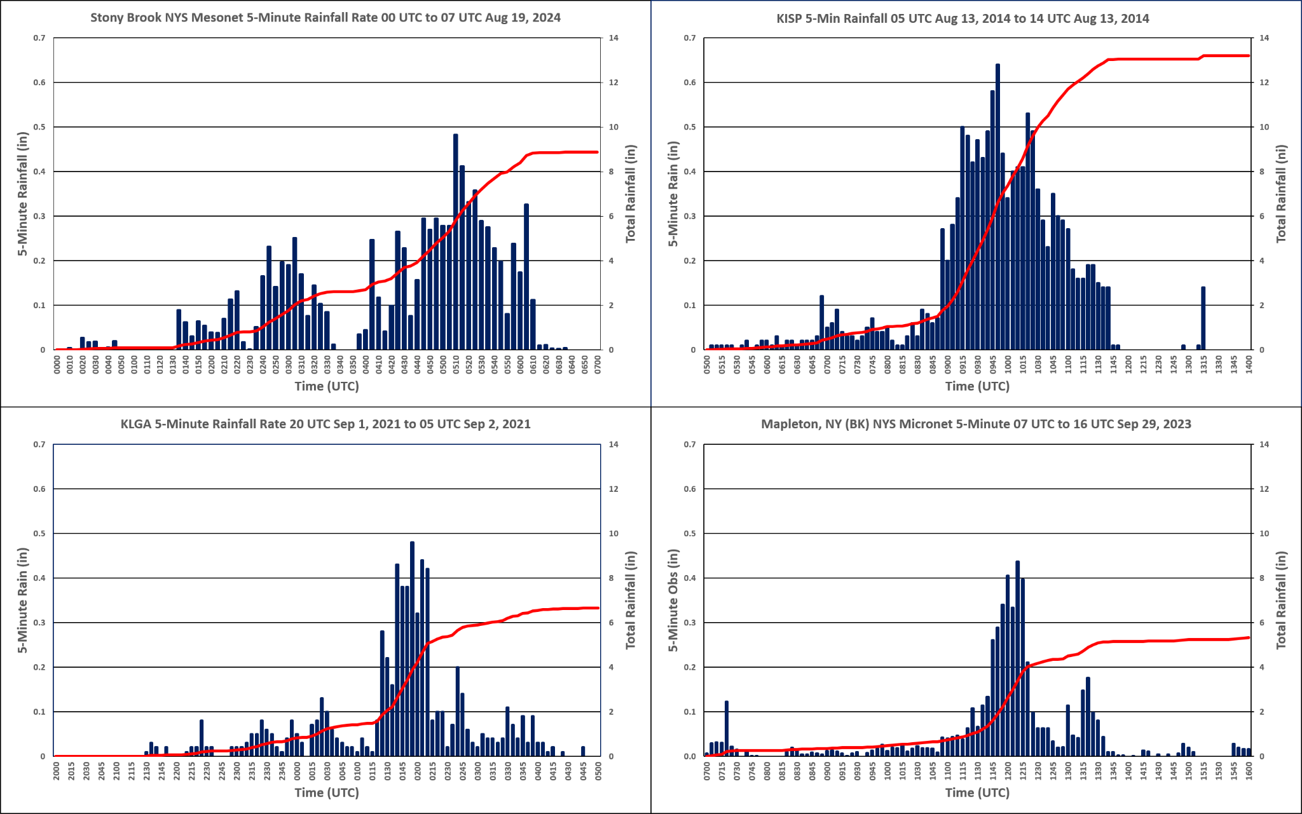
It’s all about the rates…
Emergency
“Emergency”
5-min rate in blue, cumulative in red
0.3-0.5+” in 5 min. threshold→ WOW Event!
ISP (2014) still the gold standard.
Emergency
Considerable
National Weather Service
WFO New York, NY

Slide 3
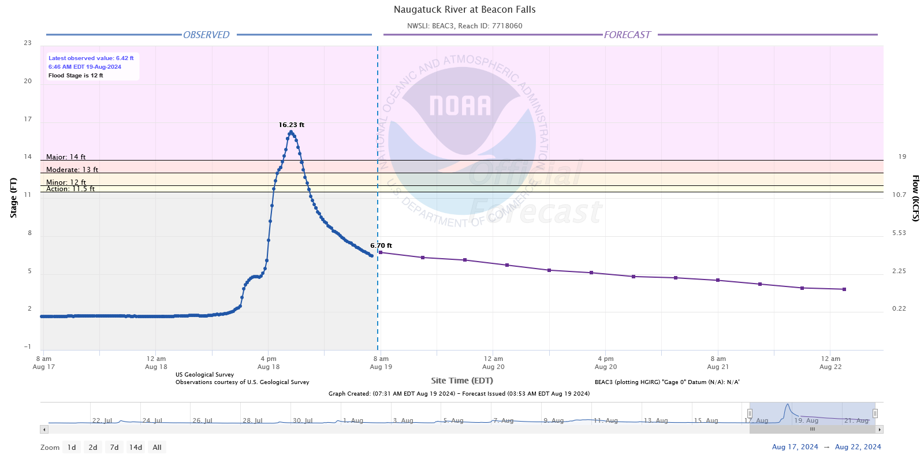
Event Overview
Widespread event totals of 1”-3”.
Parts of SW CT received 3-6” of rain with amounts upwards of 13” of rain prompting a Flash Flood Emergency
Potential 24-hour record rainfall for the state of Connecticut.
Current record is 12.77” on August 19th, 1955 from Hurricane Diane.
NW Suffolk County and Northern Nassau Counties received up to 10” of rain prompting a Flash Flood Emergency overnight.
Major flooding on the Still, Naugatuck, Pomperaug
and Housatonic Rivers (flashy response on a large
stem river).
National Weather Service
WFO New York, NY

Slide 4
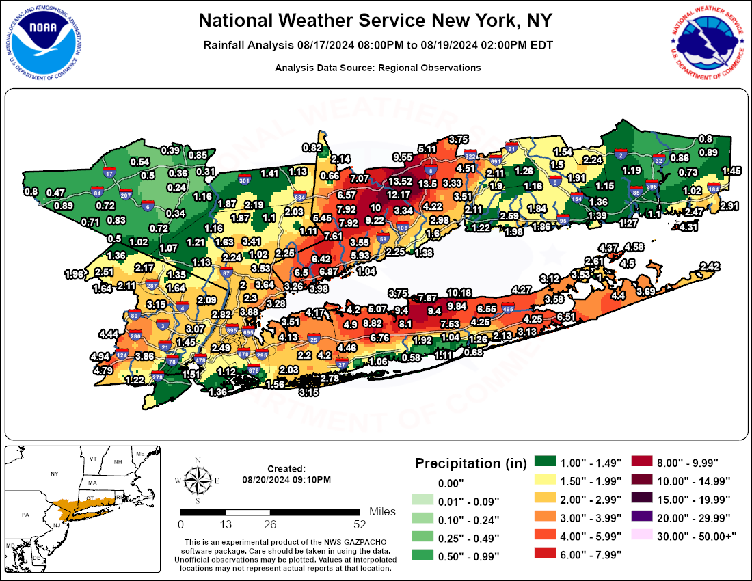
48-hr (Storm Total) Rainfall Analysis
Analysis Based on our last PNS
National Weather Service
WFO New York, NY

Slide 5
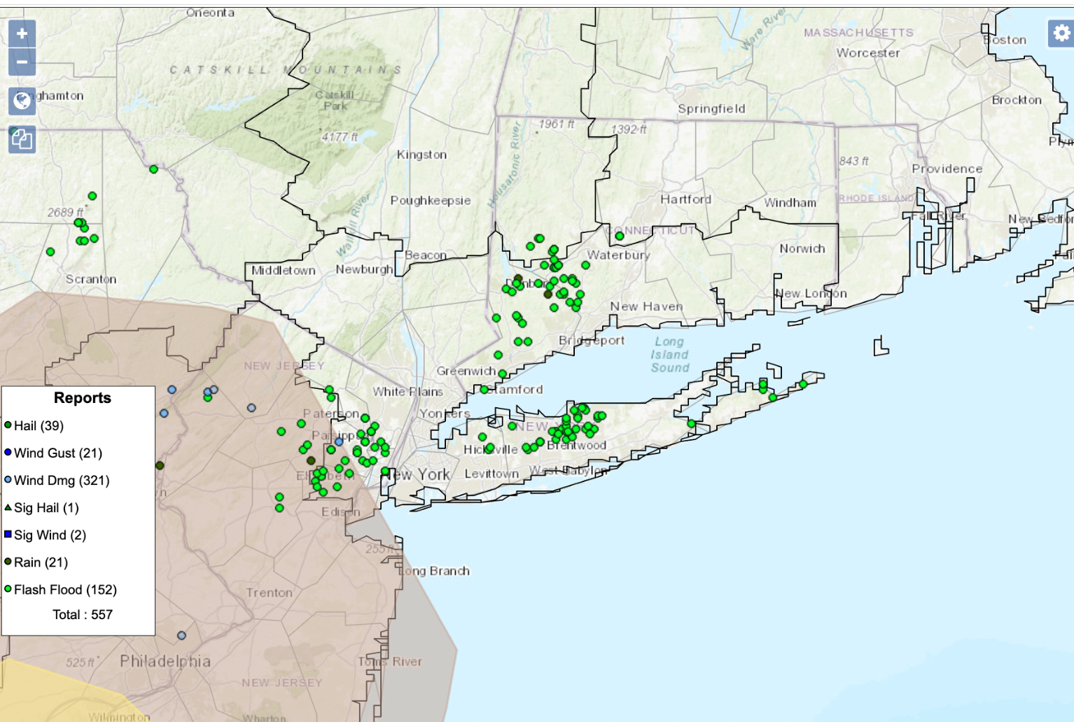
LSRs
From SPC…
National Weather Service
WFO New York, NY

Slide 6
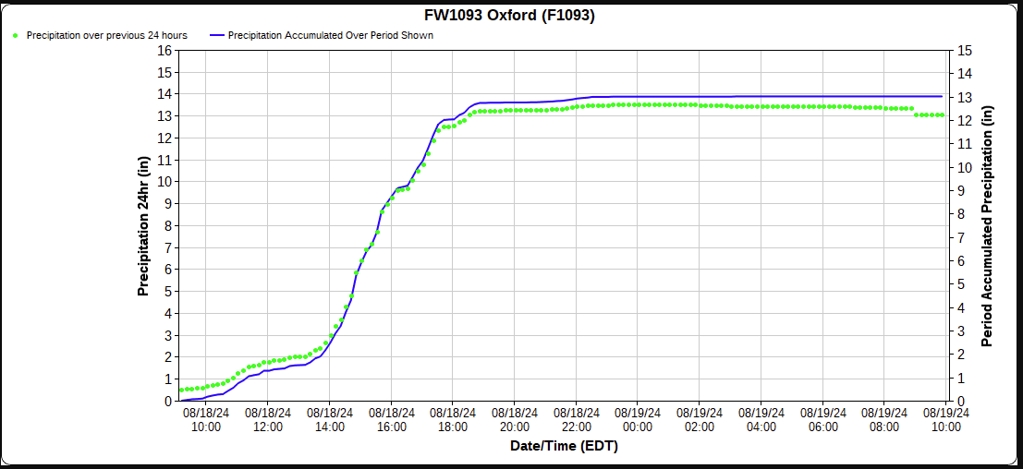
Rainfall Rates: Oxford, CT
CWOP Station
~3.5”/hr rate from 2-4 PM
~2.6”/hr rate from
2-6 PM
~4”/hr rate from
2-3 PM
National Weather Service
WFO New York, NY

Slide 7
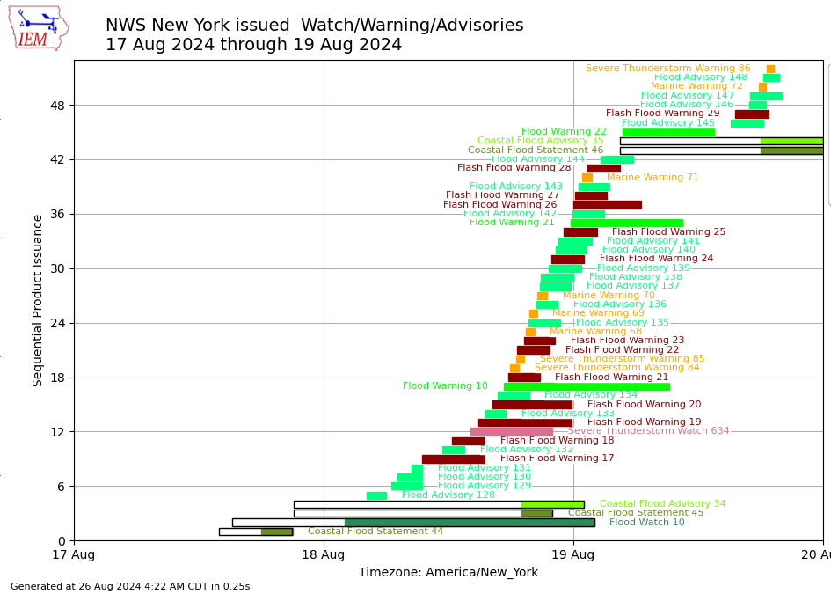
August 18/19th Flash Flood Emergencies/Severe
WFO OKX Product Timeline
12 FFWs, 2 Emergencies
2 SVRs
4 SMWs
First Flood Advisory (130) for SW CT issued at 7:07 AM
First Flash Flood Warning (17) issued at 9:26 AM for SW CT
Flash Flood Emergency (19) for SW CT at 2:52 PM
Flash Flood Emergency (28) for LI at 1:20 AM on August 19th
National Weather Service
WFO New York, NY

Slide 8
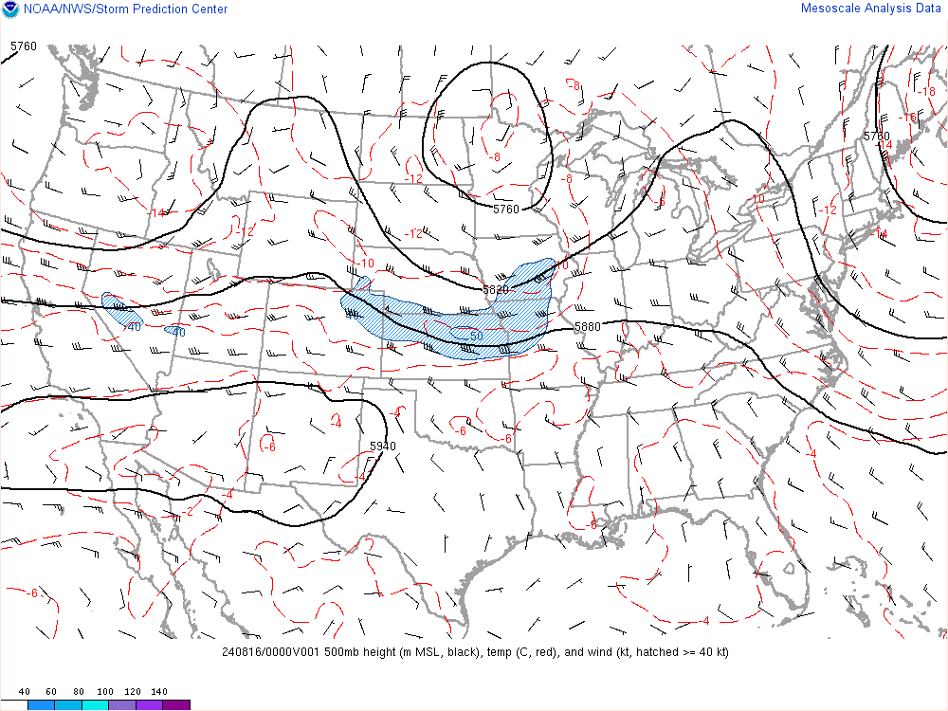
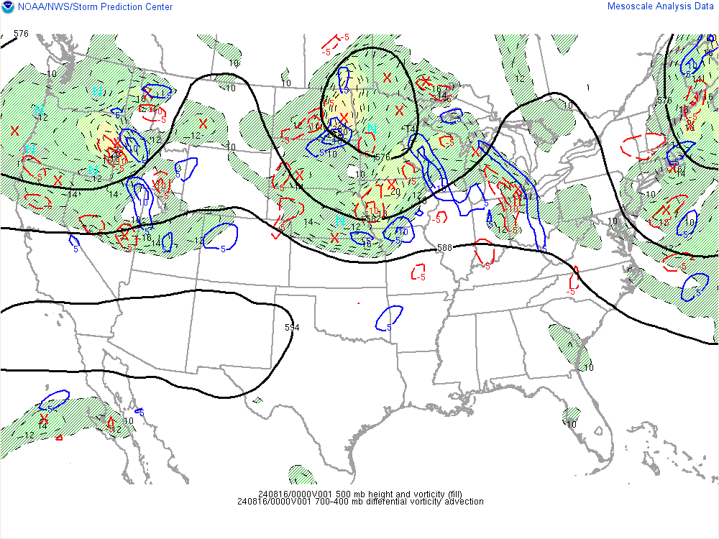
The Lead Up: Synoptic Overview
500 mb 8/16/24 00Z
Digging mid-level trough translating across the Great Lakes
Ridging builds in, then departs offshore
Deep moisture advection from Southeast US
National Weather Service
WFO New York, NY

Slide 9
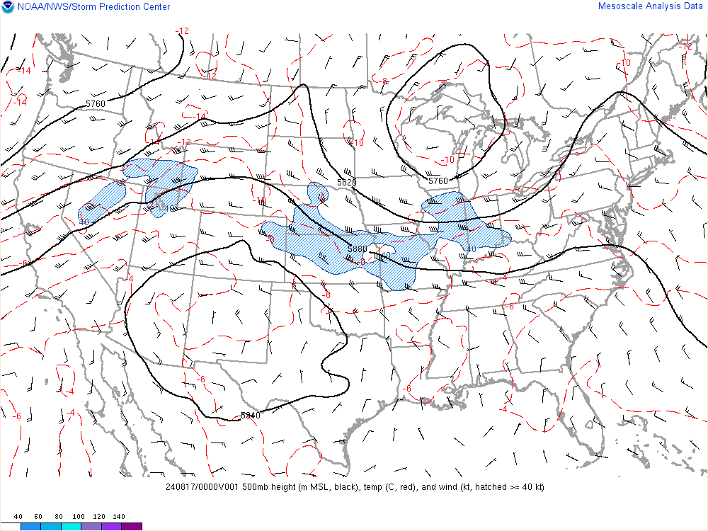
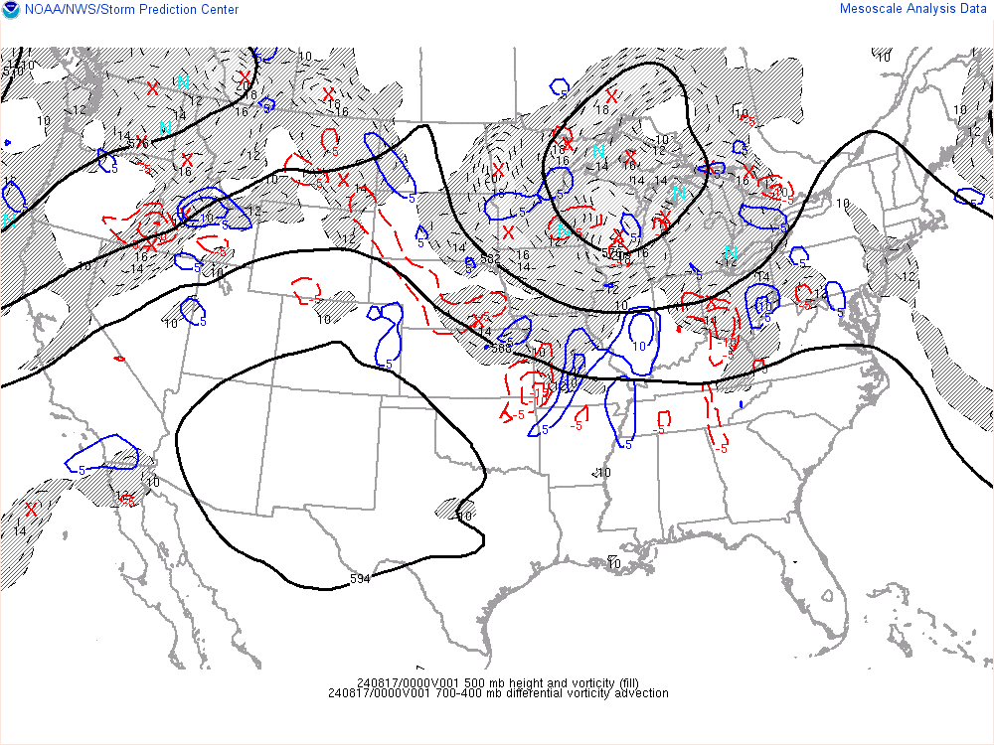
The Lead Up: Synoptic Overview
500 mb 8/17/24 00Z
Digging mid-level trough translating across the Great Lakes
Ridging builds in, then departs offshore
Deep moisture advection from Southeast US
National Weather Service
WFO New York, NY

Slide 10
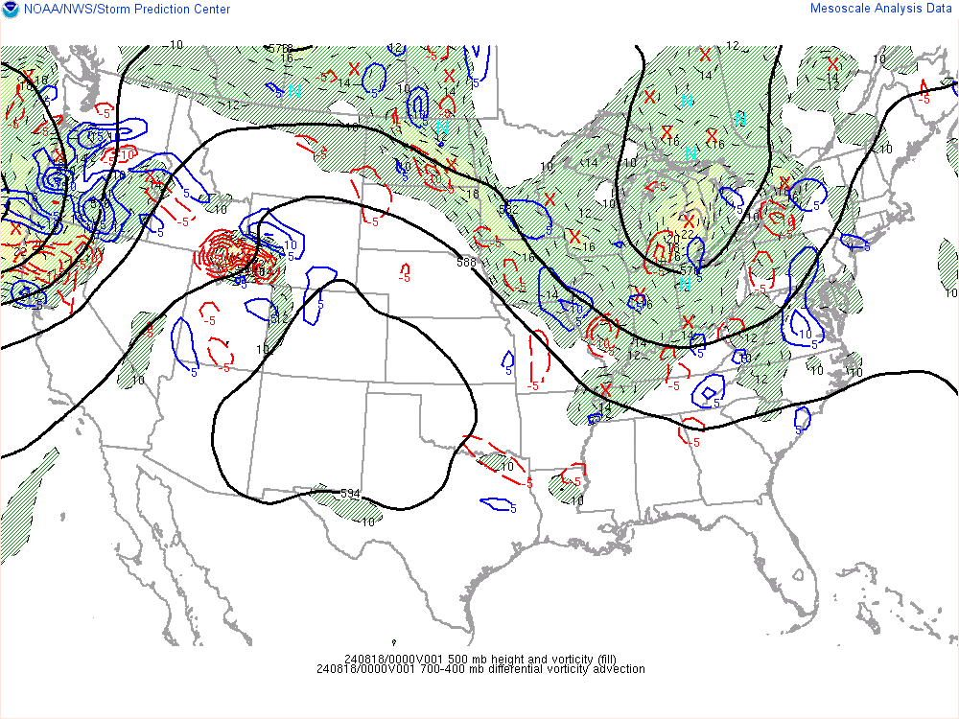
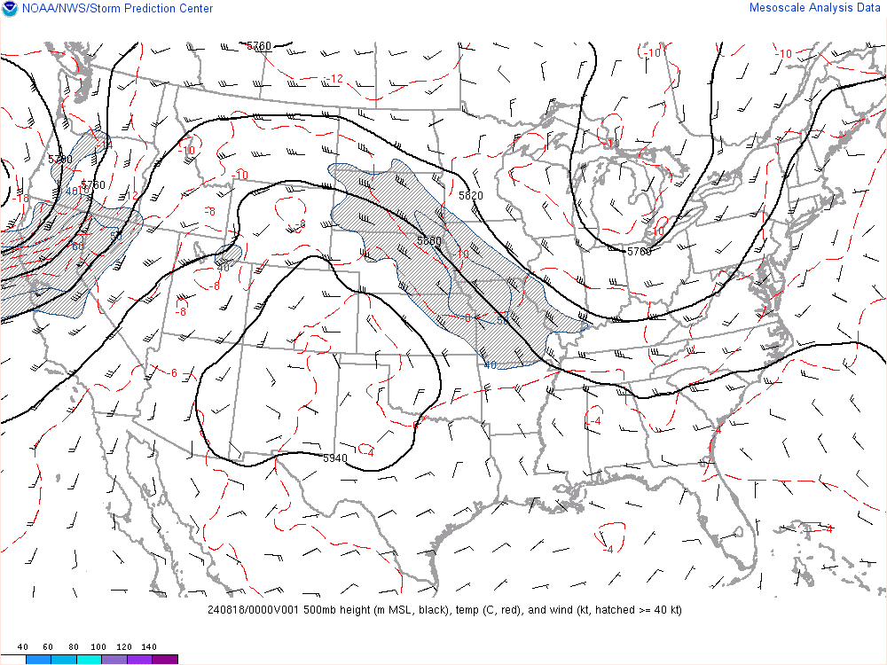
The Lead Up: Synoptic Overview
500 mb 8/18/24 00Z
Digging mid-level trough translating across the Great Lakes
Ridging builds in, then departs offshore
Deep moisture advection from Southeast US
National Weather Service
WFO New York, NY

Slide 11
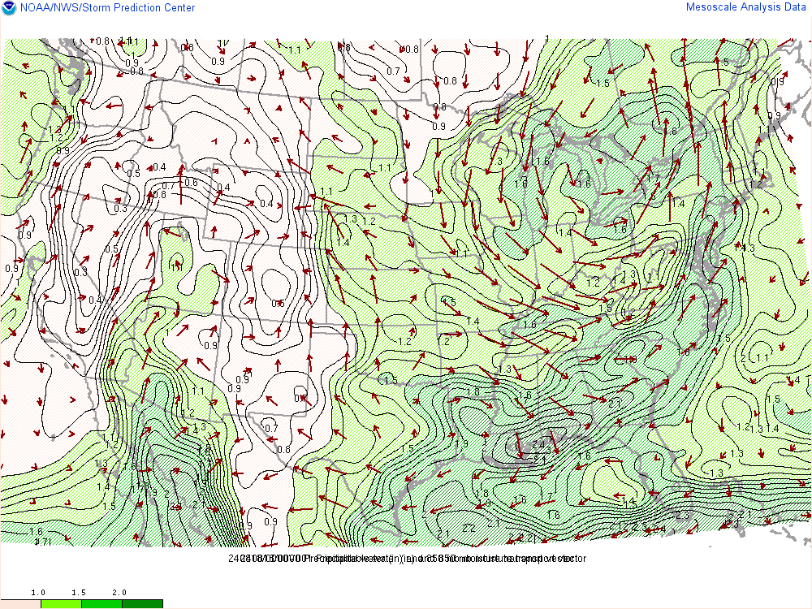
The Lead Up: Synoptic Overview
850 mb 8/18/24 00Z
Digging mid-level trough translating across the Great Lakes
Ridging builds in, then departs offshore
Deep moisture advection from Southeast US
National Weather Service
WFO New York, NY

Slide 12
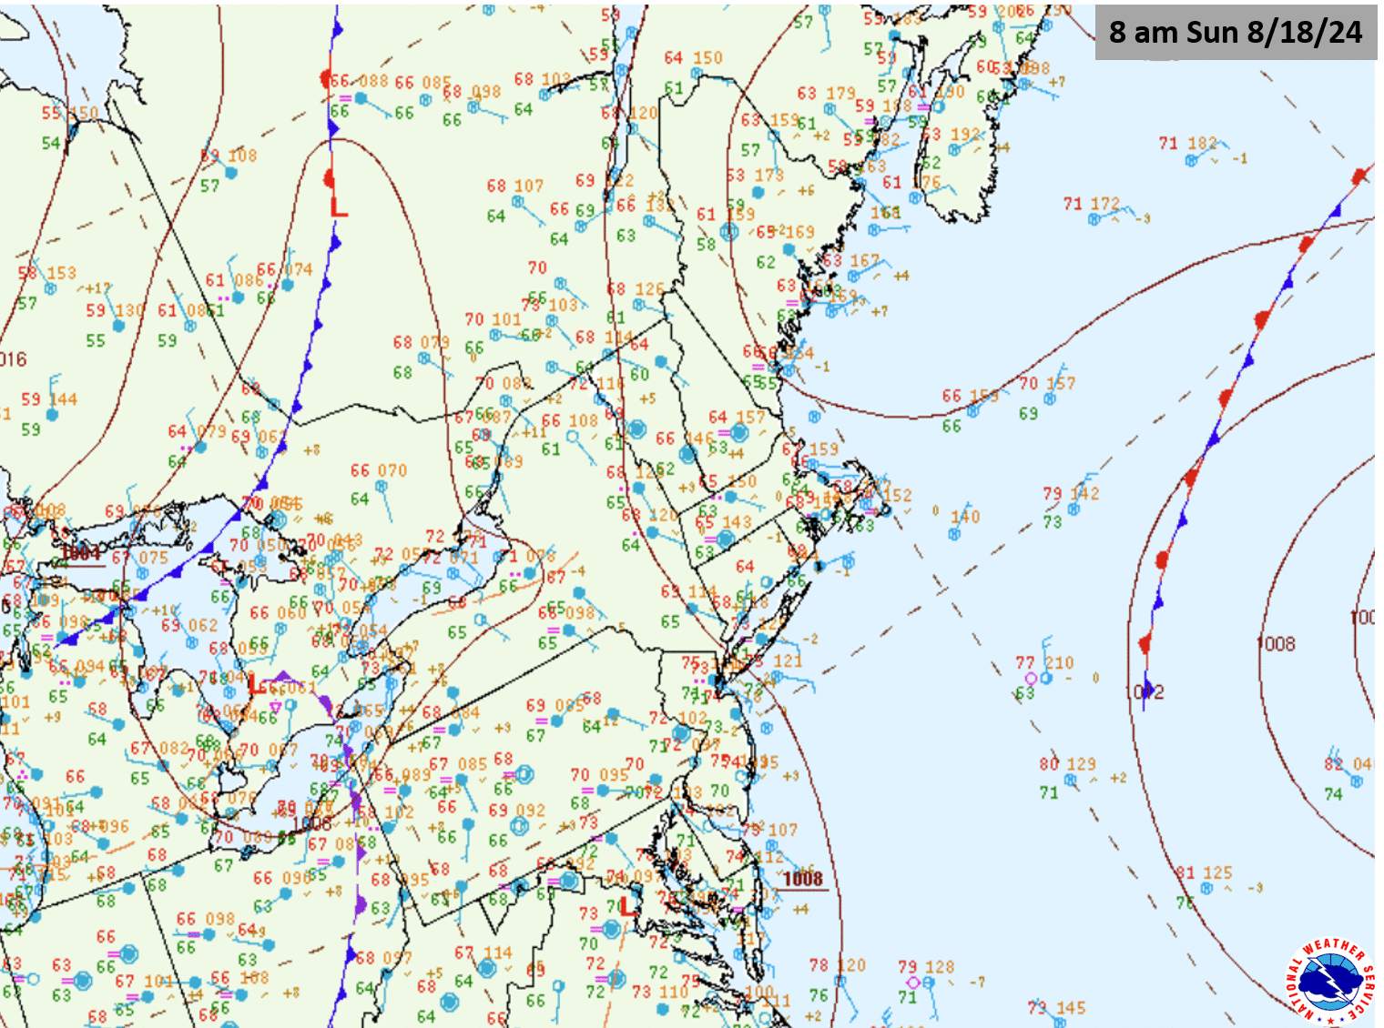
The Lead Up: Synoptic Overview
Surface 8/18/24 12Z - 8/19/24 12Z
Weak sfc trough/warm front across CT, series of mesolows enhance low level convergence
Outflow boundaries reinforce low level convergence
Convection moving in from the west becomes oriented east-to-west over Long Island along a stationary front
Moisture overruns a southward moving outflow boundary and continues to backbuild into intense thunderstorms
National Weather Service
WFO New York, NY

Slide 13
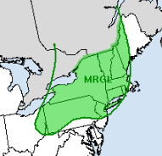
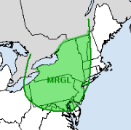
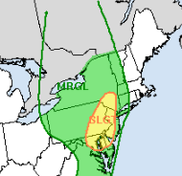
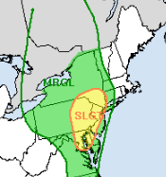
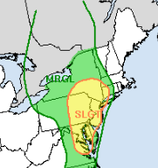
The Lead Up: WPC EROs
Day 5 ERO
Day 4 ERO
Day 3 ERO
Day 2 ERO
Day 1 ERO
Courtesy WPC
National Weather Service
WFO New York, NY

Slide 14
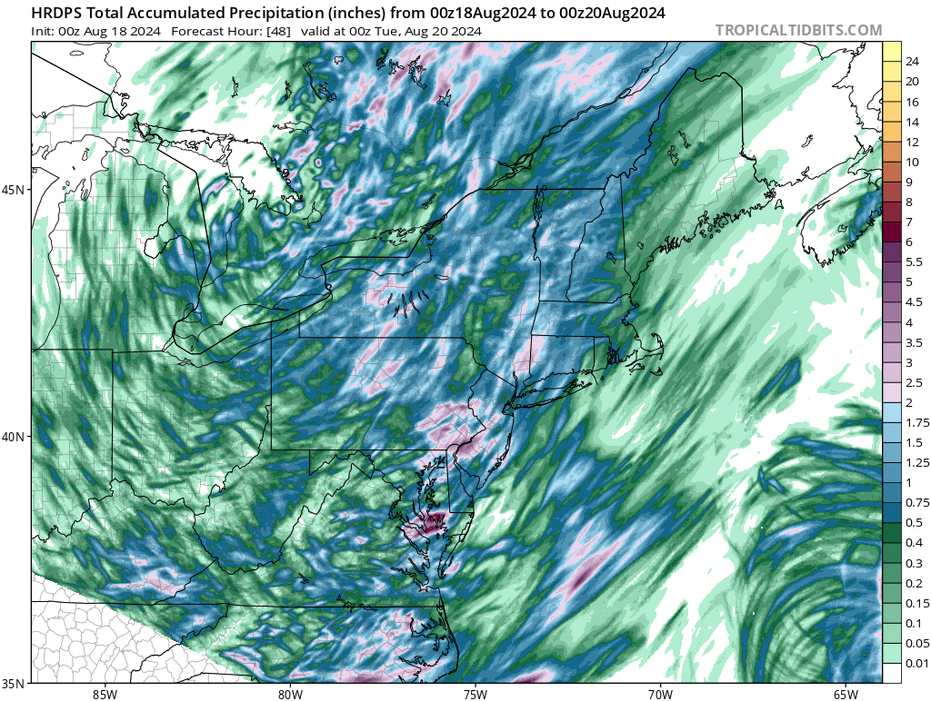
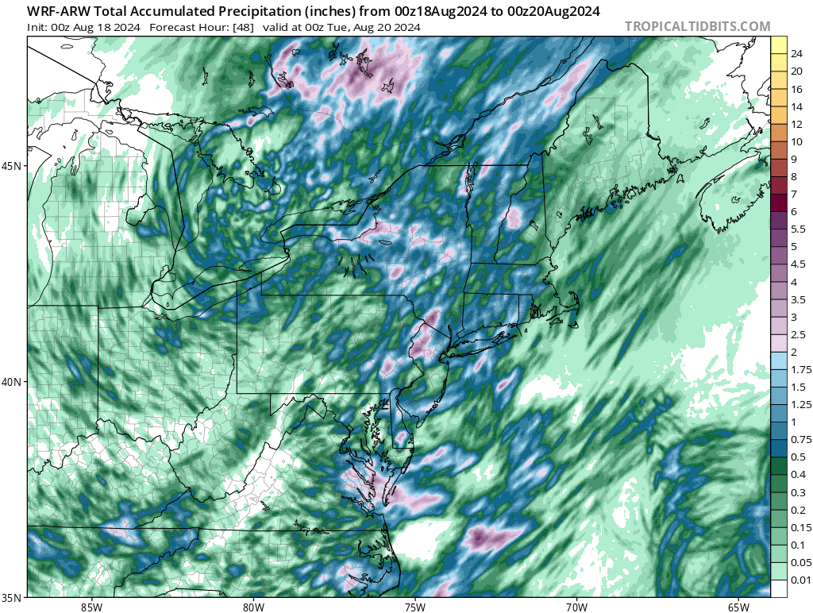
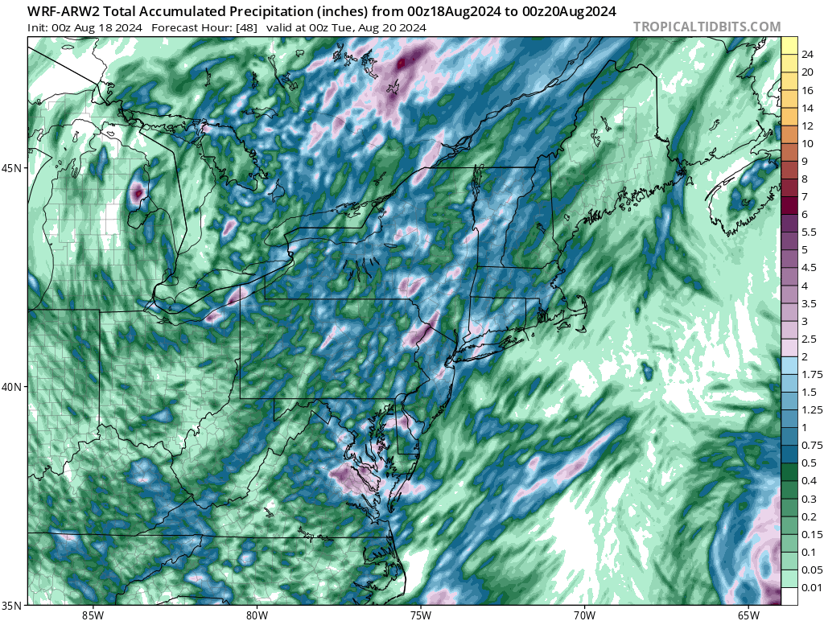
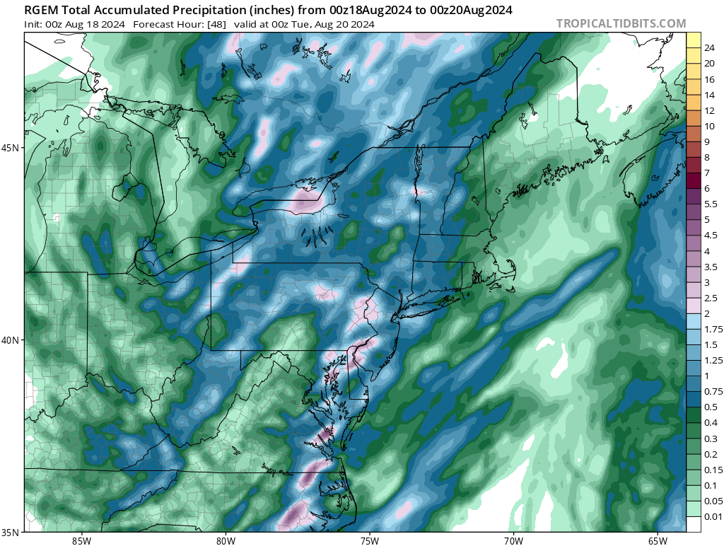
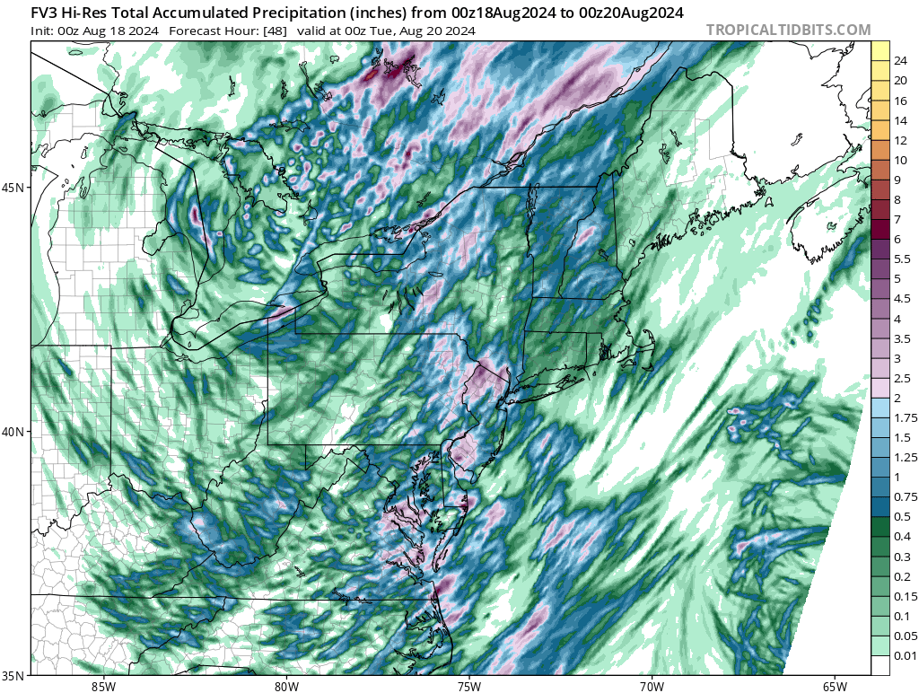
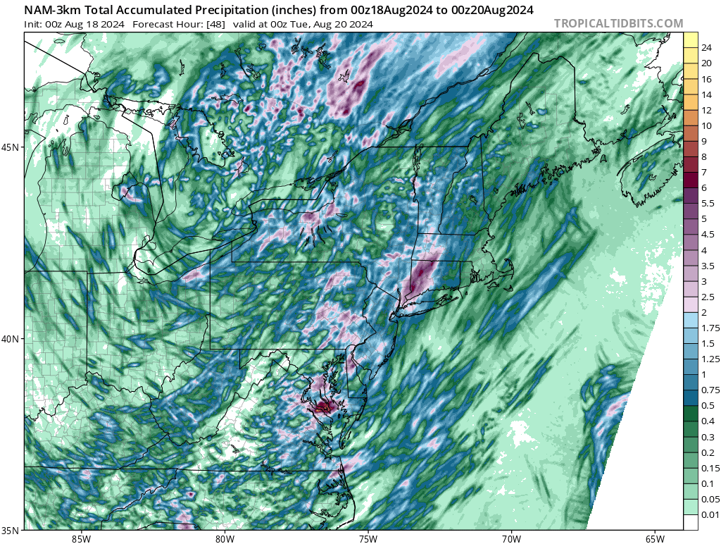
The Lead Up: Guidance
August 18th 00Z Guidance (12-24 hours before events)
HRDPS
WRF ARW
WRF ARW2
00Z Guidance Takeaways:
Other than the 3km NAM, most models had location of heaviest precip over NJ/ Lower Hudson Valley.
No model had more than 2-4” of rainfall at most.
RGEM
GFS FV3
NAM 3km
National Weather Service
WFO New York, NY

Slide 15
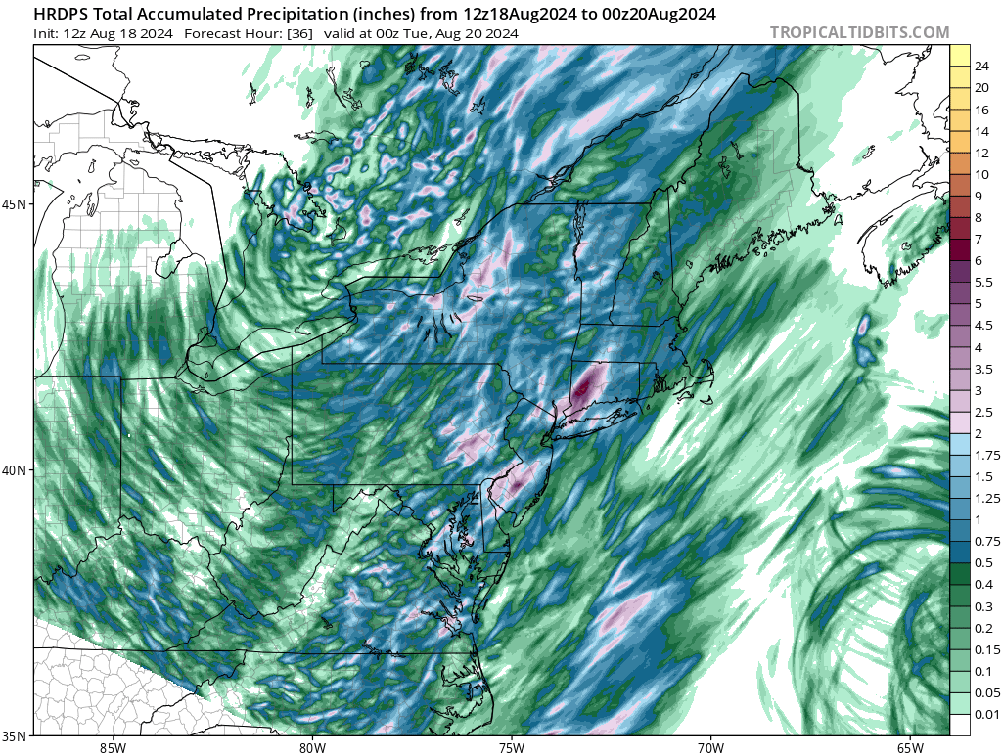
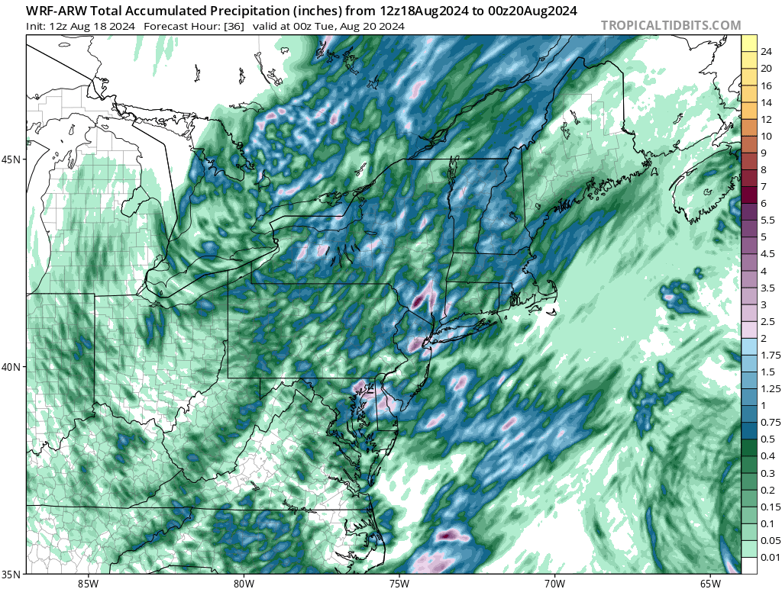
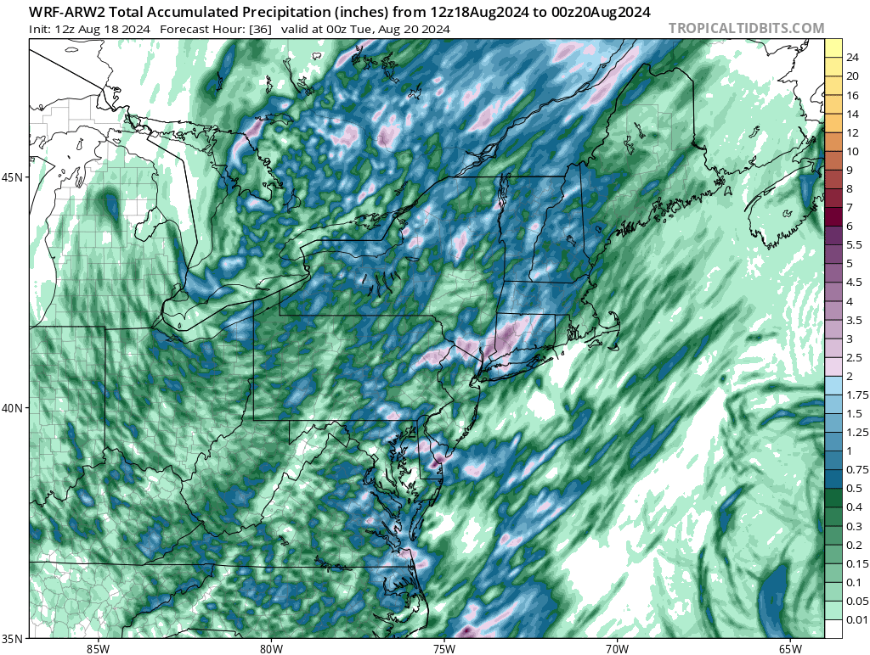
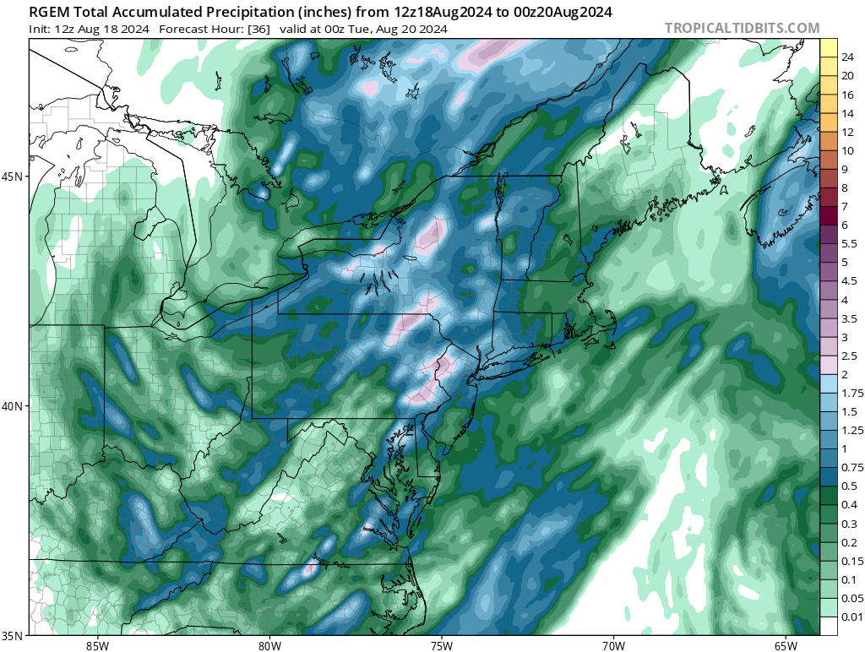
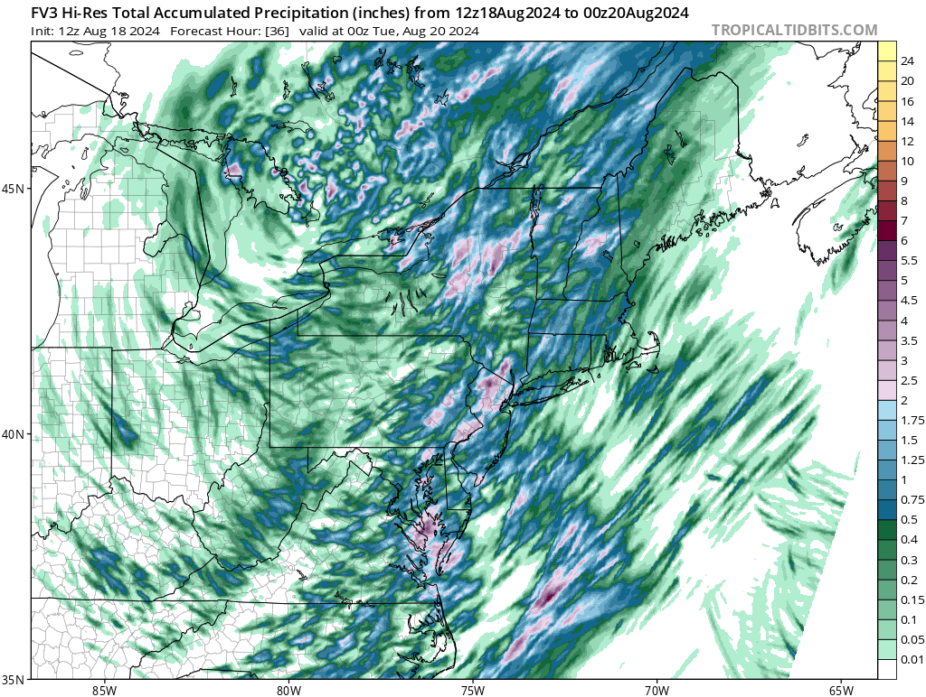
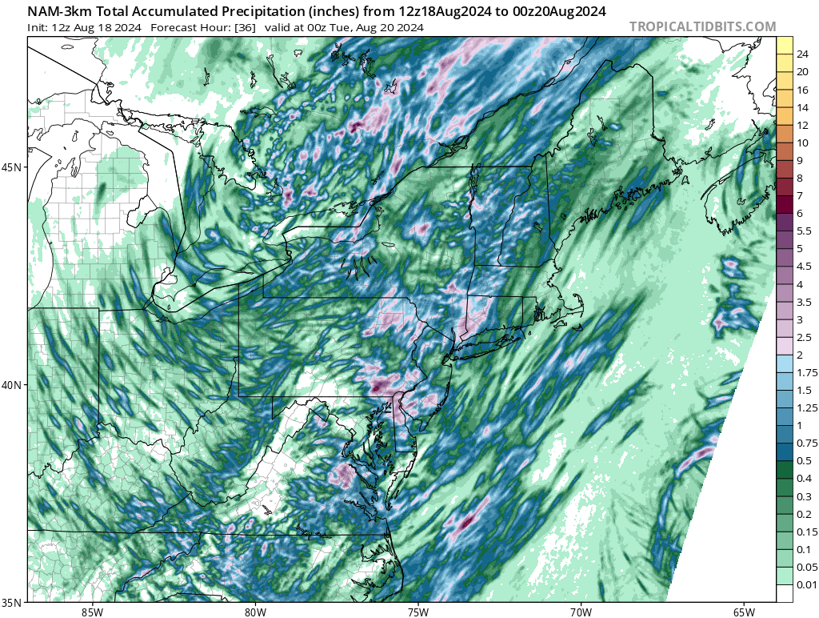
The Lead Up: Guidance
** These models began coming in as the rainfall in CT was already occurring. **
August 18th 12Z Guidance (00-12 hours before events)
HRDPS
WRF ARW
WRF ARW2
12Z Guidance Takeaways:
Some models began shifting precip into SW CT, but generally no more than 2-4” of rainfall.
Very few, if any, models highlighted heavy rainfall over Long Island.
RGEM
GFS FV3
NAM 3km
National Weather Service
WFO New York, NY

Slide 16
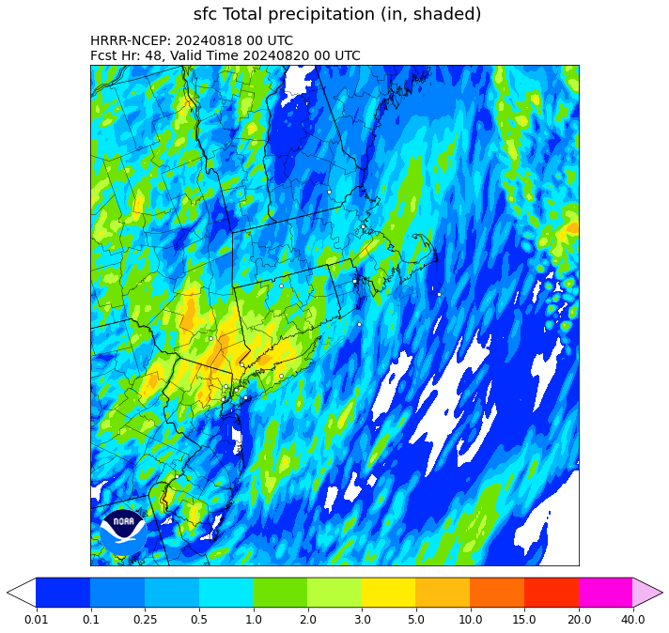
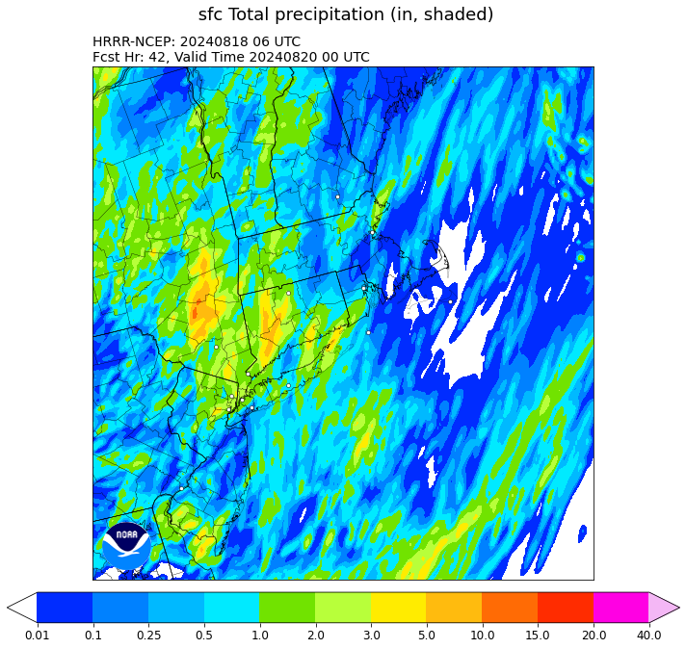
The Lead Up: HRRR Guidance
18/00Z
18/06Z
National Weather Service
WFO New York, NY

Slide 17
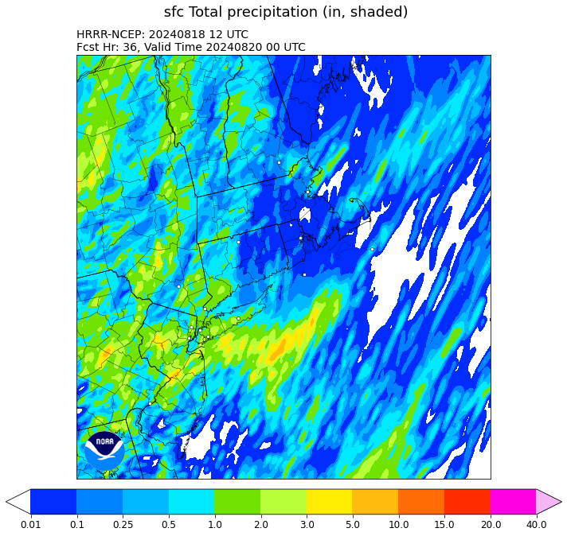
The Lead Up: HRRR Guidance
18/12Z
HRRR Guidance Takeaways:
HRRR does signal heavy rainfall potential of >5” across SW CT, 06Z run in particular.
However, it loses the signal at 12Z. 00Z has >5” swaths back to the west, and more numerous in coverage.
National Weather Service
WFO New York, NY

Slide 18
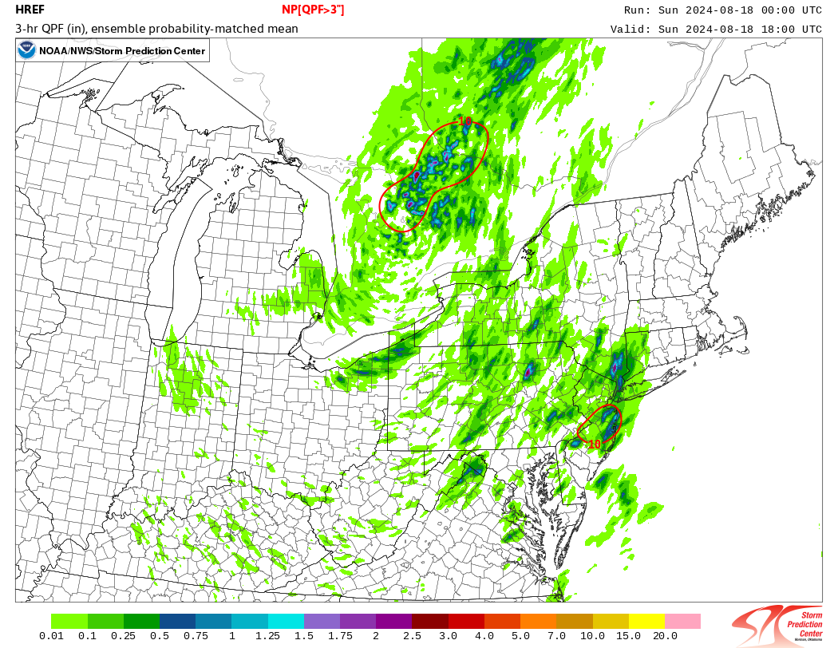
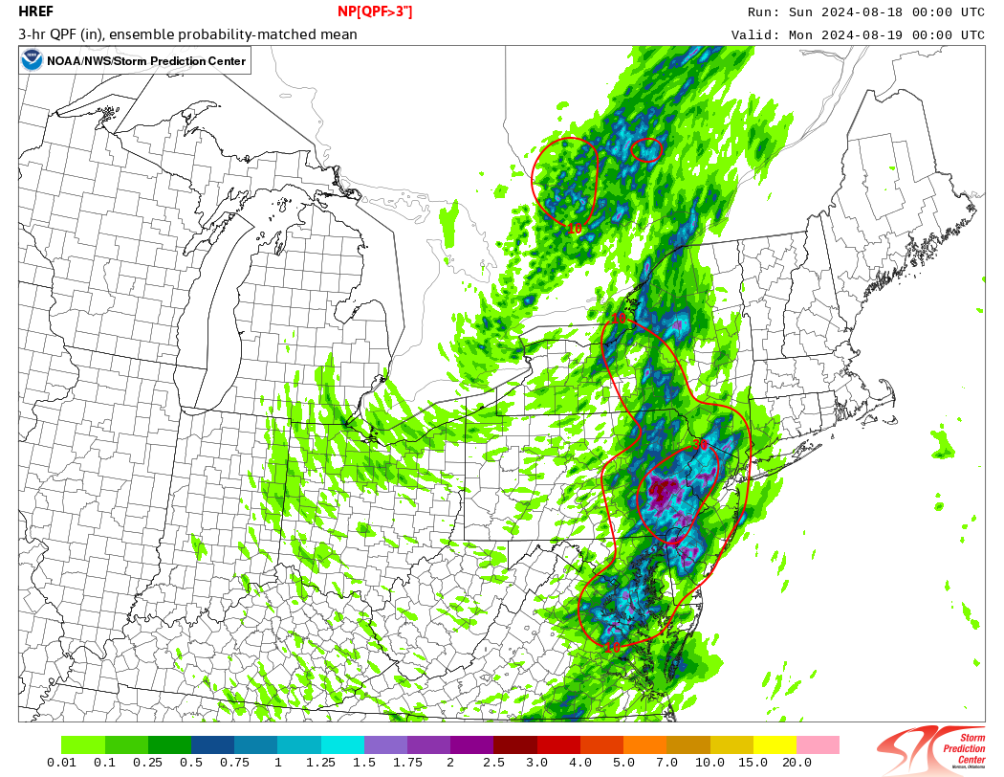
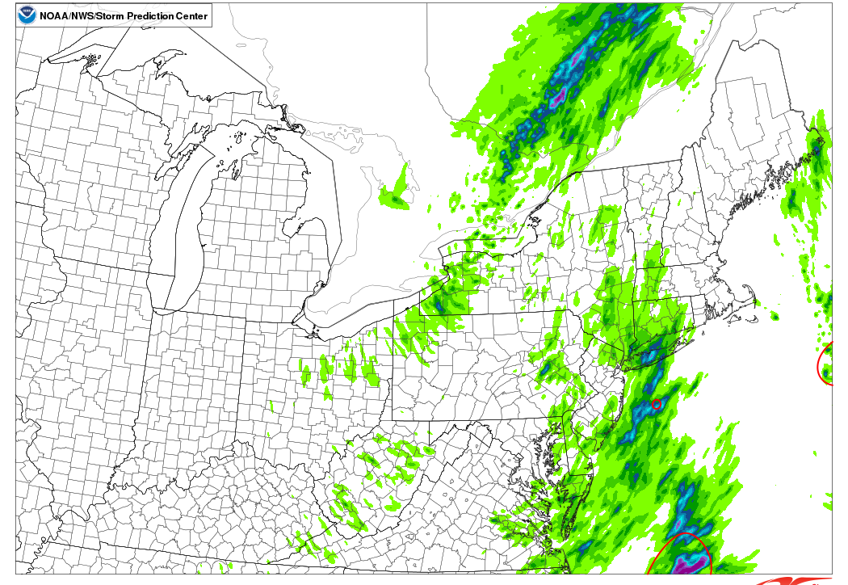
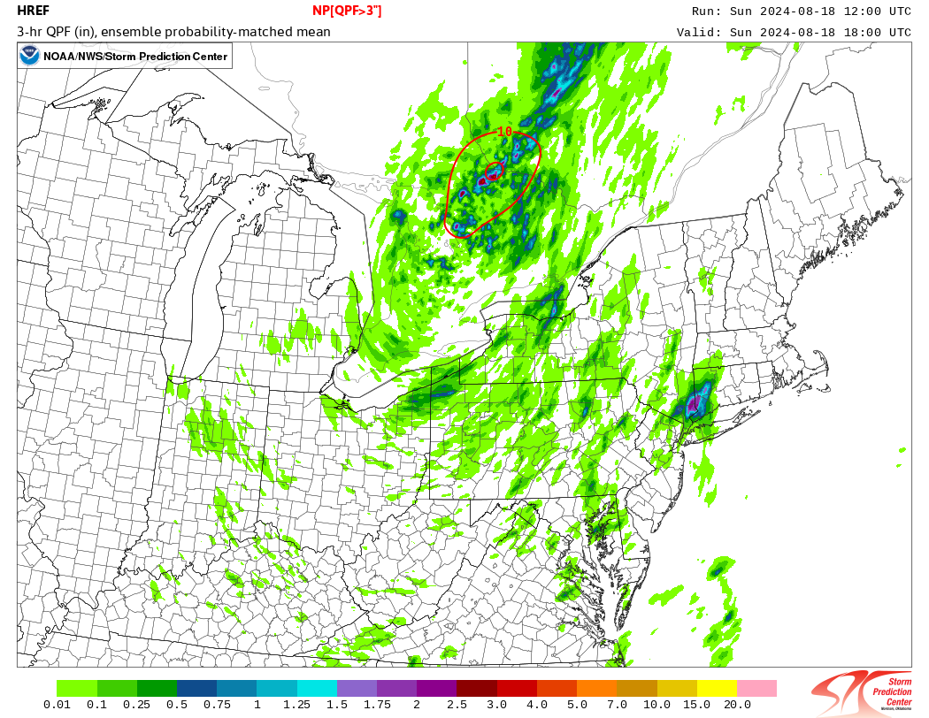
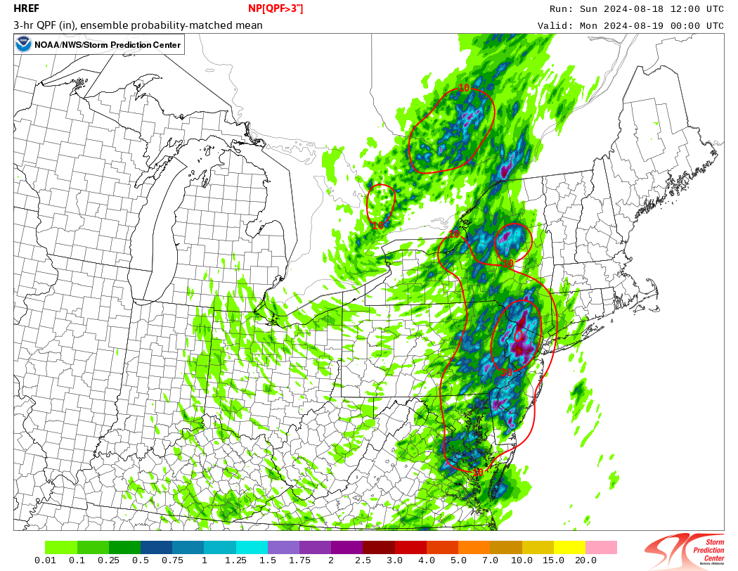
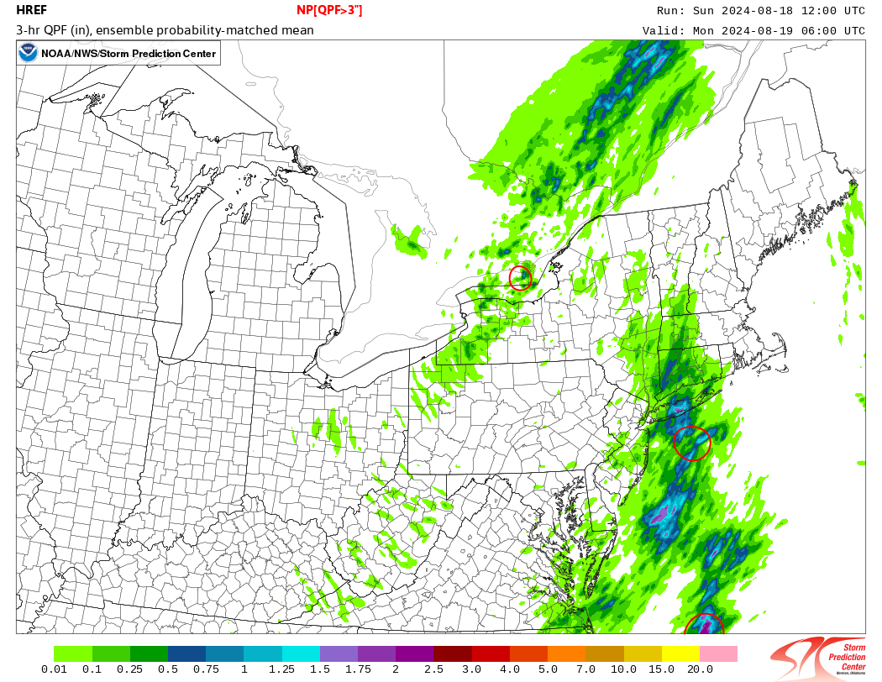
The Lead Up: HREF Prob. Guidance
August 18th 00 and 12Z Guidance | Prob. 3”/3hr
00/18Z
00/00Z
00/06Z
Prob. Guidance Takeaways:
Small signal in 30-50% >3” in 3 hours. This historically correlates well for us with higher end FF events.
But it was too late (12Z run) and focused between the actual events.
12/18Z
12/00Z
12/06Z
National Weather Service
WFO New York, NY

Slide 19
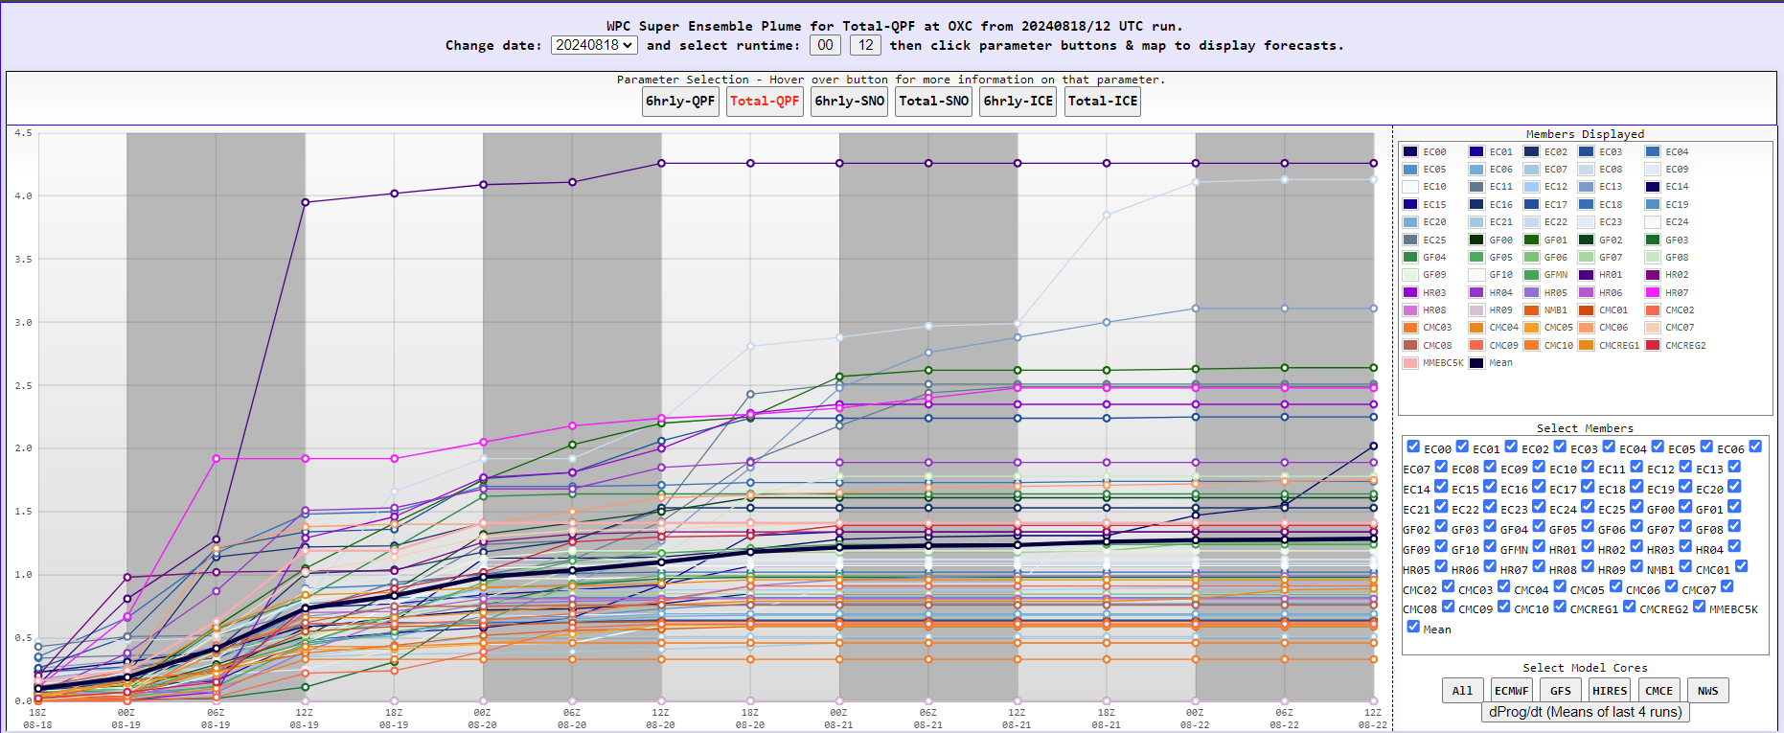
Rainfall Rates: Oxford, CT
CWOP Station
National Weather Service
WFO New York, NY

Slide 20
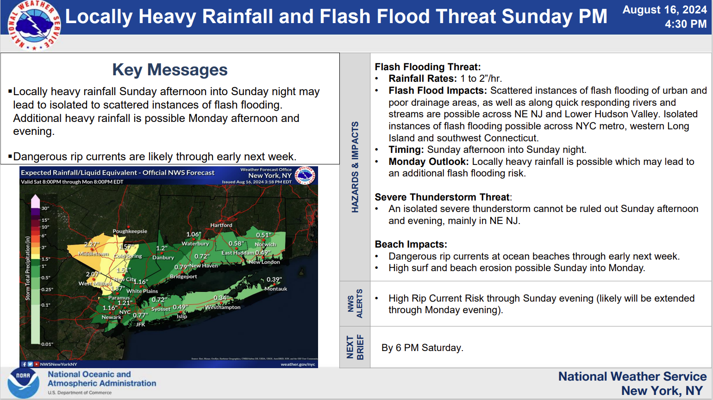
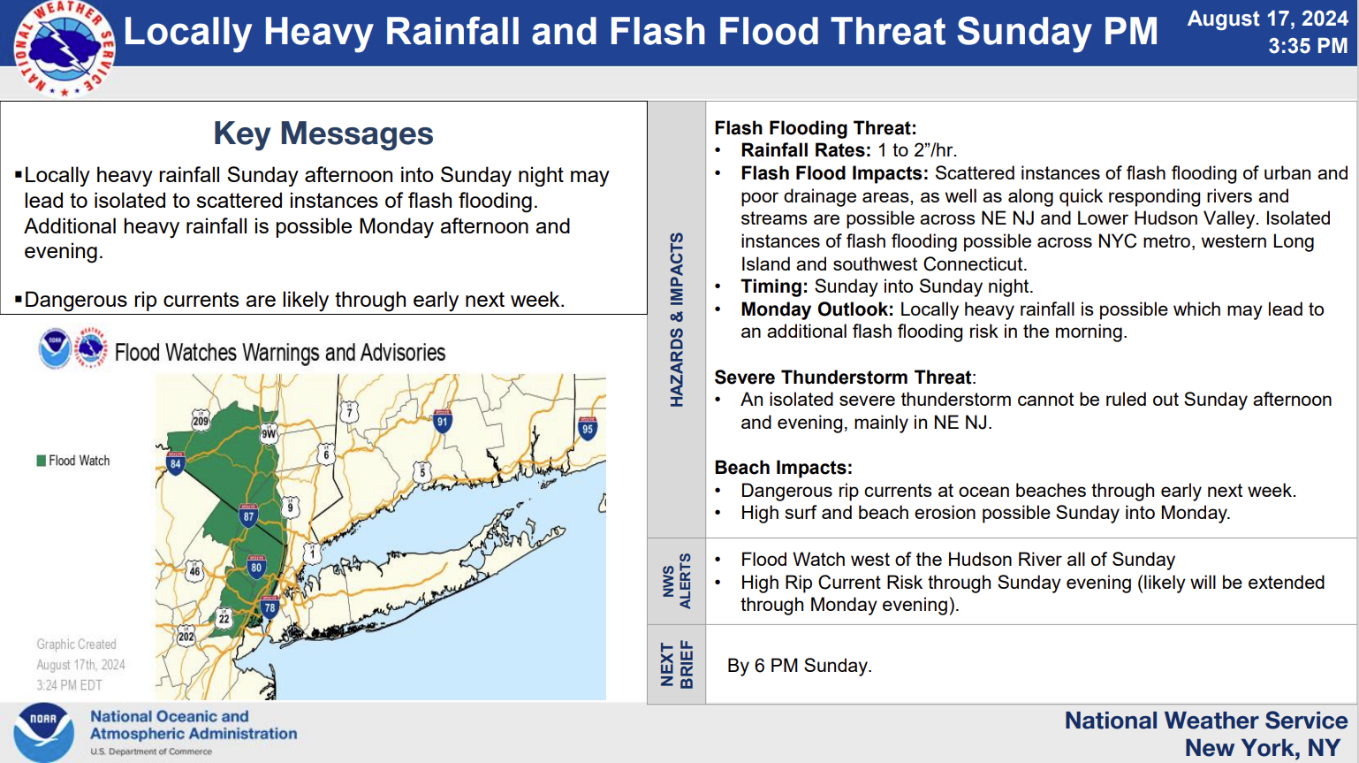
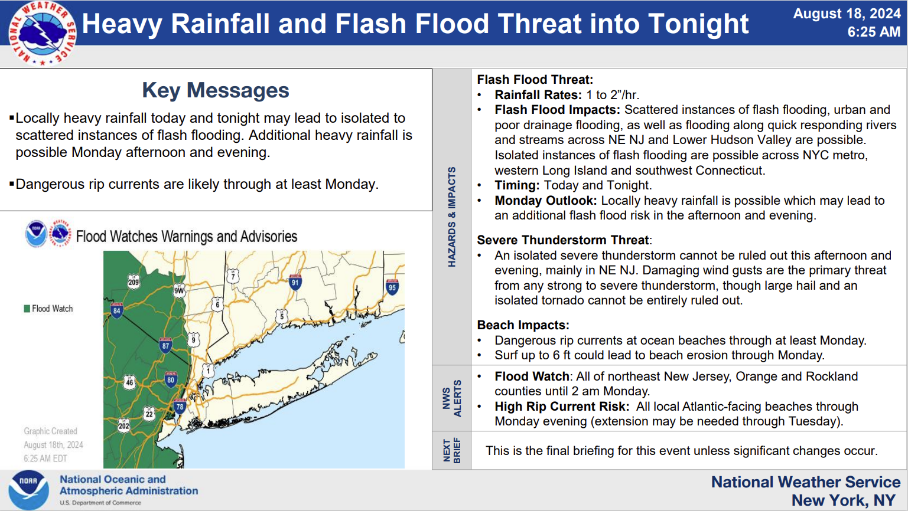
The Lead Up: IDSS
Began sending briefings and emails on August 16th indicating potential for heavy rainfall and flash flooding.
Issued a Flood Watch August 17th in collaboration with neighbors. Expansion into CT August 18th.
Final briefing sent morning of August 18th with no significant changes to hazards and slight adjustment in precipitation forecast.
National Weather Service
WFO New York, NY

Slide 21
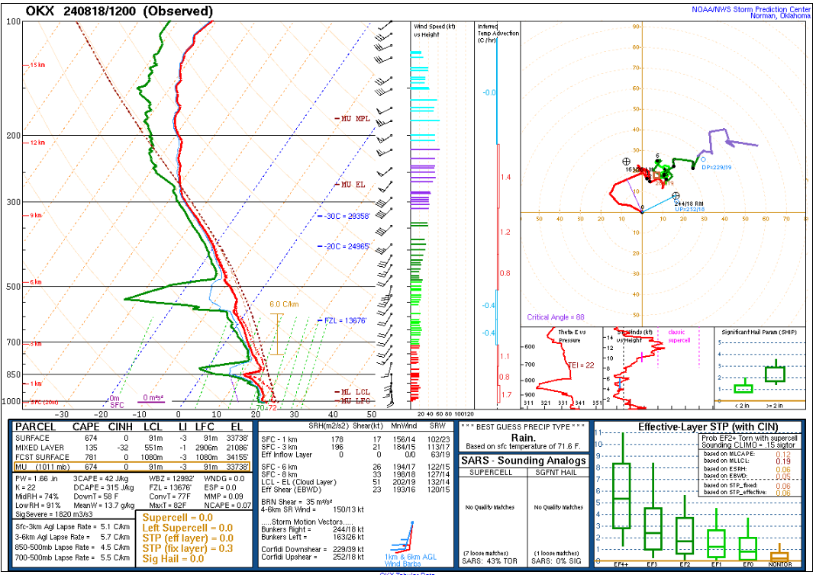
The Event
12Z Sounding (18th - Morning of Event)
PW: 1.66”
L-L RH: 91%
M-L RH: 74%
MUCAPE: 674 J/kg
Sfc-1 km SRH: 178 m2/s2
Corfidi Upshear vector: 278/18 kt
Moisture throughout the column with a large warm layer, low level WAA (warm front), and “tall and skinny” CAPE → efficient rainfall potential
National Weather Service
WFO New York, NY

Slide 22
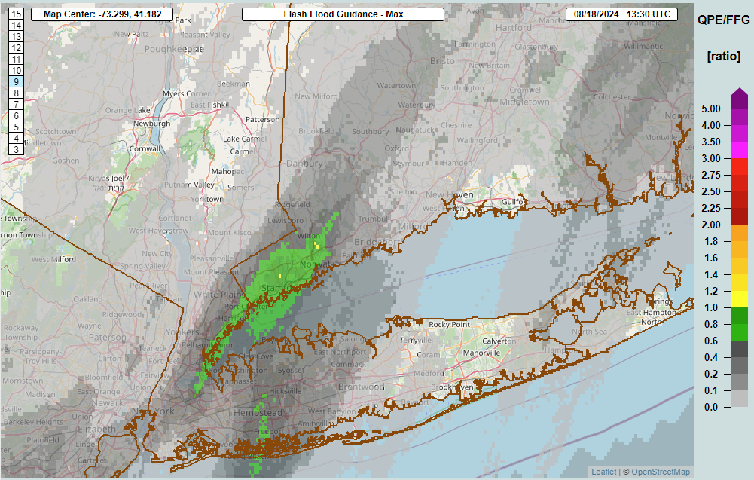
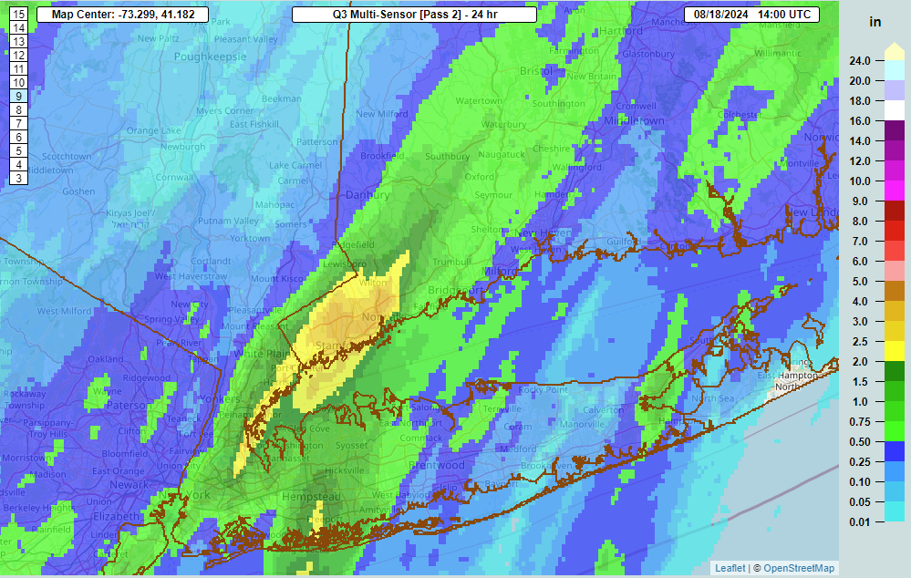
The Event
Rainfall began early across NYC, Westchester, SW CT. with FLSs issued from 4AM - 7:15AM.
First FFW issued at 9:26AM for Fairfield. Already 2-4” of rainfall in extreme SW Fairfield.
National Weather Service
WFO New York, NY

Slide 23
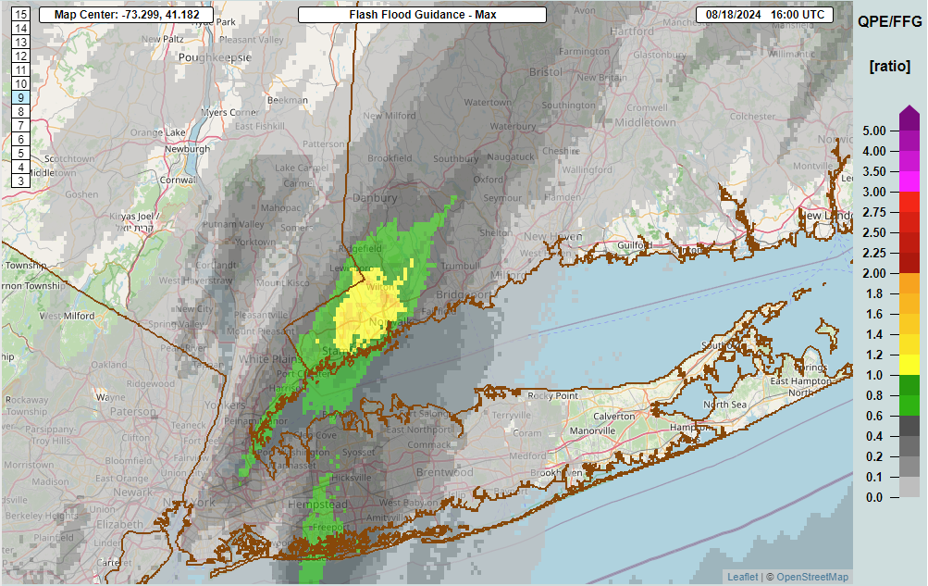
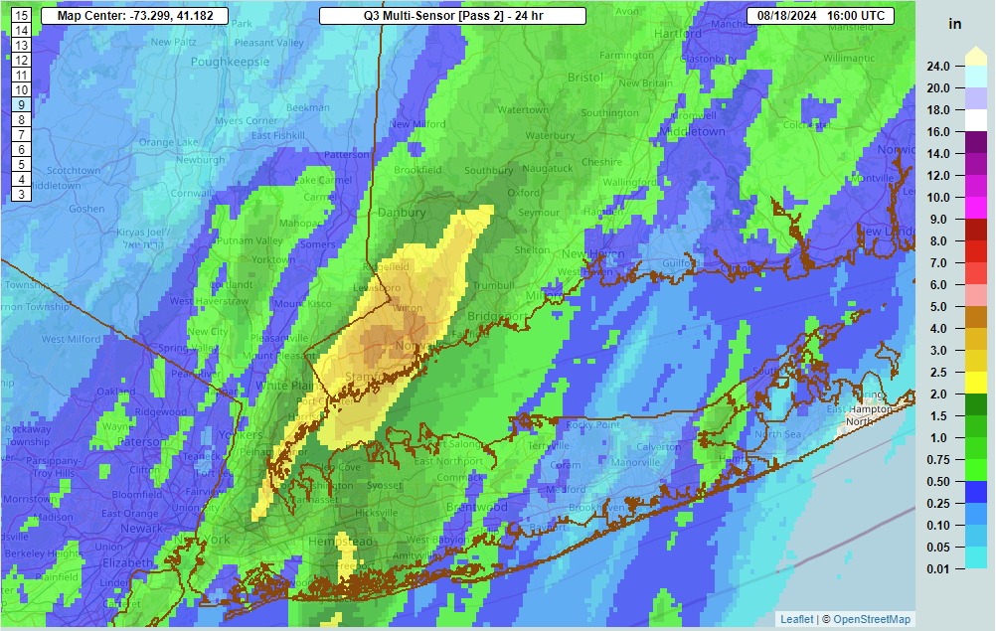
The Event
FFW upgraded to considerable over Fairfield at 12:00 PM. WEA alerted at this point.
2-4”, locally up to 5”
National Weather Service
WFO New York, NY

Slide 24
The Event
Flash Flood Emergency issued for Central Fairfield to Northern New Haven Counties at 2:52 PM.
Southern Fairfield not included in Emergency due to heaviest rainfall ending and moving north.
National Weather Service
WFO New York, NY

Slide 25
The Event: SW CT Emergency
Decision to issue:
Storms on radar continually backbuilding with primary forcing mechanism remaining stationary,
Rate of precipitation of storms,
Extent of flood related issues as seen on social media AND heard using Broadcastify,
Collaboration with others in the office
National Weather Service
WFO New York, NY

Slide 26
Radar
CT 12Z - 00Z
National Weather Service
WFO New York, NY

Slide 27
The Event: SW CT Emergency
Flash Flood Emergency updated every hour with updated totals, precipitation rates, information on impacts (mudslides, washouts, rescues) and locations heavily impacted (Southbury → Monroe → Oxford)
**Social Media, LSRs, and actively listening to various Police/Fire/Rescue/EM Scanners via Broadcastify provided this information.**
Several rivers also went into Major Flood stage during the event.
Collaboration CT DEMHS for ongoing impacts and decision to extend and eventually end the Emergency.
The primary concern shifts to Long Island.
National Weather Service
WFO New York, NY

Slide 28
The Event
00Z Sounding (19th - Between Events)
PW: 1.92”
L-L RH: 92%
M-L RH: 91%
MUCAPE: 1,550 J/kg
Sfc-1 km SRH: 262 m2/s2
Corfidi Upshear vector: 278/15 kt
National Weather Service
WFO New York, NY

Slide 29
Radar
Long Island 01Z-10Z
National Weather Service
WFO New York, NY

Slide 30
The Event: Long Island
Stony Brook Mesonet Rates and NE Suffolk County Totals
National Weather Service
WFO New York, NY

Slide 31
The Event Aftermath: Long Island
National Weather Service
WFO New York, NY

Slide 32
The Events: Takeaways
Flash flood events of this magnitude (outside of tropical systems) are inherently low confidence and low probability, but have significant and life-threatening impacts.
Unfortunately, there were 3 fatalities in SW CT. This event occurred on a Sunday (not during the workweek) so fatalities could have been a lot higher.
While there may be hints at events of this magnitude happening with model guidance, often times we don’t know it’s going to actually materialize until it’s already underway (the ‘WOW’ events…). Communicating this to anyone is fundamentally difficult without constant false alarms. How to balance?
National Weather Service
WFO New York, NY

