Slide 1
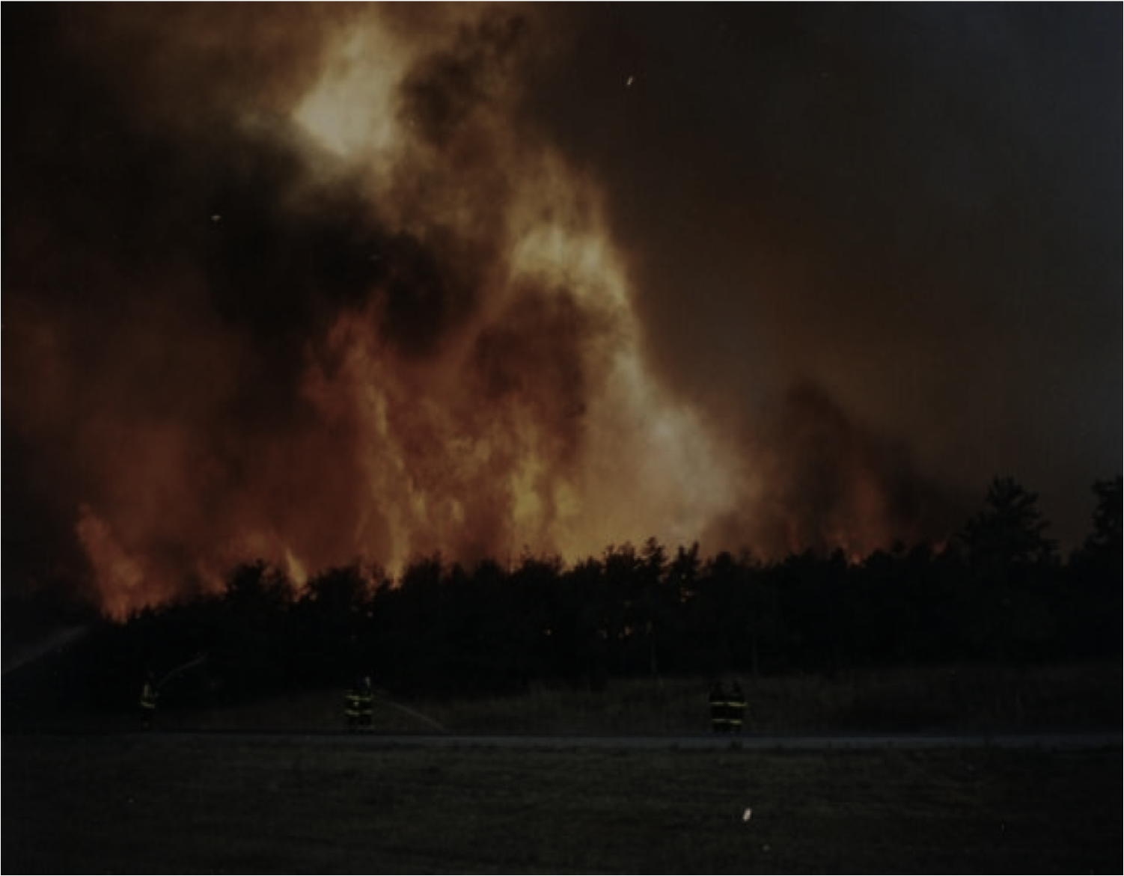
A Look at High Fire Threat Risk and Ensemble Modeling Over the Northeast United States Michael Erickson¹, Brian A. Colle¹ and Joseph J. Charney² ¹ School of Marine and Atmospheric Sciences, Stony Brook University, Stony Brook, NY ² USDA Forest Service, East Lansing, MI
1995 “Sunrise Fire” Westhampton, NY
Image taken from
the Cutchogue Fire
Department web
site at
www.cutchoguefiredept.org
“Sunrise Fire – Long Island”

Slide 2
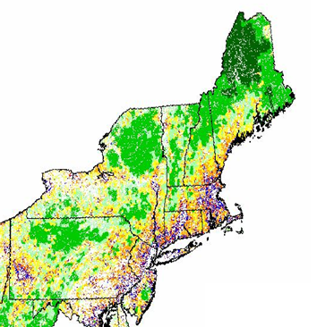
Wildfires and the Northeast United States
United States Forest Service 2010
A wildfire is any uncontrolled fire in combustible vegetation and can grow to enormous sizes.
Wildfires are natural occurrences, but they can also be destructive to humans and the ecosystem.
The sustenance and spread of wildfires is VERY sensitive to the overlying meteorology conditions (i.e. dryness, wind speed, direction, temperature, etc).
Although rare, wildfires along the Northeast coast of the United States can be dangerous due to a high population density.
Notes:
The megalopolis from
Philadelphia to Boston contain
many areas of highly populated
forested areas (only areas in
white are purely urban without
any forests). Wildfires can
have a greater impact in this
region.
2

Slide 3
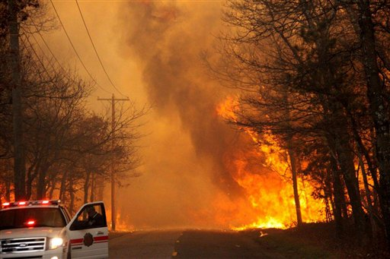
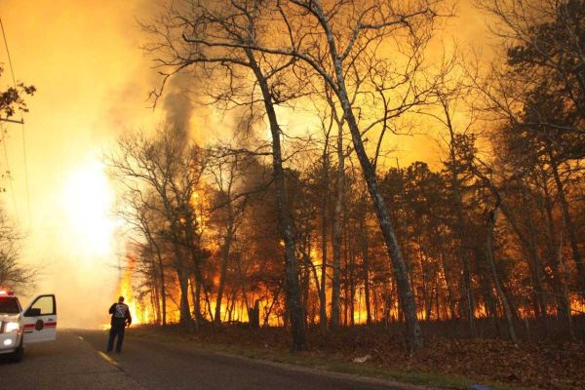
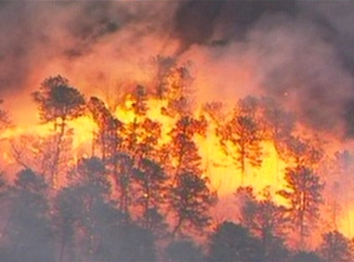
Ridge-Manorville Brush Fire – April 9th, 2012
1000-2000 acres burned.
600 firefighters from 109 departments battled the fire with 30 brush trucks, 20 tankers and 100 engines.
New York State Police Helicopters made airdrops of water.
Fortunately the fire broke out in a relatively rural area of Long Island.
Source: longislandpress.com
Source: newsday.com
Source: new12.com
Notes:
The megalopolis from
Philadelphia to Boston contain
many areas of highly populated
forested areas (only areas in
white are purely urban without
any forests). Wildfires can
have a greater impact in this
region.
3

Slide 4
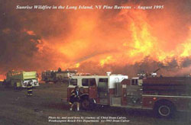
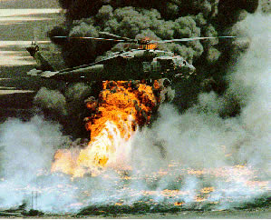
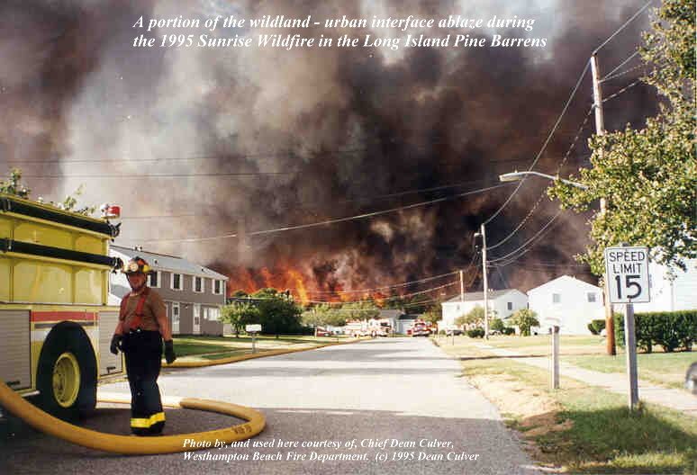
Sunrise Fire – late August 1995
7000 acres burned by a series of brush fires between late August and early September.
Highways and railways were closed cutting off the Hamptons from the rest of Long Island.
Numerous homes and business were damaged, as was the pine barrens ecosystem.
Source: pb.state.ny.us
Source: dmna.ny.gov
Source: pb.state.ny.us
Notes:
The megalopolis from
Philadelphia to Boston contain
many areas of highly populated
forested areas (only areas in
white are purely urban without
any forests). Wildfires can
have a greater impact in this
region.
4

Slide 5
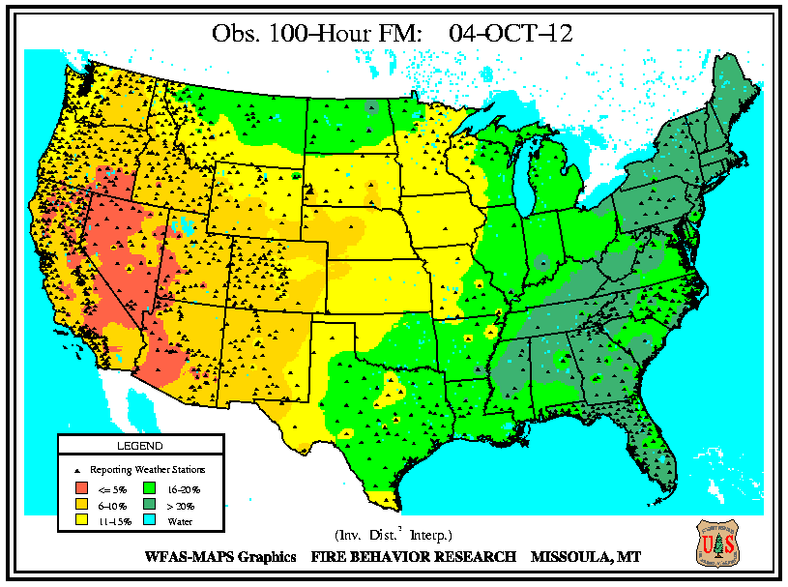
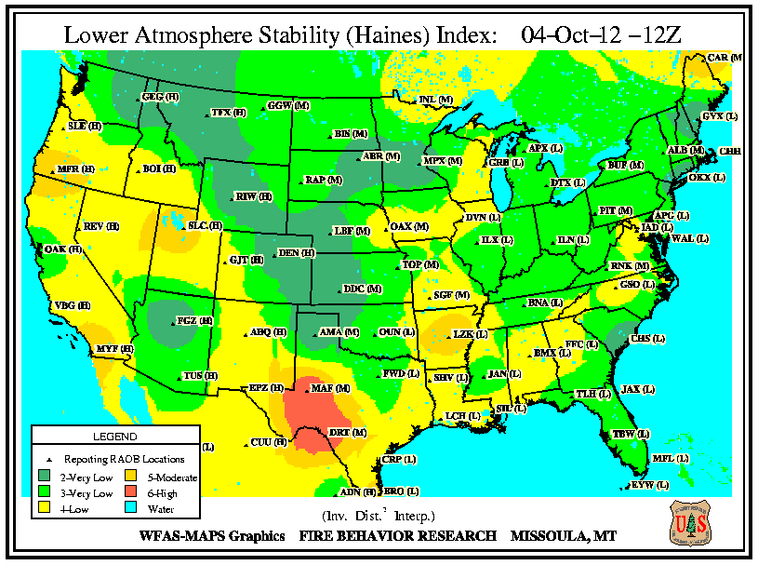
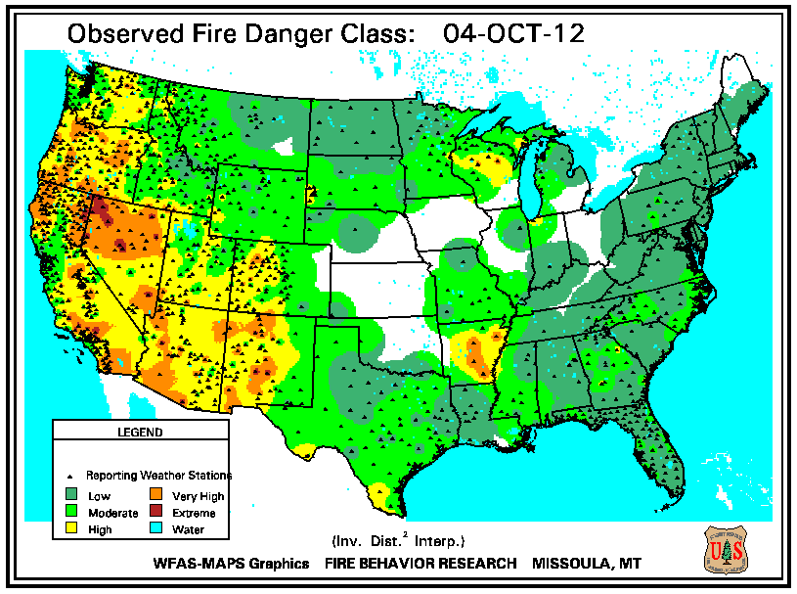
Forecasting Wildfire Occurrence
100-Hour Fuel Moisture (10/4/12)
Attempts to forecast wildfire occurrence are relatively new, and based both on the surface conditions and overlying atmosphere.
Many fire-risk parameters consider the current state of vegetation, fuel moisture, local meteorology and terrain height.
There is still the additional complex factor that many wildfires are caused by human activity.
Lower Atmosphere Haines Index (10/4/12)
Fire Danger Class (10/4/12)
Notes:
The megalopolis from
Philadelphia to Boston contain
many areas of highly populated
forested areas (only areas in
white are purely urban without
any forests). Wildfires can
have a greater impact in this
region.
5

Slide 6
Motivation
All days with high fire threat risk should be examined, since similar ground/weather conditions may not always produce a fire due to human influences.
Model performance on high fire threat days should be known if model output is going to be used to drive high fire threat forecasts.
Model biases may vary with the atmospheric flow pattern on high fire threat days, suggesting potential room for improvement in model post-processing.
Goals
Define a High Fire Threat Index (HFTI) that captures the occurrence and strength of fire threat risk between 1979-2012.
Evaluate model performance and post-processing methods on high fire threat days compared to the typical warm season day.
Determine if meteorological model biases vary with “weather regime” and suggest ways this can be used to improve operational forecasts.

Slide 7
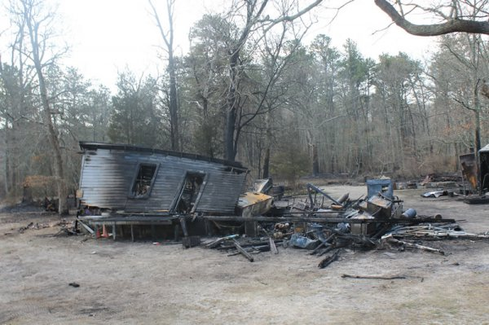
Defining High Fire Threat Strength (HFTS) - Assumptions
Fuels (i.e. dead leaves/brush) for wildfires dry out quickly, and can occur within a day of a rain event if atmospheric conditions are favorable.
Relative humidity is the main driver for forest fires, while wind speed is a secondary driver.
Considering fire threat over a smaller regional area is desirable since it increases the sample size while ensuring the region considered has relatively homogenous weather conditions.
Source: longislandpress.com

Slide 8
High Fire Threat Strength (HFTS)- Definition
The Automated Surface Observing System (ASOS) station observations shown to the right are used between 1979-2012.
HFTS Definition
No rainfall > 0.5” or snow cover at any station 24 hours before the high fire threat day starts.
HFTS consists of 5 categories; a total of 3 categories from relative humidity (RH) and two from wind speed (WS).
Mean daytime RH must be in the bottom 2.5, 1, and 0.5 percentile to achieve sub-categories 1, 2, and 3, respectively.
If RH criteria is meet, WS > 10 and 15 knots are needed to meet the WS criteria for sub-categories 1 and 2, respectively.
HFTS consists of summing the RH and WS components and can vary between 0 and 5.
Relative Humidity Hrly Histogram
Arrows indicate
bottom 0.5, 1,
and 2.5
percentile,
respectively

Slide 9
Fire Threat – Monthly and Annual Variability
Fire Threat Frequency by Month
Fire Threat Frequency by Month
Fire Threat Frequency by Year
High fire threat days typically occur between March and May, and may have been increasing in frequency more recently.

Slide 10
Fire Threat – Annual Variability
Fire Threat Frequency by Year -
Relative Humidity Component Only
Fire Threat Frequency by Year -
Wind Speed Component Only
The recent increase in high fire threat risk is caused mostly by drier rather than windier conditions.

Slide 11
Analyzed the National Center For Environmental Prediction (NCEP) Short Range Ensemble Forecast (SREF) system for 2-m temperature.
The same Automated Surface Observing System (ASOS) are used as verifying observations between 2006 and 2012.
Methods and Data
Region of Study
21 UTC NCEP SREF 21 Member Ensemble
SREF consists of 4 models:
The old Eta model
The Regional Spectral Model (RSM) which is a regional variant of the Global Forecast System (GFS)
The Weather Research and Forecasting (WRF) Advanced Research WRF (ARW) core.
The WRF Non-hydrostatic Mesoscale Model (NMM) core.
IC’s perturbed using a breeding technique to increase the number of members.
Notes:
11
11
11

Slide 12
Exploring Model Bias on High Fire Threat Days
Model Error Calculation
Model bias is represented by calculating mean error (ME), which is the average of the model minus observation.
Model error is represented by calculating mean absolute error (MAE), which is the average of the absolute value of the model minus observation.
Bias Correction Details
A running-mean bias correction (Wilson et al. 2007) is used to bias correct 2-m temperature.
The impact of post-processing on training period is explored by:
Sequential Training – Used the most recent 14 consecutive days.
Conditional Training – Used the most recent 14 similar days.
Analyzed daytime model output (1200-0000 UTC) for ensembles initialized the day of and the day before the hazardous weather event (i.e. SREF model hours 15-27 and 39-51).
Notes:
12
12
12

Slide 13
Fire Threat – Monthly and Annual Variability
Feb Mar April May Oct
Feb Mar April May Oct
Temperature model biases do not vary significantly by month on high fire threat days, but stronger high fire threat events have cooler temperature model biases.

Slide 14
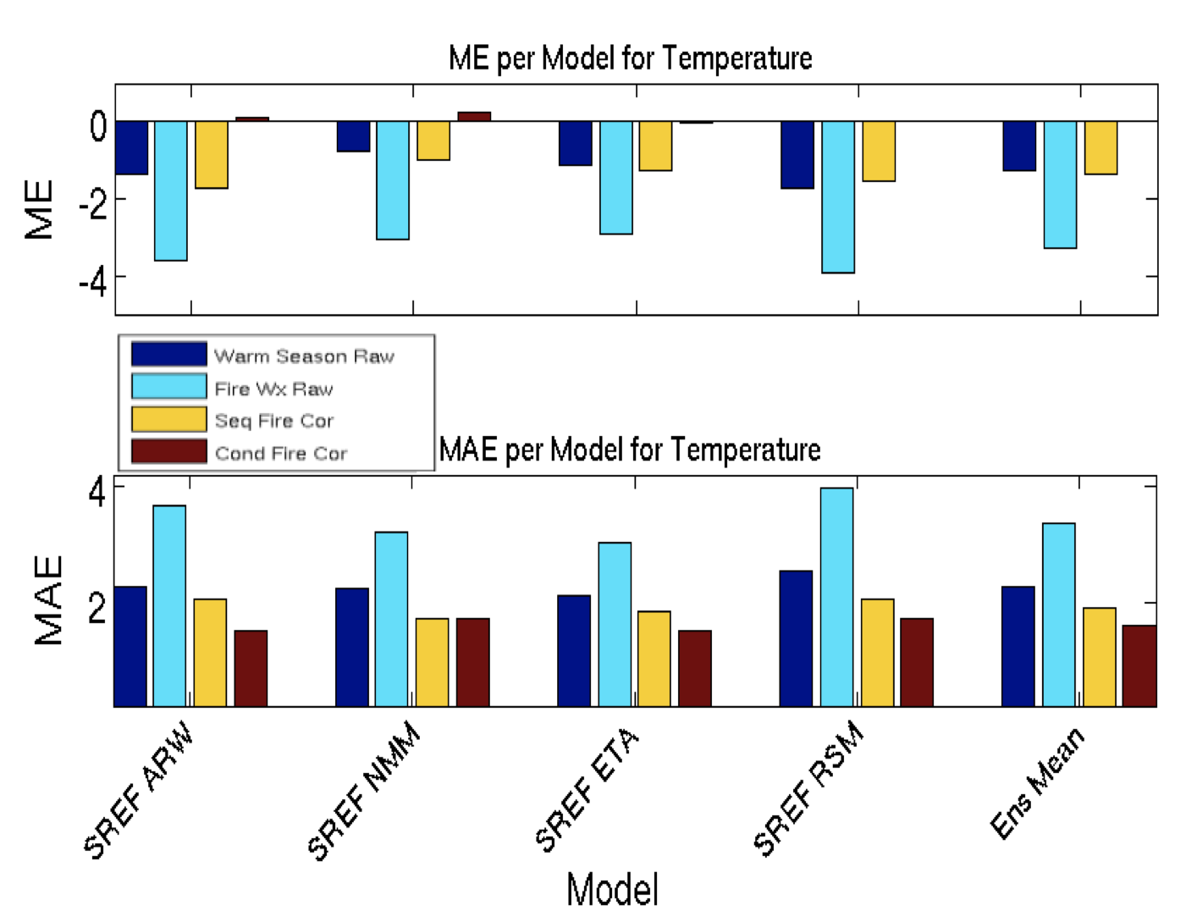
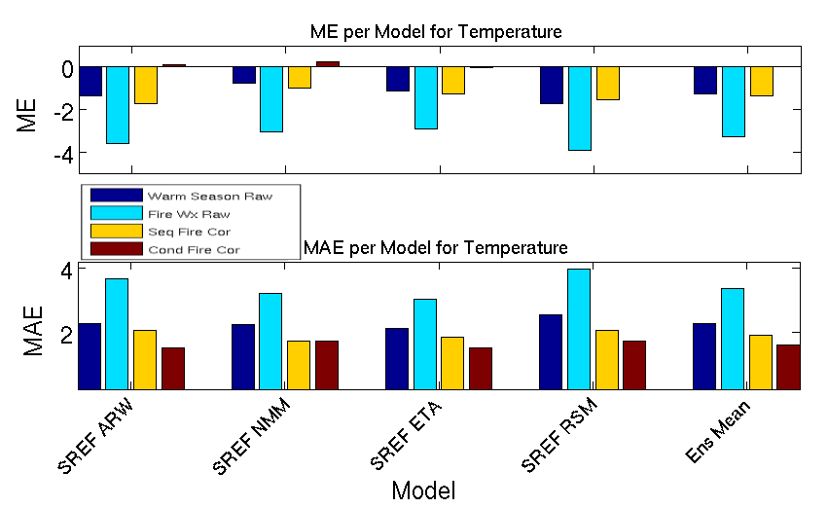
Conditional Vs Sequential Bias Correction – 2-m Temperature
Most models exhibit a cool temperature bias, but this cool bias is greater (by 1 to 2 ºC) on high fire threat days compared to the warm season average.
Operationally, this cool bias would result in the model underestimating high fire threat risk.
Using a similar-day (conditional) post-processing completely removes the cool bias on high fire threat days on the average.

Slide 15
Temperature Model Biases in the Vertical High Fire Threat Days – 10/2009 to 8/2012
200
300
400
500
600
700
800
900
1000
200
300
400
500
600
700
800
900
1000
Comparison between the SREF and the Rapid Update Cycle (RUC) Initialization reveals that model bias and error is not confined to the near surface, but extends well up into the Planetary Boundary Layer.

Slide 16
Bias As a Function of High Pressure Location
Model bias seems to be related to the center of the surface high pressure system.
The coldest model biases occur when the high pressure is to the west or west-northwest of the region.
Temperature Bias By High Pressure Center Location With Respect to New York City – Fire Threat Days
Model Bias

Slide 17
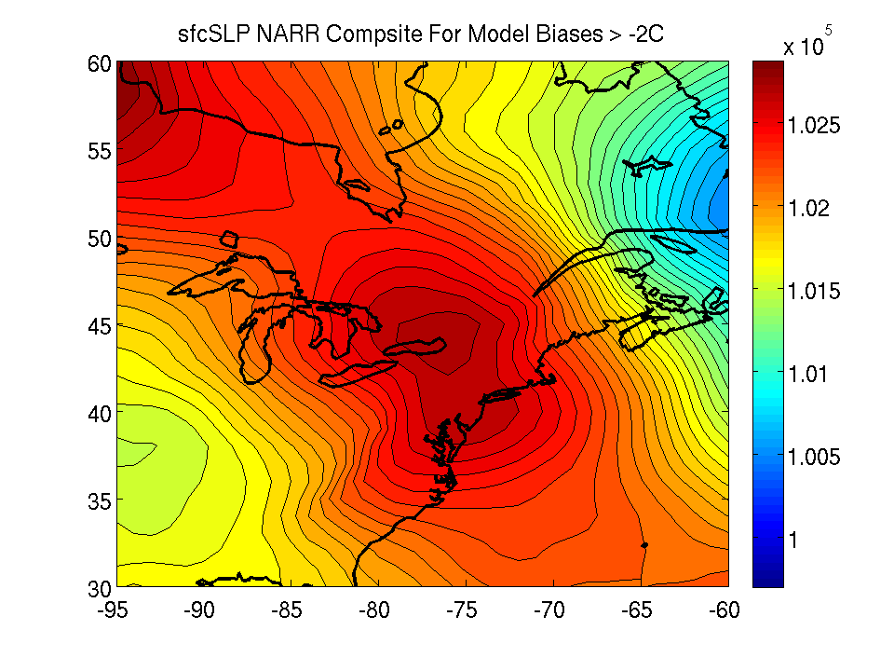
Synoptic Flow Patterns on High Fire Threat Days
High fire threat days may be associated with a few consistent large-scale atmospheric flow regimes.
Regimes are examined using North American Regional Reanalysis (NARR, 32 km grid spacing) 3-hour composites on high fire threat days.
Sea level Pressure (SLP) NARR data for all high fire threat days is spatially smoothed between 38º to 48ºN and -73º to -83ºW.
Principal Component Analysis (PCA) is performed on the NARR SLP to find the dominant modes of variability.
K-means clustering is performed on the retained modes. Model bias is then grouped by cluster.
Surface SLP Composite By Model Bias High Fire Threat Days
(m)

Slide 18
Clustering – A Fancy Way of Saying We Are Trying to Find Days That Look Similar - SLP
Day 1 In Cluster 1
Day 4 In Cluster 1
Day 2 In Cluster 1
Day 5 In Cluster 1
Day 3 In Cluster 1
Day 6 In Cluster 1

Slide 19
Clustering Results With SLP – High Fire Threat Days
Results with 2 clusters reveal one cluster with a high pressure to the NW or W of the region. The second cluster has a ridge to the SW of New York City.
Cluster 1 - SLP Composite
Cluster 2 - SLP Composite

Slide 20
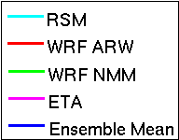
Clustering Results With SLP – High Fire Threat Days
The differences in model bias between these two clusters easily exceed 95% confidence, suggesting a relationship between model performance and the weather pattern.

Slide 21
Conclusions
A High Fire threat Index (HFTI) has been calculated using meteorological parameters in the New York City area. High fire threat days occur most commonly between March and May.
Modeled temperature is cooler (by 1-2 ºC) on high fire threat days than the warm season average. This bias is corrected when other high fire threat days are used in the training statistics instead of the warm season average.
Model bias appears to be related to the large-scale atmospheric flow pattern. More research is needed to determine the potential operational utility of an analog fire weather bias correction.

